Slide 1
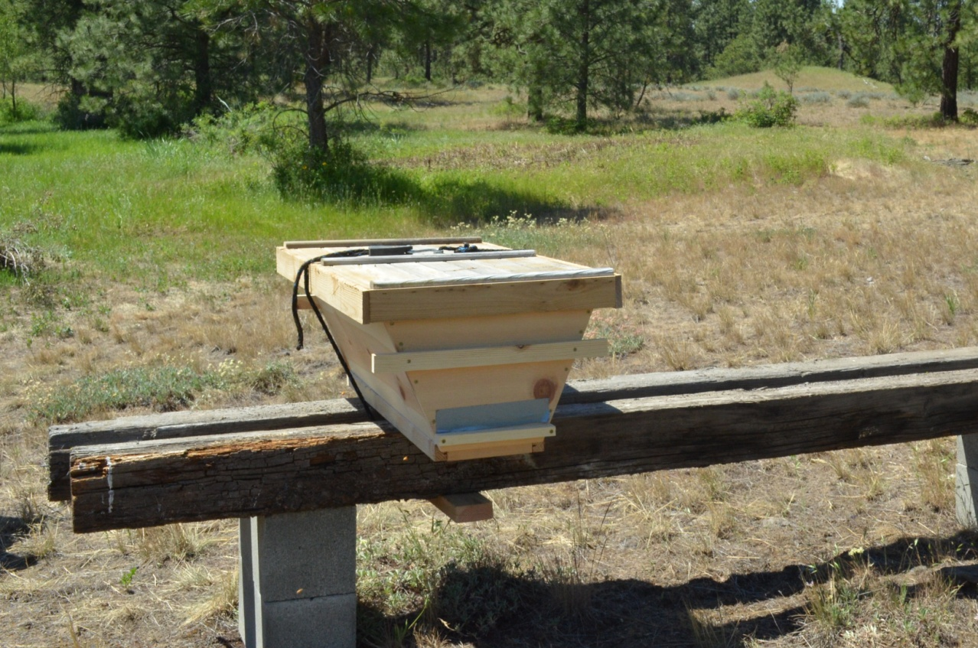
The Top Bar Hive
Building and Managing the Top Bar Hive

Slide 2
What is a Top Bar Hive
The Kenyan Top Bar Hive is a long box with slanted sides while the Tanzanian version has straight sides.
Both have been used for centuries in Africa. It is claimed the KTBH is less susceptible to comb attachment to the sides of hive. A layer of wood strips 1 ¼” - 1 3/8” wide and 17 - 20” long cover the top of the box which is about 10 - 12”deep.

Slide 3
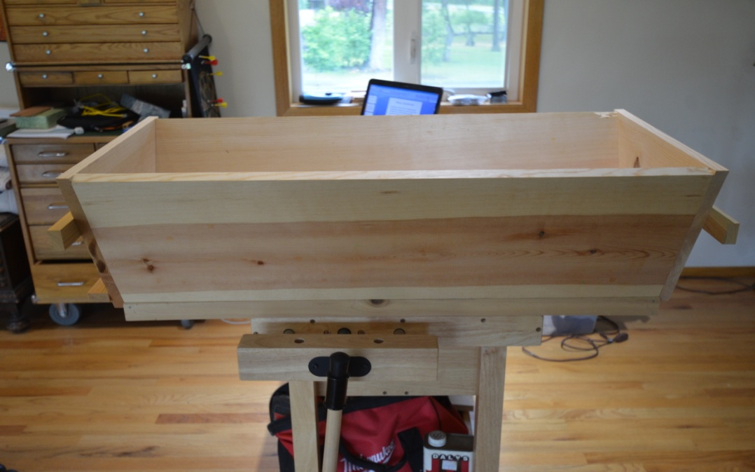
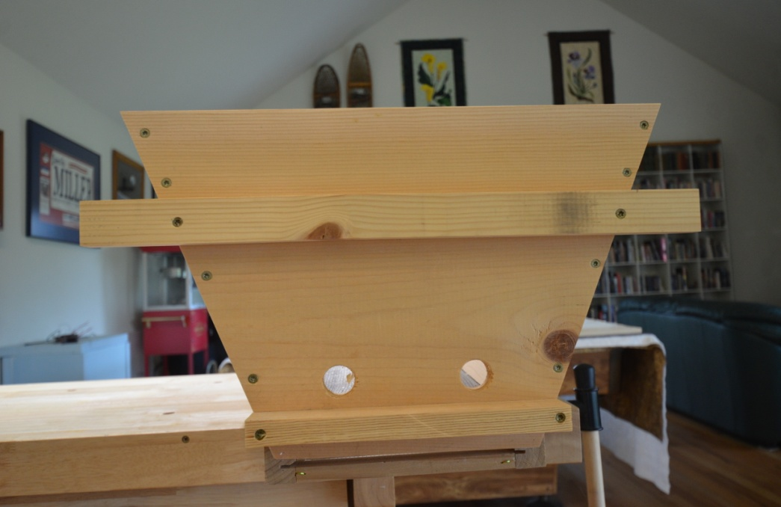
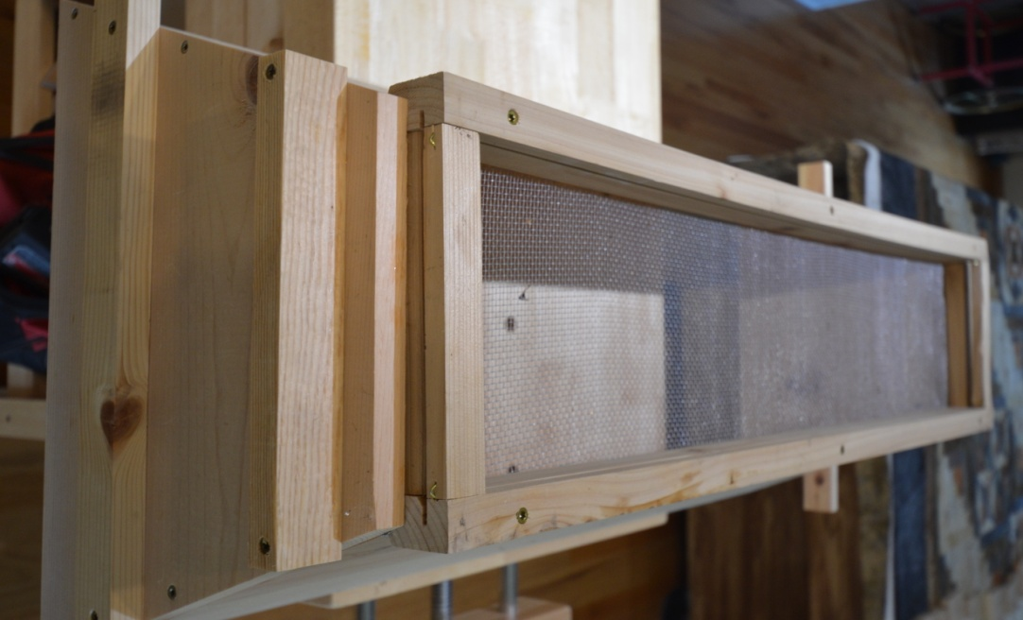
Kenyan Top Bar Hive

Slide 4
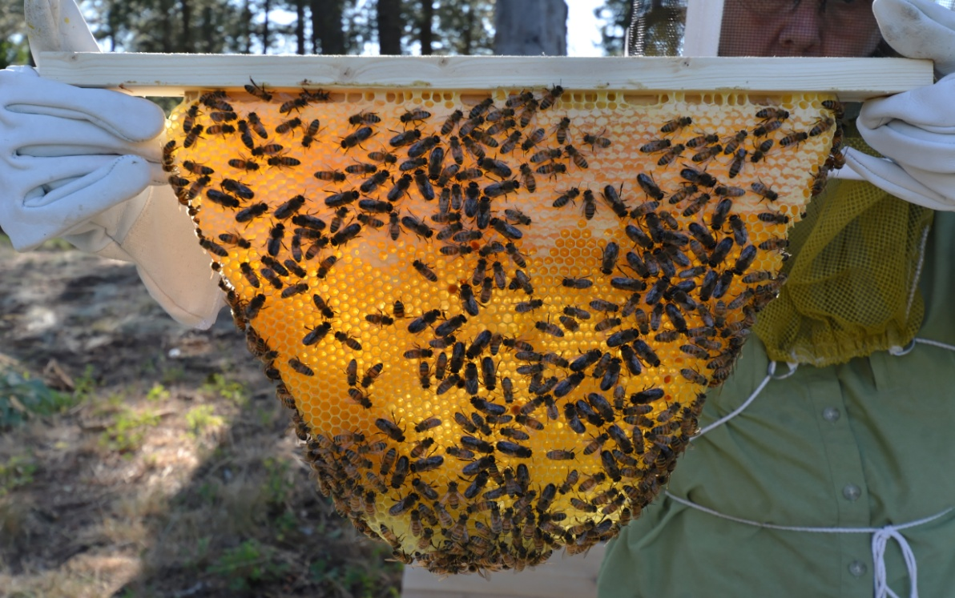
Why Use a Top Bar Hive?
Simple to build
Low cost
Save space
Can be modified to make an observation hive
Easy to manage – no tall stacks; no bending over
Minimal or no heavy lifting
Comb honey with no embedded foundation

Slide 5
Why Not use a Top Bar Hive?
Not suitable for centrifugal honey extraction
Not easily sealed for transport
No national standard size
May not be suitable for harsh winters

Slide 6
Building a KTBH Some Considerations
Need to standardize components
Use standard dimensional lumber
Minimize number of pieces
Simple straight cuts
Simplify construction

Slide 7
Lumber
1 X 12 straight boards for sides and ends and top bars
1 X 10 straight boards for top bars and for hive bottoms on bait hives.
It is important to find straight boards and it is sometimes easier to find straight 1 X 10’s instead of 1 X 12’s

Slide 8
Screens, Fasteners, etc.
No. 8 hardware cloth (8 wires per inch) for hive bottoms
1 ½ or 2 inch screws
Wax foundation for starter strips
Staples to attach hardware cloth

Slide 9
The Hive Body
2 ea sides 1 X 12 X 36
2 ea ends 1 X 12 X 17 ½ with 22 ½ deg sides
2 straight cuts gets you the sides and 3 more cuts on a miter saw get you the ends. To save wood if you are making more than one hive, cut the ends from a single length of board. Just flip the board after each cut.

Slide 10
The Top Bars
Cut a 1 X 12 or 1 X 10 into 19 inch boards
Rip the boards into strips 1 3/8th wide
Cut a saw kerf down the middle 3/16th deep
Cut a kerf across the bar 1 ½” from one end

Slide 11
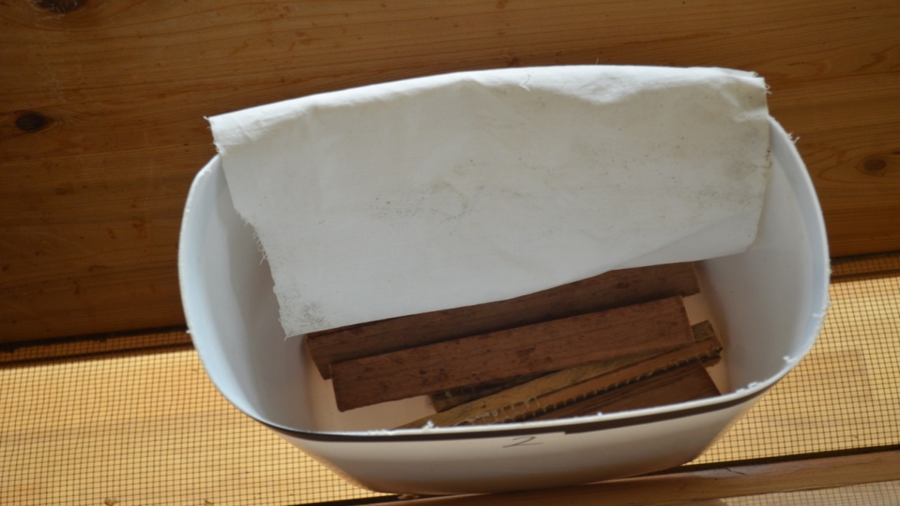
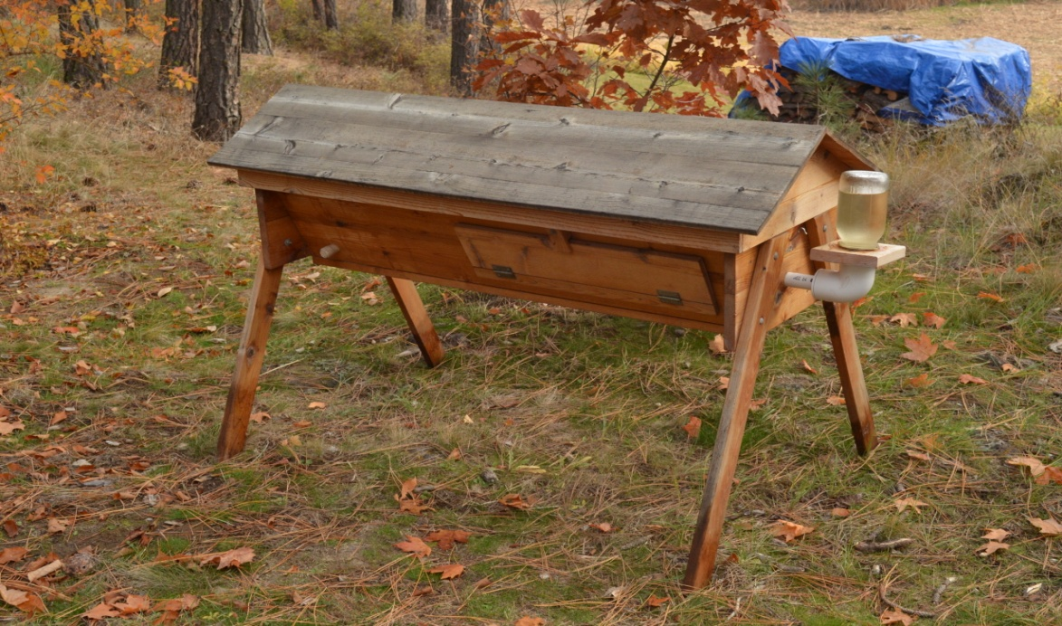
Feeders

Slide 12
Covers

Slide 13
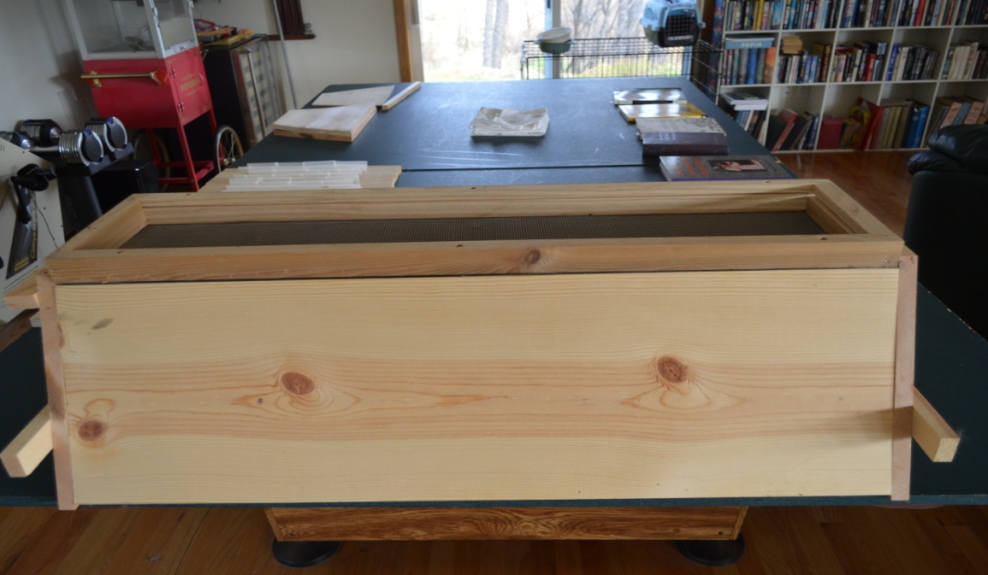
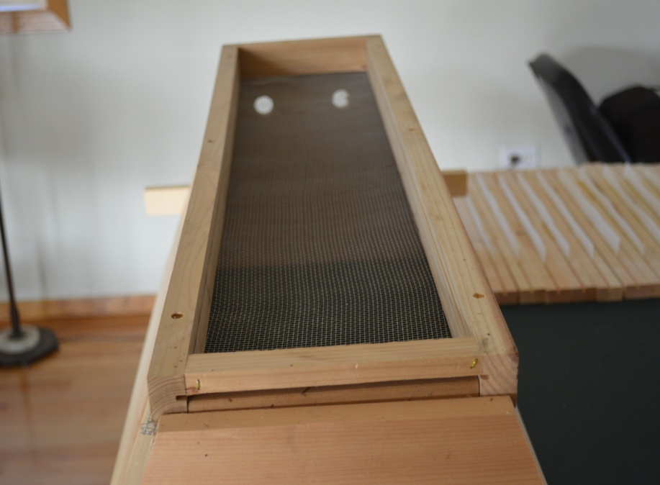
Bottom Board
#8 hardware cloth stapled to the bottom
1 X 10 screwed to the bottom
Can include side grooves for an 8 inch sheet metal mite board.

Slide 14
What Size?
The size of a TBH need only be large enough to provide space for bees and stores to overwinter as honey is taken off one top bar at a time. Bees like about 40 liters.
Minimum size is 2 feet long for 1 x 12’s
Good as bait hive or nuc or pollination hive
(51 liters)
My standard size is 3 foot (77 liters)

Slide 15
Entrance
Entrance should be at one end of the hive as the brood nest will be near the entrance and the honey combs farther away.
Bees like 15 square centimeters.
I use 2ea 1 inch holes.
A 1 inch hole is about 10 square centimeters.

Slide 16
Hives Must be Level
The hive can be mounted on it’s own legs or it can be mounted on a hive stand but it is critical that the hives are mounted level if the top bar combs are to be interchangeable.
There is no foundation so the bees will build the comb perfectly vertical.

Slide 17
Handling Comb
When inspecting hives care must be used not to tilt the comb on the short axis of the top bar.
Rotate the top bar along the long axis only.

Slide 18
Weighing the TBH
I generally only weigh the entrance end of the hive to determine if it is gaining or losing weight.
Any hive stands should be wide enough so that the back end of the hive is the pivot point which makes weight reading consistant.

Slide 19
Feeding Sugar or Patties
You will need to make a collar or some kind of spacer to allow for room for the feed if you use a flat roof.
You will need to spread a couple of top bars enough so that the bees can access the feed or you may use a notched top bar over the brood nest.

