Slide 1
SPLITTING HIVES
THE WHY AND HOW TO
SPLIT A HIVE

Slide 2
THE WHY
Start a new hive
Overcrowding
Swarming
Control of mites
Nucs to sell
Notes:
Splitting hives helps in reducing the exponential growth of varroa mites – because the varroa needs a continuous cycle of brood production.
Nucs to sell – pullimg 3-5 frames and inserting them into a nuc box can be done as a method to increase your income. (If the hobbyist can call beekeeping a profitable income.)
These frames all have a queen, larva, nurse and worker bees.

Slide 3
STARTING A NEW HIVE
2 Caucasian hives
Goal – increase numbers
Extract honey from original hives
Notes:
Hives #! &#@ are Caucasian.
Our goal is to increase our number of Caucasian hives.
WE also want to be able to extract some honey from hives 1 & 2 in August or September.

Slide 4
OVER CROWDED

Slide 5
SWARMING

Slide 6
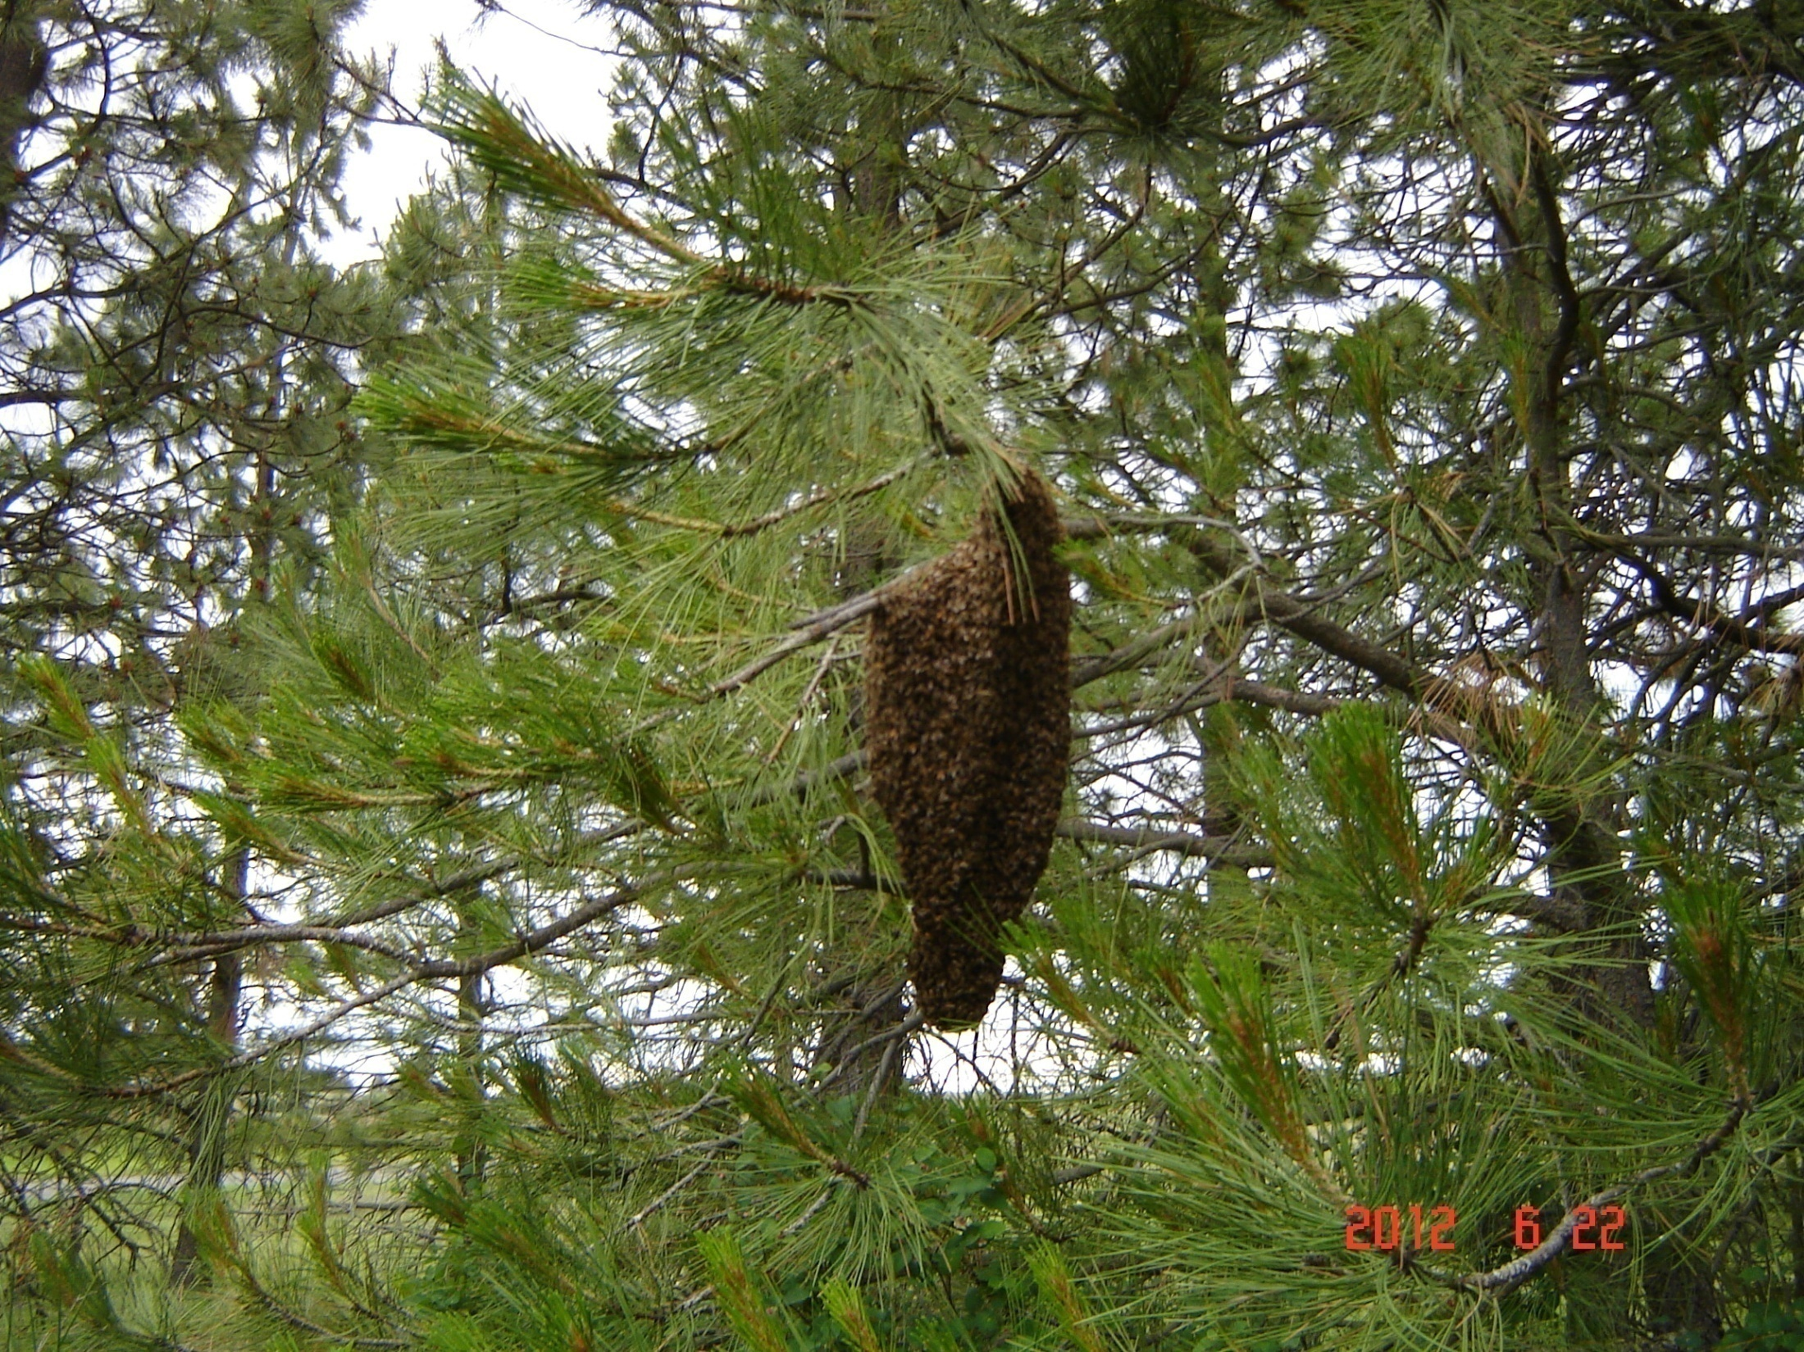
SPLITTING HIVES
JUNE 22---SWARM OF BEES

Slide 7
CONTROL OF MITES
SPLITTING COLONIES HELPS IN REDUCING THE EXPONENTIAL GROWTH OF THE VARROA MITE. THE VARROA MITE NEEDS A CONTINUOUS CYCLE OF BROOD PRODUCTION.

Slide 8
NUCS TO SELL
PULLING 3 TO 5 FRAMES AND INSERTING THEM IN A NUC BOX CAN BE DONE AS A METHOD TO INCREASE YOUR INCOME. (IF THE HOBBYIST CAN CALL BEEKEEPING A PROFITABLE INCOME.)

Slide 9
THE HOW
THREE WAYS TO DO THIS:
1. THE RIGHT WAY
2. THE WRONG WAY
3. MY WAY (hope it works)

Slide 10
THE RIGHT WAY
REMEMBER—YOU’RE THE BEEKEEPER
(so your way is right)
WHEN
WHAT
HOW

Slide 11
THE RIGHT WAY - WHEN
SPLIT DURING SPRING OR SUMMER (the old hive must have 6-8 frames of bees in it)
A MINIMUM OF 6 WEEKS BEFORE THE HONEY FLOW
FIRST OF MAY FOR A NEW SPLIT HIVE
Notes:
Split during spring and summer to provide time for the hive to strength before the honey flow or before winter sets in.
A minimum of 6 weeks before the honey flow is considered minumum lead time. (the first day of May for a new split hive.
Your chance of getting a surplus of honet will be slim – unless you start with drawn frames.

Slide 12
THE RIGHT WAY – WHAT (things needed)
NEW BROOD CHAMBER
FOOD FOR BEES
FRAMES (drawn or new)
BEST TO USE AN ENTRANCE BLOCK

Slide 13
THE RIGHT WAY - HOW
MOVE 2-3 FRAMES WITH BROOD FROM OLD HIVE TO NEW HIVE
PLACE FRAMES IN MIDDLE OF NEW HIVE BODY
PLACE A FRAME OF HONEY AND POLLEN ON EACH SIDE OF THE BROOD
ADD FRAMES TO FILL OUT THE HIVE
MAKE SURE THEN ENTRANCE IS BLOCKED FOR A COUPLE OF DAYS
REPLACE NEW FRAMES IN OLD HIVE
MOVE THE NEW HIVE TO A NEW LOCATION
Notes:
It Move 2-3 frames with brood to new hive.helps if there is a supersedure or a swarm cell included.
Place these frames in the middle of the hive body.
Frames should contain eggs, larva, and capped brood – and be covered with nurse bees. You also need worker bees.
Place a frame of pollen and honey on each side of the brood.
Add frames too fill out the hive.
Make sure that the entrance is blocked for at least a couple of days – especially if you have a new queen.
Refill the old hive with new frames.
Move the new hive to a new location – at least 30’ away.

Slide 14
LIFE CYCLE (remember- starting w/o a queen )
16 DAYS FOR THE QUEEN TO HATCH
3 TO 21 DAYS TO MATE AND START LAYING EGGS
21 DAYS FOR THE EGGS TO HATCH
21 DAYS TO BECOME A FIELD BEE
65 TO 79 DAYS(16 days less if a new queen)
(May 1st to June 30th = 61 DAYS)
Notes:
It is important to have a strong colony, with a force of field bees when the main honey flow starts.
A colony with only a lot of nurse bees won’t produce a crop of honey.
If the bees make their own queen, it will be 65 to 75 days before she has workers in the field.

Slide 15
METHODS
THE METHOD OF SPLITTING HIVES WILL VARY FOR THE HOBBYIST AND THE COMMERCIAL BEEKEEPER
EXAMPLES:
A DOUBLE SCREEN BOARD
THE DAMAREE METHOD
SIDE BY SIDE SPLITS
MY WAY

Slide 16
SPLITTING HIVES

Slide 17
SPLITTING HIVES
THE DEMAREE METHOD IS SPLITTING ALL THE EGGS,BROOD AND NURSE BEES ABOVE A QUEEN EXCLUDER.
THE QUEEN AND THE WORKER BEES ARE IN THE 2 BOTTOM BROOD CHAMBERS WITH NEW OR DRAWN OUT FRAMES—SIMILAR TO THE DOUBLE SCREEN BOARD

Slide 18
THE WRONG WAY
NOT DOING THINGS THE RIGHT WAY
HAVING NURSE BEES AND BROOD AND NO WORKER BEES
NO FOOD

Slide 19
MY WAY
I DIDN’T SAY ALL OF THIS IS THE RIGHT WAY BUT REMEMBER:
“I’M THE BEEKEEPER “.

Slide 20
Starting a new hive
10th OF FEB 2016–WE STARTED FEEDING HIVES #1 & #2 (snowing that day )
(hives were 8 months old and started with all drawn foundations)
Hive # 1 #2 were started with new queens in June 2015 and with 4 frames of Italian bees in each hive
Bees were Italians and the queens were new Caucasians – by Feb 2016 we had all Caucasian bees

Slide 21
MY WAY
9th April-added 2nd brood chamber to #1 & 2 (these are the Caucasians who have been fed for 2 months so their numbers are up )
17th April— package bees-- made new hives #3 & 4
6th May- lots of bees in the hives
11th May –bees all over the front of the hives --elevated #1 & #2 for circulation
29th May last feeding

Slide 22
SPLITTING TO MAKE A NEW HIVE

Slide 23
MY WAY
1ST June– hive #1 & #2 ( Caucasians ) have lots of bees --took 2 frames with bees out of each hive and made hive # 5 -- #1 had a supersedure cell while #2 had a swarm cell– ( destroyed this cell )
Put the supersedure cell in hive #5
Moved this hive a few feet away and fed and restricted the entrance
All hives have drawn foundations

Slide 24
SPLITTING HIVES
Hives #3 & #4 were new package bees
2nd week of May the bees were flying but when we checked the frames of #3 there were no eggs or larva—just empty cells except for some food and a hand full of live bees—DEAD QUEEN !
We took 4 frames out of hive #4 and put into #3—they will have to make their own queen !

Slide 25
SUMMARY
THE HIVE YOU ARE GOING TO SPLIT SHOULD HAVE 6 TO 8 FRAMES OF BEES.
YOU NEED TO HAVE EGGS ,LARVA ,NURSE BEES, FIELD BEES AND FOOD FOR YOUR NEW HIVE.
YOU NEED TO BE AWARE OF THE LIFE CYCLE OF THE BEES.

Slide 26
SPLITTING HIVES
ANXIOUS FOR SUMMER TO COME SO we CAN SEE HOW MY WAY WORKED OUT !
ANY QUESTIONS ?

Slide 27
CREDITS
PRODUCER & DIRECTOR JOE GEIGER
PHOTOGRAPHER JOE GEIGER
(VIA HIS IPHONE)
TECHNICAL ADVISOR MARILYN GEIGER
EDITOR MARILYN GEIGER
(MOSTLY VERBAGE REDUCTION)

