Slide 1
SPLITTING HIVES
THE WHY AND HOW TO
SPLIT THE HIVE

Slide 2
THE WHY
1. TO START A NEW HIVE
2. SWARM CONTROL
3. CONTROL OF MITES
4. TO MAKE NUCS TO SELL

Slide 3
THE HOW
THREE WAYS TO DO THIS:
1. THE RIGHT WAY
2. THE WRONG WAY
3. MY WAY (hope it works)

Slide 4
THE RIGHT WAY
THINGS NEEDED:
NEW BROOD CHAMBER
FOOD FOR BEES
FRAMES (drawn or new )
BEST TO USE AN ENTRANCE BLOCK

Slide 5
THE RIGHT WAY
REMOVE 2 OR 3 FRAMES WHICH HAVE BROOD FROM THE OLD HIVE AND PLACE IN THE NEW HIVE– IT HELPS IF THERE IS A SUPERSEDURE OR A SWARM CELL INCLUDED—PLACE THESE FRAMES IN THE MIDDLE OF THE HIVE BODY—FRAMES SHOULD CONTAIN EGGS,LARVA AND CAPPED BROOD AND BE COVERED WITH NURSE BEES—
ADD FRAMES TO FILL OUT THE HIVE
MAKE SURE THAT THE ENTRANCE IS BLOCKED FOR A COUPLE OF DAYS (mainly if you have a new queen )
REPLACE NEW FRAMES IN THE OLD HIVE.
MOVE THE NEW HIVE TO A NEW LOCATION

Slide 6
THE RIGHT WAY
REMEMBER—YOU’RE THE BEEKEEPER

Slide 7
THE RIGHT WAY
SPLIT DURING SPRING OR SUMMER TO PROVIDE TIME FOR THE HIVE TO STRENGHTEN BEFORE WINTER
A MINIMUM OF 6 WEEKS BEFORE THE HONEY FLOW IS CONSIDERED MINIMUM LEAD TIME.
(your chance of getting a surplus of honey the 1st year will be slim )

Slide 8
LIFE CYCLE
Its important to have a strong colony with a
force of field bees when the main honey flow starts. A colony with only a lot of nurse bees won’t produce a honey crop. If the bees make their own queen, it will be 65 to 79 days before she has workers in the field.

Slide 9
LIFE CYCLE (remember)
16 DAYS FOR THE QUEEN TO HATCH
7 TO 21 DAYS TO MATE AND START LAYING
21 DAYS FOR THE EGG TO HATCH
21 DAYS TO BECOME A FIELD BEE
65 TO 79 DAYS(16 days less if a new queen)
(April 1st to June 1st = 61 DAYS)

Slide 10
METHODS
THE METHOD OF SPLITTING HIVES WILL VARY FOR THE HOBBYIST AND THE COMMERCIAL BEEKEEPER
Examples:
A double screen board
The Damaree method
MY WAY

Slide 11
THE WRONG WAY
NOT DOING THINGS THE RIGHT WAY

Slide 12
MY WAY
I DIDN’T SAY IT WAS THE RIGHT WAY BUT REMEMBER:
“I’M THE BEEKEEPER “.

Slide 13
MY DAILY LOG
25th OF MARCH 2012– STARTED FEEDING HIVES #1, #2 & #3
(hives were 1 year old and started with all new foundations)
Hive # 3 was started from a swarm in 2011
Bees are Italians (more on that later)

Slide 14
MY WAY
9th April-added supers to #1 & 2
14th April—new hives #4, #5 & #6
6th May-still no bees in #1 & #2 supers but lots of bees in the hive—( ? )
11th May –bees all over the front of the hive –elevated #1 & #2 for circulation
29th May last feeding

Slide 15
MY WAY

Slide 16
MY WAY
1ST June– hive #1 &#2– think they might swarm --took 5 frames with bees out of each hive and made hives #7 & #8--#7 had a supersedure cell while #8 had swarm cells
Moved these hives a couple hundred feet away and fed and restricted
All hives have new foundations

Slide 17
MY WAY
4TH June—Remember- I’ve taken 5 frames out of hive #1 and added 5 new frames with new foundations
So there is lots of work for the worker bees---right?
GUESS WHAT !

Slide 18
MY WAY

Slide 19
MY WAY

Slide 20
MY WAY

Slide 21
THEY SWARMED
This was 3 days after I had removed 5 frames. I swept that swarm up and put them in a hive body which is now #9---no idea if I got the queen or not, so I took 2 more frames out of hive #1 and placed into hive #9 —that’s 7 frames with bees that I’ve taken out of hive #1 and it’s still full of bees! Does hive #9 have a queen? – I hope so!

Slide 22
MY WAY

Slide 23
MY WAY
THE NEW HIVE #9 WAS PLACED ABOUT 50 FEET AWAY FROM THE OTHER HIVES– I BLOCKED THE ENTRANCE– 4 DAYS LATER I TOOK HIVE # 9 AND MOVED IT NEXT TO Hive # 1– THE PALLET WAS LEFT WHERE IT WAS.

Slide 24
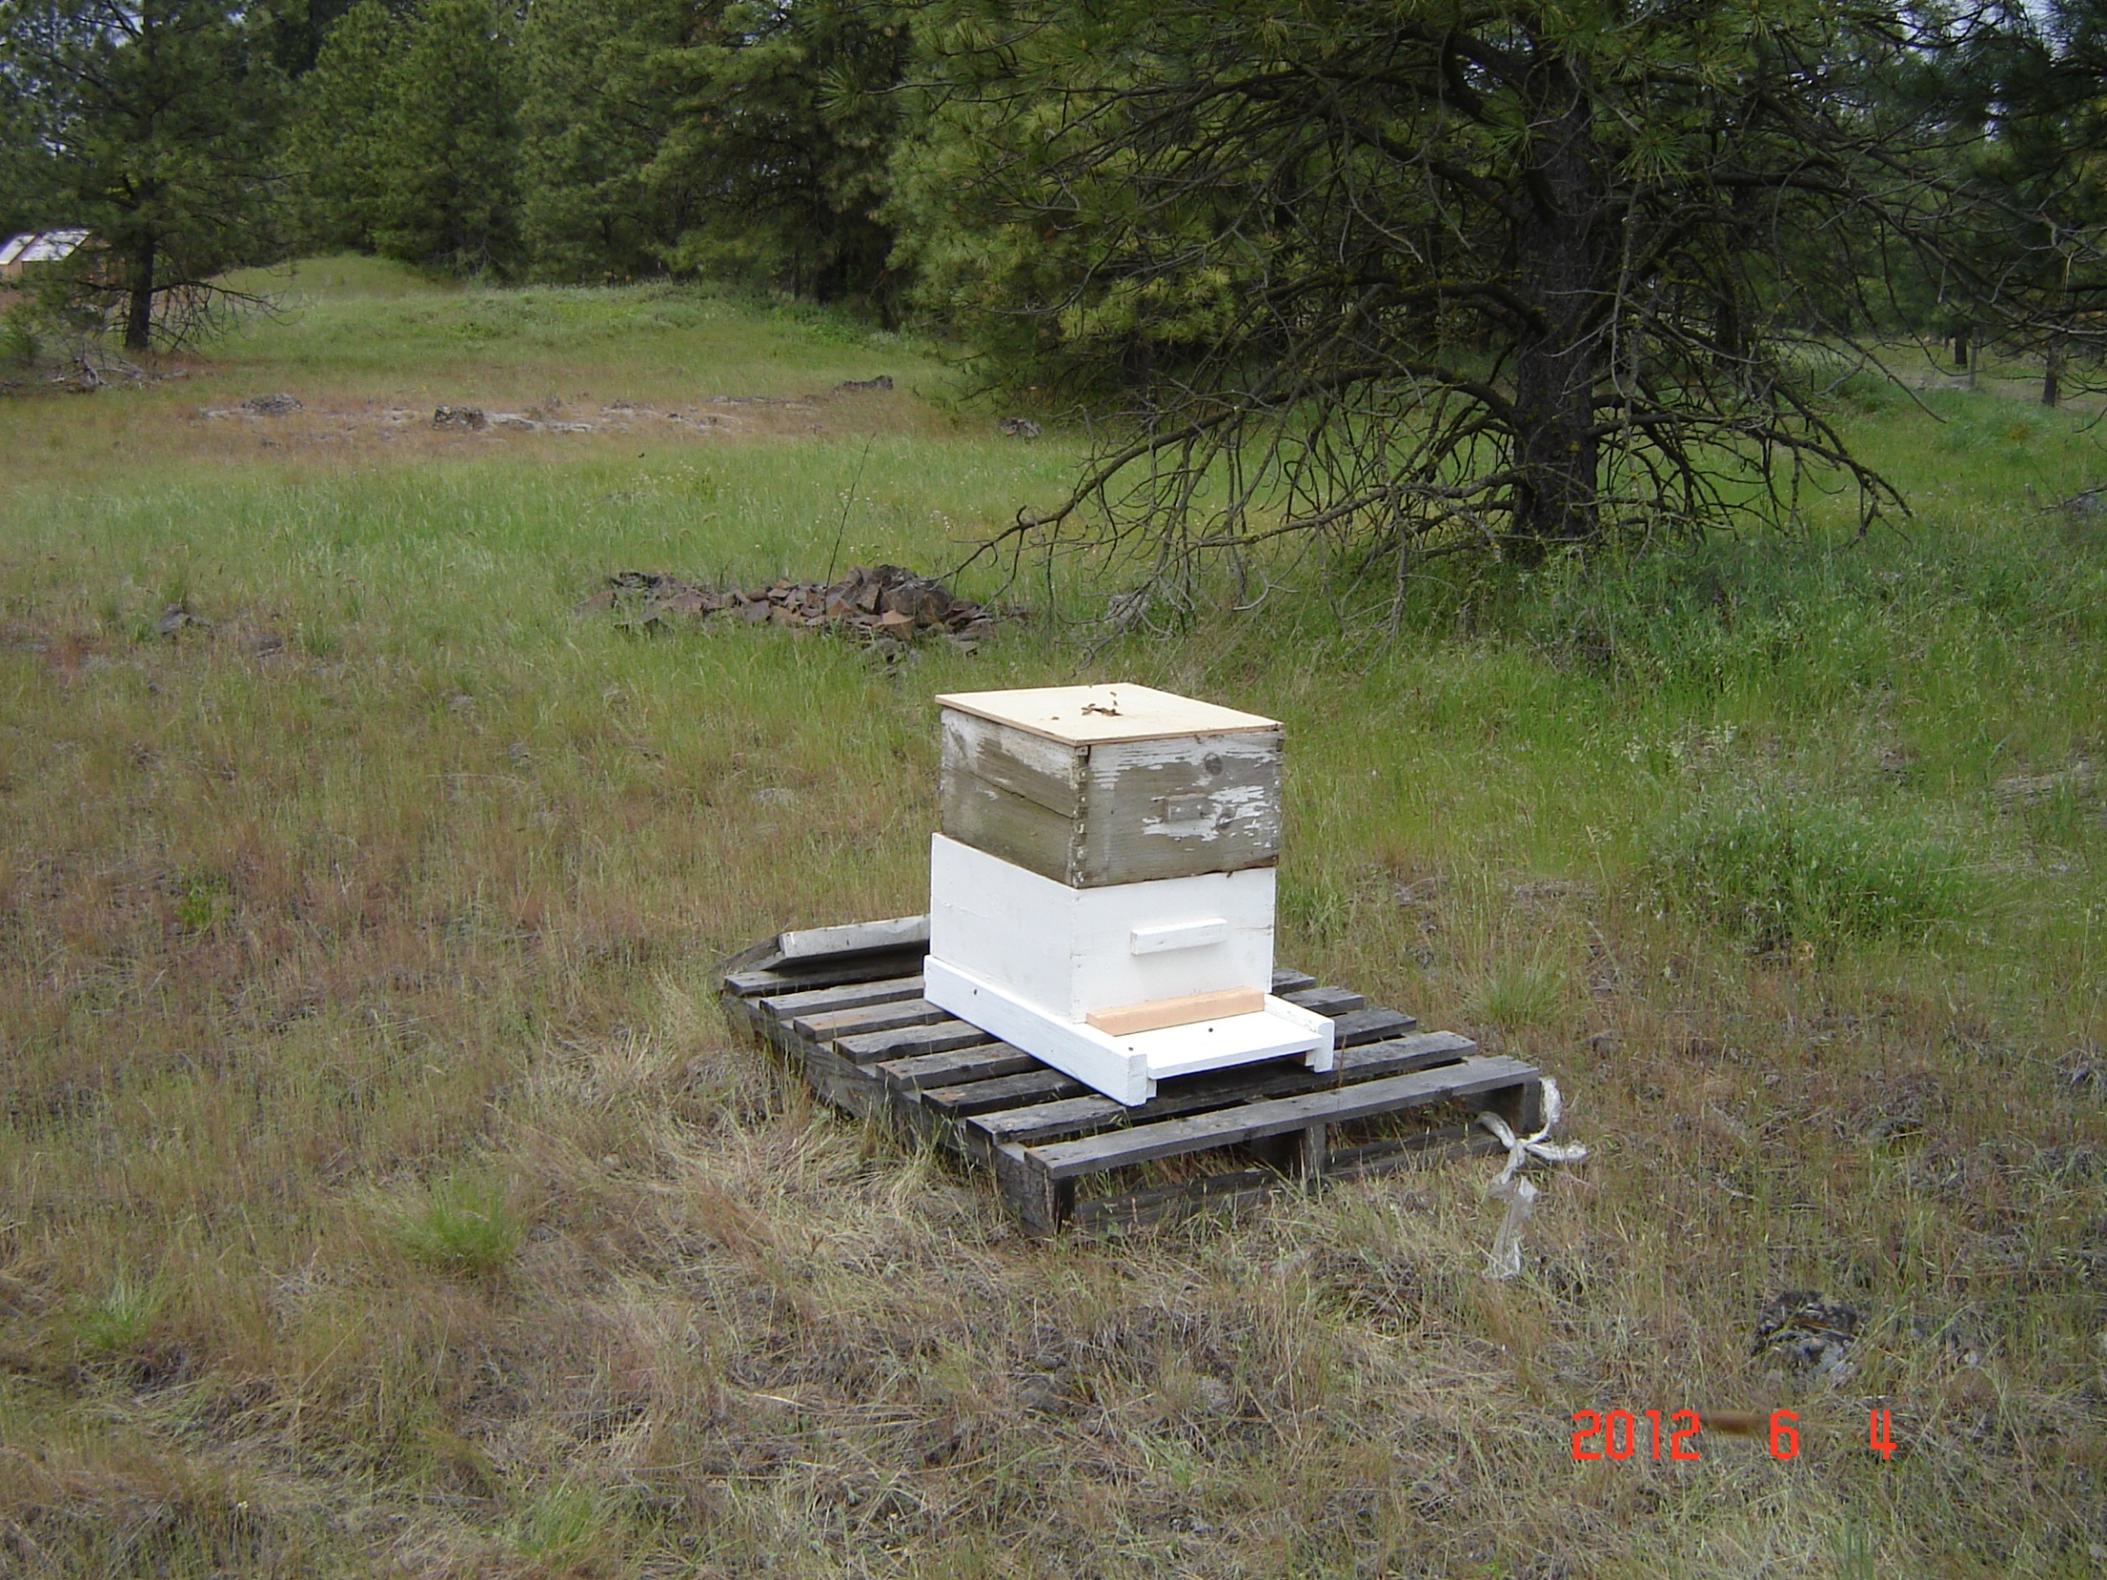
MY WAY
THE REMAINDER OF THE BEES FROM HIVE #1 WENT BACK INTO THE HIVE. HIVE #9 WAS PLACED ABOUT 50 FEET AWAY ON A PALLET— I ADDED A FEEDER AND BLOCKED THE ENTRANCE TO #9

Slide 25
MY WAY
LATER THAT DAY WHEN I WENT BACK TO CHECK ON THE BEES THERE WERE 100 OR MORE BEES GATHERED ON AND AROUND THE PALLET—I GRABBED ANOTHER HIVE BODY AND PLACED IT ON THE PALLET –I TOOK 2 MORE FRAMES OUT OF HIVE #1 AND PUT INTO HIVE #10– (that’s 9 frames taken out of hive #1)—I ALSO THREW IN A SWARM CELL THAT HAD BROKEN OFF OF ONE OF THE FRAMES
AND GUESS WHAT !

Slide 26
HIVE # 2

Slide 27
YOU GUESSED IT
HIVE # 2 SWARMED WHILE WE WERE IN MONTANA
REMEMBER THESE ARE ITALIAN BEES
(THE REASON THEY SWARM??)

Slide 28
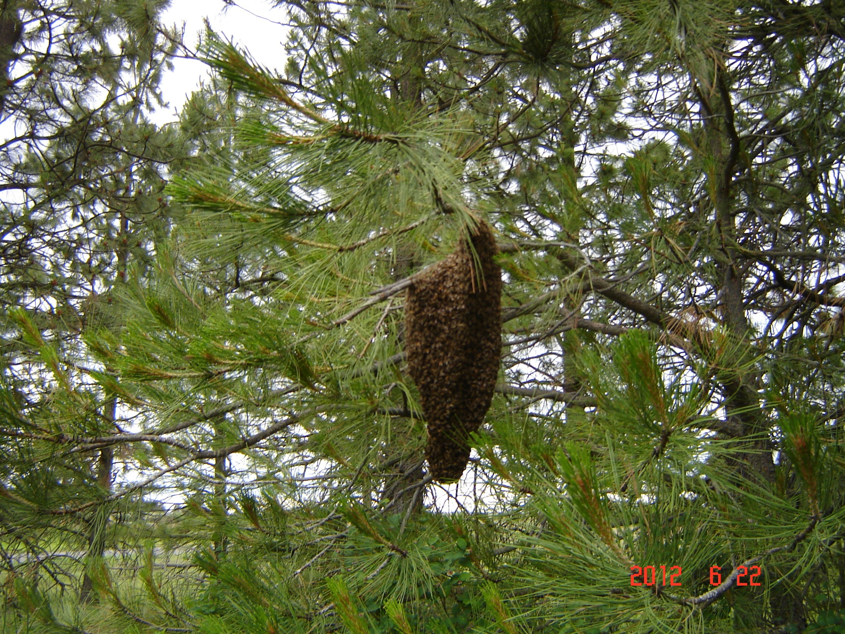
SPLITTING HIVES
JUNE 22---SWARM OF BEES

Slide 29
NEW SWARM
THIS WAS JUNE 22– 7:30 am
23RD JUNE- WPBA HAD THE HIVE TOUR
ALL HIVES LOOKED OK EXCEPT #9

Slide 30
SPLITTING HIVES
ANXIOUS FOR SPRING TO COME SO I CAN SEE HOW MY WAY WORKED OUT !

