Slide 1
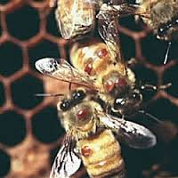
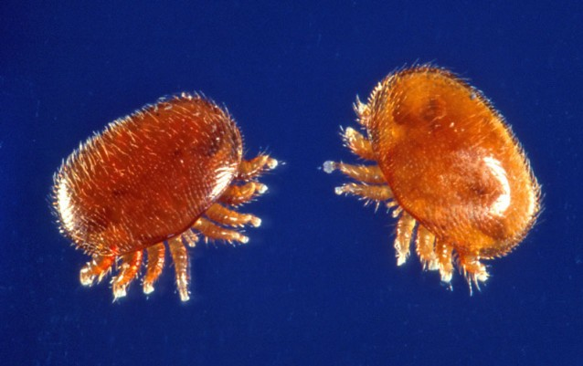
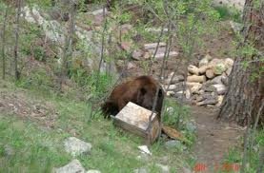
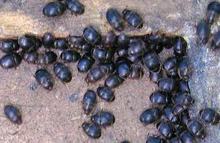
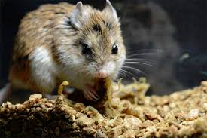
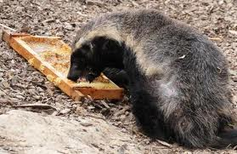
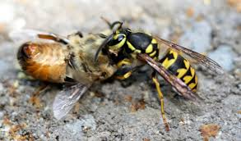
Pests and Predators
The Not-So-Good, the Bad, and the Ugly

Slide 2
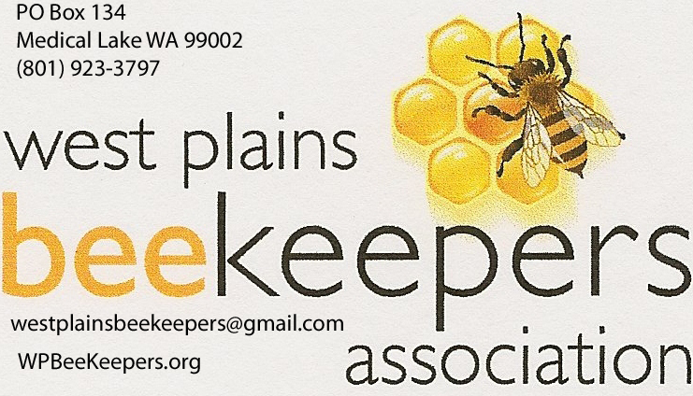
Predators and Pests The Not-So-Good, the Bad, and the Ugly
Summary
Pests and Predators
In-hive
Out-of-hive
Treatment and/or deterrent
IPM – Integrated Pest Management
Healthy, strong hives

Slide 3
Predators and Pests What We Will Cover
Mites: Tracheal and Varroa
Small Hive Beetle
Wax Moths
Ants, Spiders, Earwigs
Wasps, Hornets, Yellow Jackets
Mice
Skunks, Raccoons, Badgers, Bears
Domestic Livestock and Not-So-Domestic

Slide 4
Know what your hive looks like when it’s healthy.
Simple observations
Thorough inspection in early spring. Then every 7-14 days look at the hive entrance and lift inner cover. Notice when things change. It could mean pests have arrived.
Observe the amount of activity at the front of the hive
Large number of dead bees lying at the entrance?
Fecal matter on the front of the hive?
Notice when things change
When soothing hum changes pitch
Sweet scent becomes foul
Movements are not happy and harmonious
Scratching in the dirt in front of the hive?

Slide 5
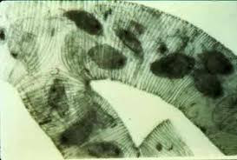
Mites
Began to be a significant problem in the mid 1980’s with 50%-80% losses in the North East in 1995.
Tracheal mites (Acampis woodi)
Microscopic in size, infest breathing tube and they can’t breathe.

Slide 6
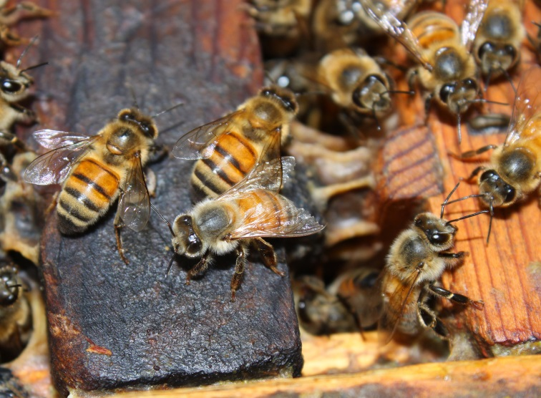
How can you tell they are present? Observations: - K wings - See lots of bees crawling on ground in front of hive @ temps lower than 40 degrees. They can’t breathe so they leave the hive in search of fresh air and it’s too cold so they die. - Collect 100 bees. Freeze them and Jim Miller can test them. Looks at the bees in the microscope to see if mites are in the trachea. Biggest problem in Fall decreasing the life span of the Winter bee
Tracheal mites

Slide 7
Treatments for Tracheal mites
Menthol – A component of Peppermint oil fumes
Mite-A-Thol
Commercially available- menthol crystals that cause the microscopic mite to die from dehydration.
Menthol and formic acid (Mite-Away II)
temperature dependent (50-79 degrees); most effective 60-75 degrees
can’t use when honey supers are on
grease patties may stop the transfer of mites from one bee to another (6c sugar mixed with 3 c hydrogenated vegetable shortening – Crisco) divided into 10 patties, 1 per hive
Lightly covers the bees and inhibits movement of the mites between the bees.

Slide 8
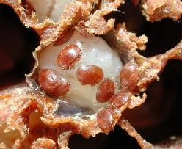
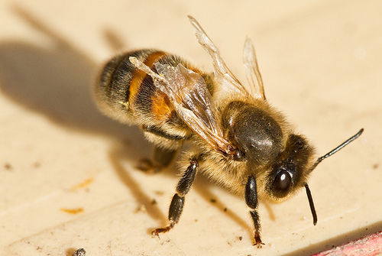
Varroa Mites
(Varroa Destructor)
Visible. About the size of a pinhead.
Oval reddish brown mite lives on the outside of the adult bee and larva
Detection through observations –
Bees have deformed wings. Deteriorated brood, declining worker population.
Sticky white board inserted under the screened bottom board. After a certain number of days, count the number of mites.

Slide 9
Varroa Mites (Varroa Destructor)
Treatments: Integrated Pest Management (IPM): Natural method
Screened bottom boards – Mites fall through screen and can’t climb back up to bees.
Smoke – makes them fall off bees
Powdered sugar – slippery so they fall off. Use only when the bees can fly. It contains corn starch that must be eliminated.
Grease patties with essential oils. Make bees slippery. Oil clogs the mite breathing tubes. Thymol believed to sterilize the female mite. 2 parts crisco to 1 part sugar and a drop of thymol.
Split hives. New hives have fewer mites.
Drone combs – Favorite meal for this mite. Remove after mites have collected on drone brood and freeze to kill mites.

Slide 10
Varroa Mites (Varroa Destructor)
Chemical treatments
Api Life VAR – thymol based pesticide. Approved for organic agriculture. Don’t use when honey is being made. Use spring and autumn.
Apistan; Mite-Away II; Sucrocide; Apiguard; Hivastan; Check Mite (illegal to harvest honey) Mites have developed resistance to Apistan
Soft chemicals such as Formic Acid, Thymol, Sucrose octanoate can be sprayed on bees; treats tracheal mites; Eucalyptus essential oil

Slide 11
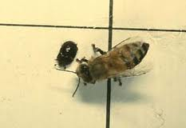
Small Hive Beetle (Aethina tumida)
Discovered in southern US in 1996. Not usually in Washington.
Adult has six legs, two pair of wings, reddish brown/black, ¼” long; feed off of pollen on solid bottom boards
Larvae are cream; 1/16”; when mature they burrow into the ground under the hive
Treatment: Relocate hive
Freezing temps

Slide 12
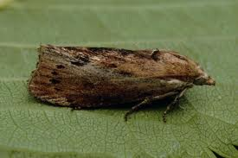
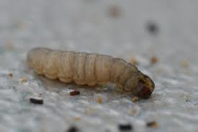
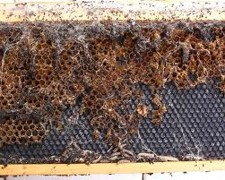
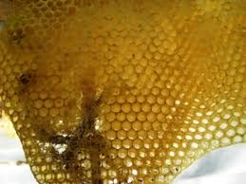
Wax Moths
-- Don’t attack bees directly
Larvae feed on combs (pollen, brood). Healthy hive will take care of them
Usually found in abandoned or improperly stored frames
Keep your hive area clean and store your hive body parts where animals can’t get to them or you’ll invite pests

Slide 13
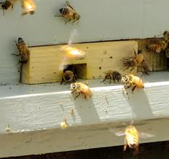
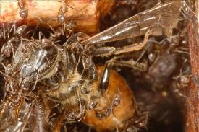
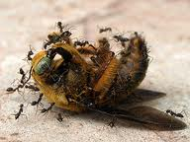
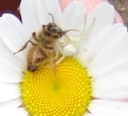
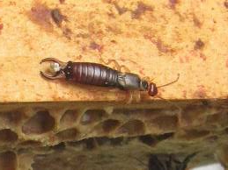
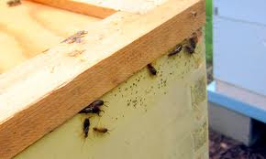
Reduce the entrance size and the bees can protect the hive
Ants
Placement of hive away from established nest
Vaseline, ashes, diatomaceous earth, cinnamon
Spiders
Ghost spider predates on field bees
Earwigs

Slide 14
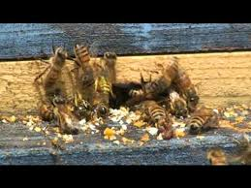
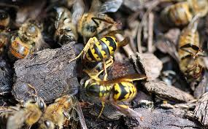
Wasps, Hornets, Yellow Jackets
Will take over a weak hive
Trap queens in early spring (March)
Can fly in colder temperature
Hang traps near hive

Slide 15
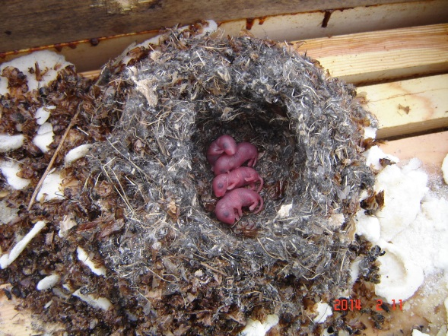
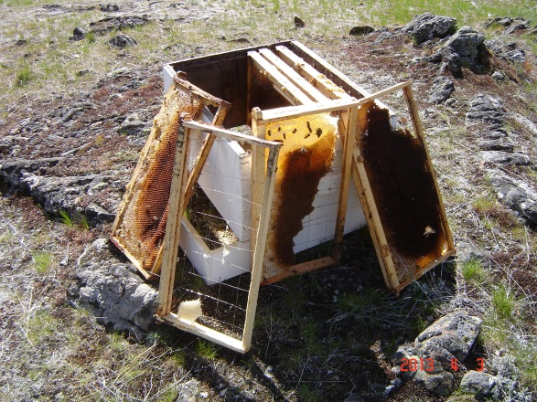
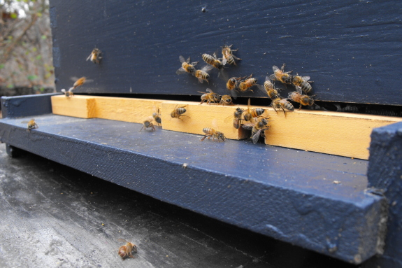
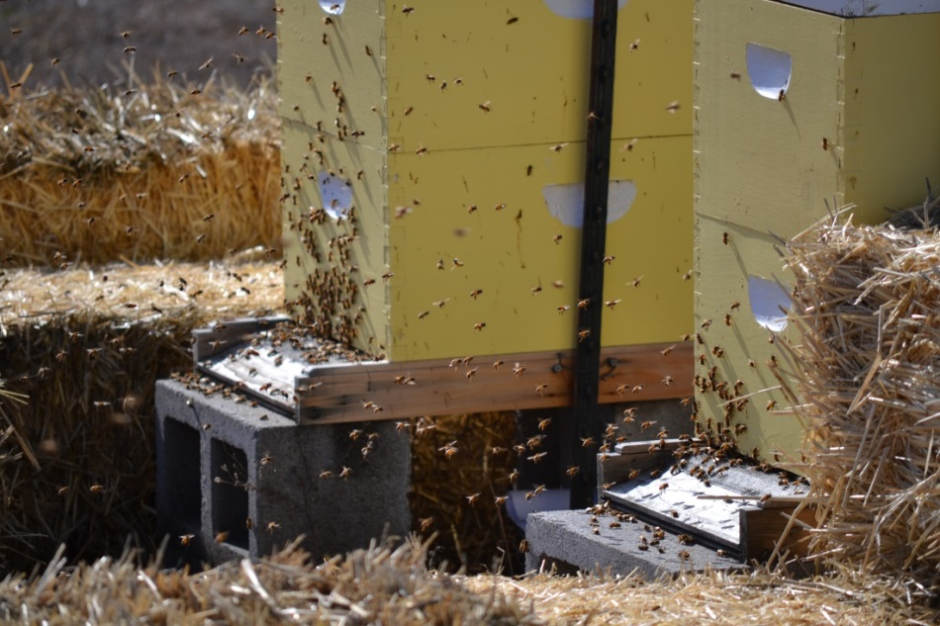
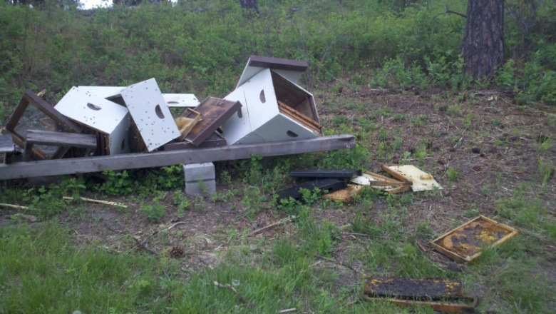
Mice are a problem if the hives are in a field – Restrict opening at hive entrance.
Skunks, Raccoons, Badgers – Keep hive at least a foot off ground, secure hive bodies. Keep hive area clean. If you see scratching in front of the hive, you may have a skunk around.

Slide 16
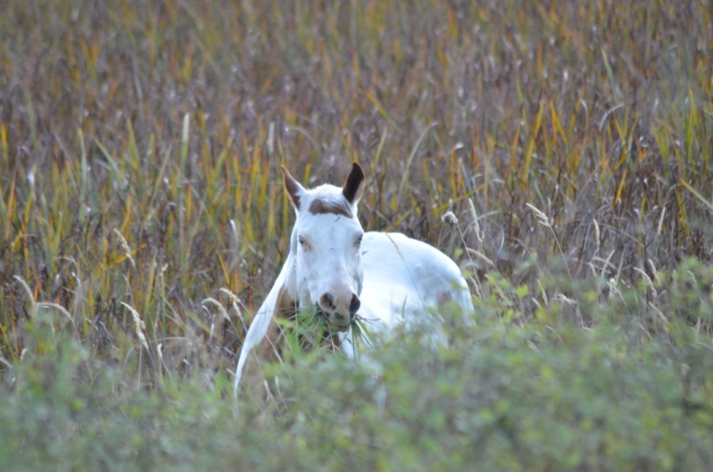
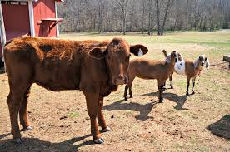
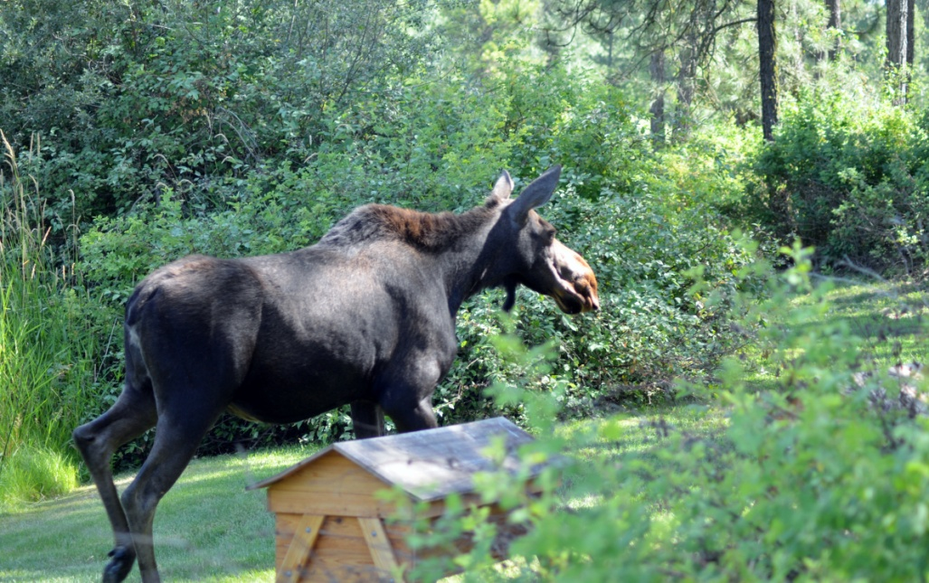
Domestic livestock and wild animals .
Electric fences to keep them away from hives.

Slide 17
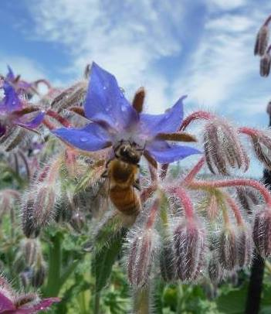
Predators and Pests The Not-So-Good, the Bad, and the Ugly
Summary
Pests and Predators
In-hive
Out-of-hive
Treatment and/or deterrent
IPM – Integrated Pest Management
Healthy, strong hives. Know how your hive looks, sounds, smells when it’s healthy so you can tell when something changes and pests or diseases may be present.
Know what your hive
looks like when it’s healthy.

