Slide 1
Lesson One
The Honey Bee
&
Her Products

Slide 2
Overview
Stuff about Honey Bees
Subspecies
The Colony and its Inhabitants
Queen
Worker
Drone
Bee Products

Slide 3
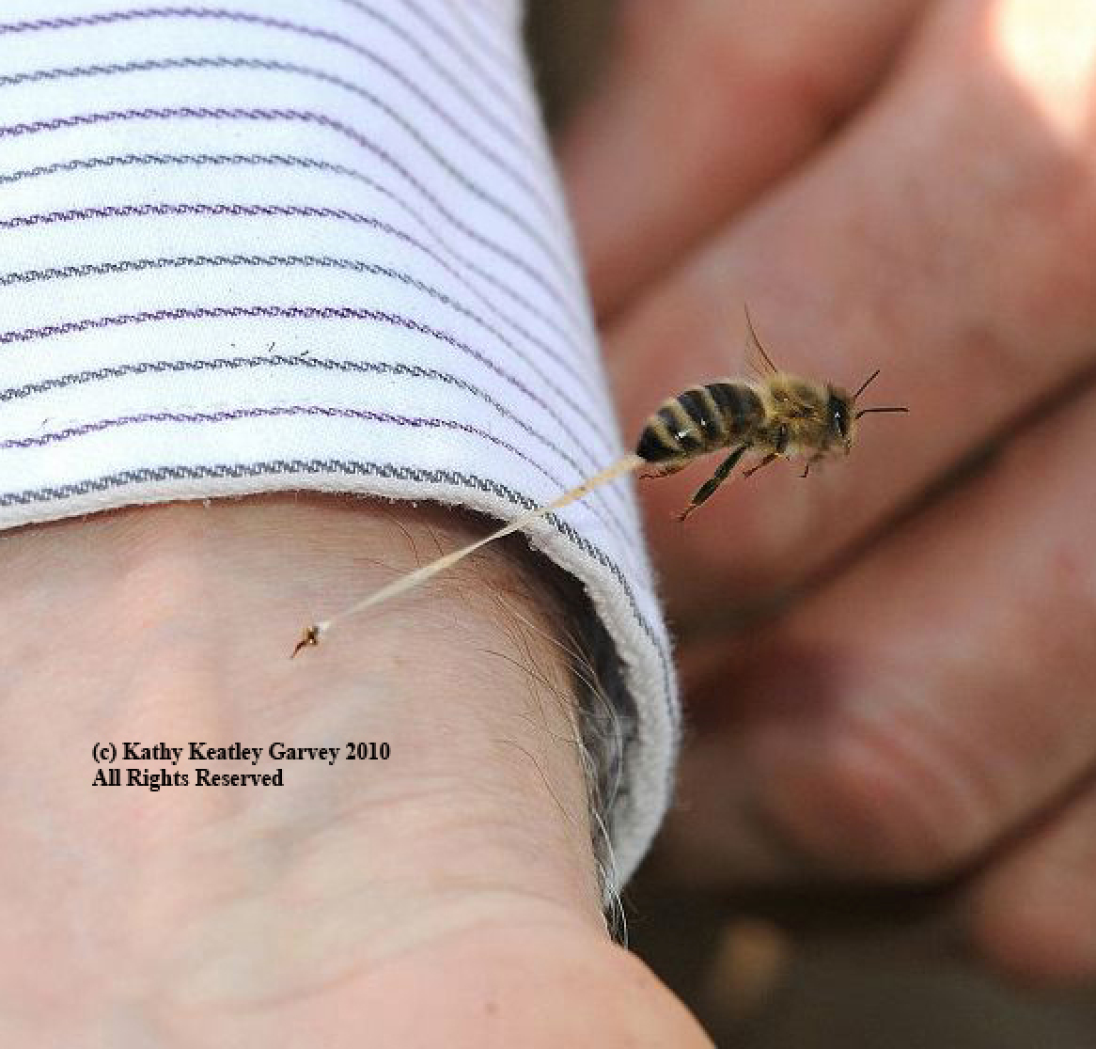
What’s the 1st thing you think about when you think of bees?

Slide 4
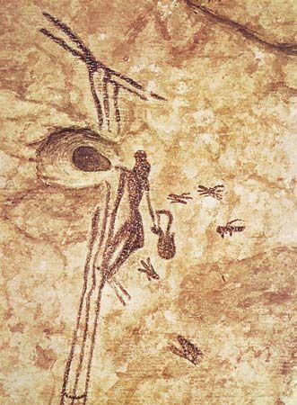
8000 year old cave painting of honey gathering – near Valencia, Spain

Slide 5
Some General Stuff about Honey Bees

Slide 6
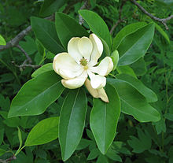
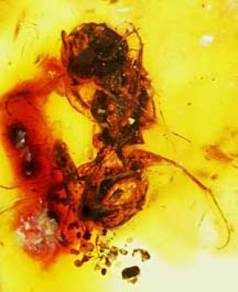
Flowering plants became wide spread 120 million years ago
Scientists believe that bees first appeared ~120 million years ago
16,000 species of bees organized into 7 families. Only 7 species of Apis (honey bee)
Bees and flowers co-evolved

Slide 7
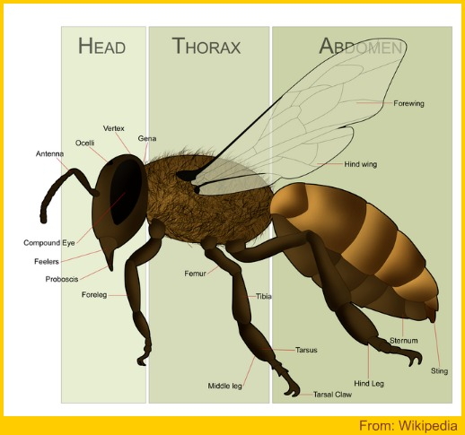
4 wings (forewings larger than hind wings
Mouth can bite and suck
2 compound eyes, 3 simple eyes (used for orientation)

Slide 8
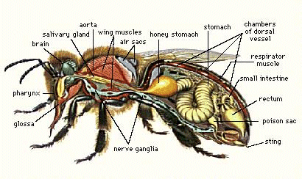
Dissected Bee

Slide 9
Subspecies

Slide 10
44 recognized subspecies of Apis mellifera (honey bee)
Believed to have evolved in Asia/Southeast Asia
Although distributed worldwide, they are endemic to the Old World
mellifera
iberica
carnica
ligustica
macedonica
caucasica
intermissa
(16 days)
(21 days)
(24 days)
sahariensis
syrica
meda
lamarkii
yemenitica
adansonii
jemenitica
monticola
scutellata
litorea
unicolor
capensis

Slide 11
Apis mellifera carnica
CARNIOLANS
Apis mellifera caucasica
CAUCASIANS
“Bee of the Alps”
(Slovenia, Germany)
“Bee of the Caucasus Mountains”
(Georgia, Turkey)
Apis mellifera ligustica
ITALIANS
“Bee of the Italian Peninsula”
(Italy)

Slide 12
ITALIANS
Yellow bees
Quieter/gentler
More resistant to European Foulbrood
Use more winter stores
CARNIOLANS
Most commonly sold here
Large, dark bees
Suited to colder climates, conserve honey in winter
Gentle
CAUCASIANS
Gentle (hmmm…not in my experience)
Winter well in colder climates
Not easily distinguishable from Carnis
RUSSIANS
Hardy winter characteristics
Some resistance to parasitic mites
May be agresses
Imported to USA because hygienic & mite resistant

Slide 13
The Colony
&
Its Inhabitants

Slide 14
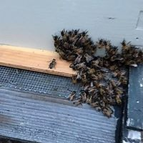
INDIVIDUAL BEES (EXCEPT QUEEN) ARE NOT IMPORTANT
THE COLONY IS THE ORGANISM

Slide 15
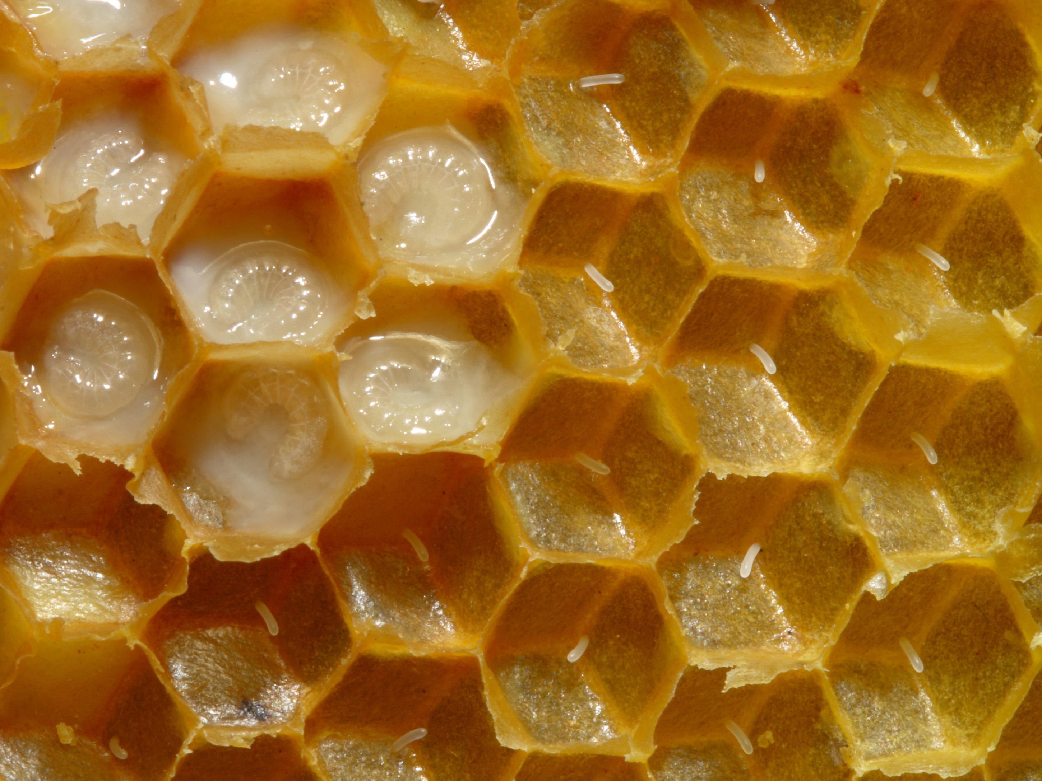
Hive Inhabitants
Eggs (brood)
Larvae (brood)

Slide 16
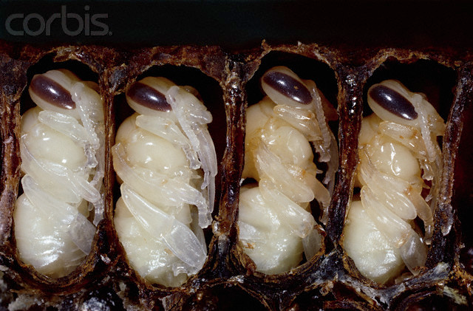
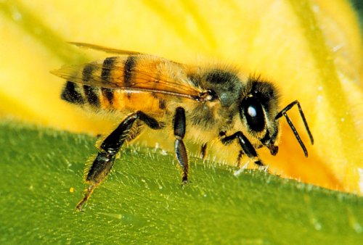
Hive Inhabitants
Adult
Pupae (brood)

Slide 17
Hive Inhabitants
Time required in each stage of development
 | Eggs | Larvae | Pupae | Total time from egg to adult
Queen | 3 days | 5 ½ days | 7 ½ days | 16 days
Worker | 3 days | 6 days | 12 days | 21 days
Drone | 3 days | 6 ½ days | 14 ½ days | 24 days

Slide 18
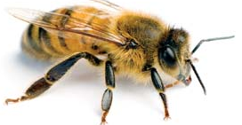
Hive Inhabitants
Worker
(Diploid = 2n)
Queen
(Diploid = 2n)
Drone
(Haploid = 1n)
II II II II
II II II II
II II II II
II II II II
II II II II
II II II II
II II II II
II II II II
I I I I
I I I I
I I I I
I I I I
32 chromosomes
(16 pairs)
32 chromosomes
(16 pairs)
16 chromosomes

Slide 19
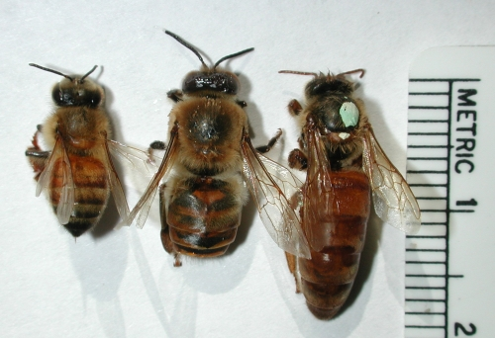
Hive Inhabitants
Worker
Drone
Queen
Thousands
Hundreds (in season
One

Slide 20
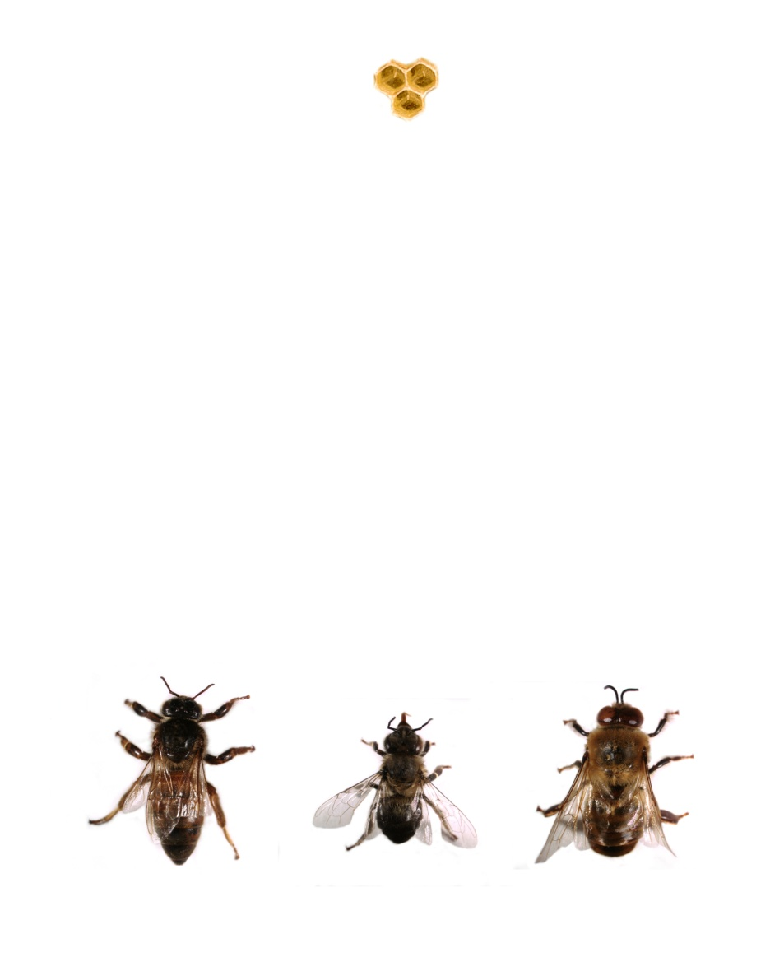
Reproductive Biology and Genetics
Egg
Fertilized
Unfertilized
Heavy feeding with
royal jelly
Light feeding with royal jelly
Queen
Worker
Drone
Figure 1. Sex and caste determination in the honeybee Apis mellifera L.

Slide 21
The Queen

Slide 22
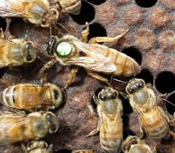
Queen has 2 jobs
Mate and lay eggs/day
Produce pheromones that influence hive behavior
Egg laying
Produces 0-3000 eggs/day, depending on conditions
One egg/cell
Eggs can be fertile or infertile
Pheromone production
Hive identification
Influence swarming & supercedure
Other Queen Facts
Can sting more than once (but usually only stings other queens in hive)
Can live up to 5 years

Slide 23
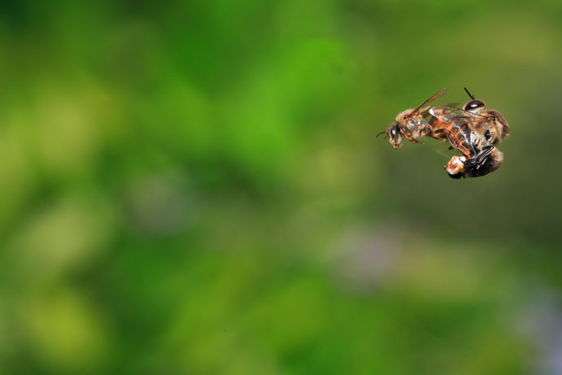
Honey bees have evolved to maintain good genetic diversity
Mates 5-10 days after emerging with an average of 12 drones
www.thehoneygatherers.com

Slide 24
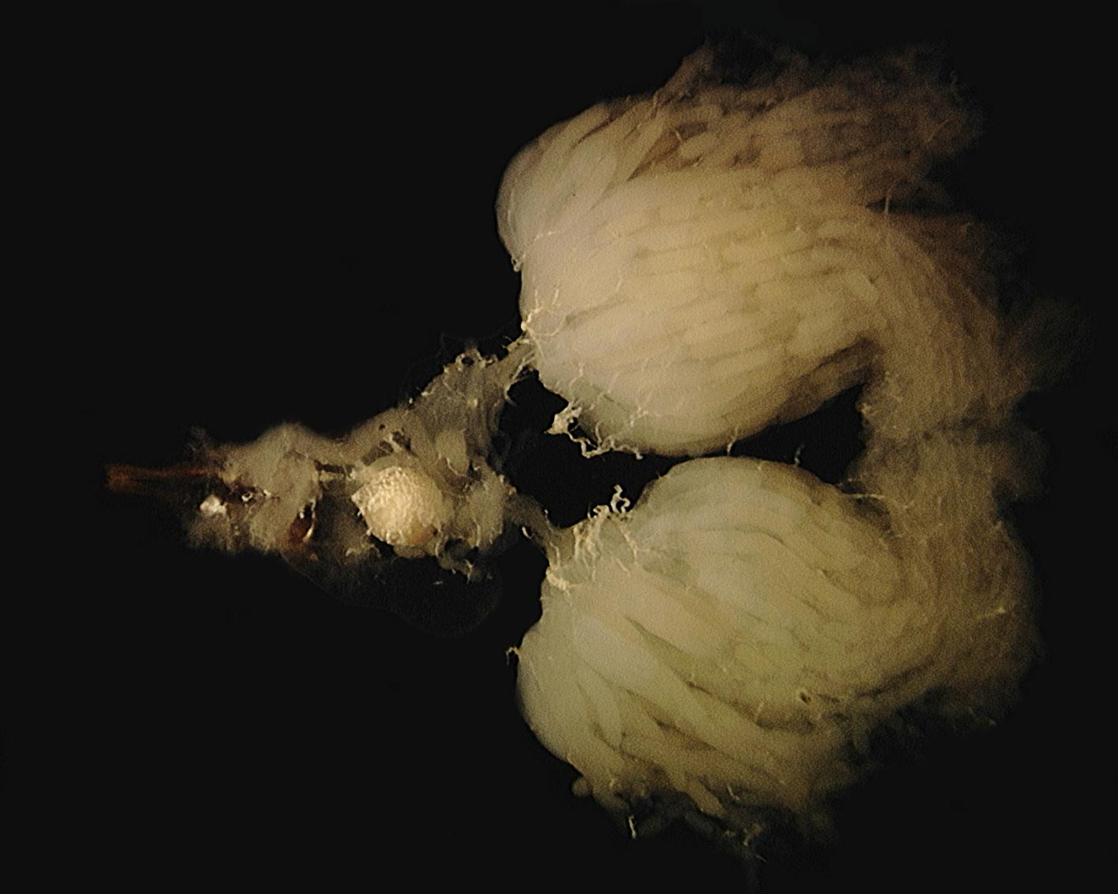
Ovarioles
Tracheal Tissue
Spermathecal Gland
Dufour’s Gland
Spermatheca
Ovipositor
Venom Sac
Lateral Oviduct
Ovary
Figure 3. Dissected reproductive system of mated queen (Photo: M. Taylor)

Slide 25
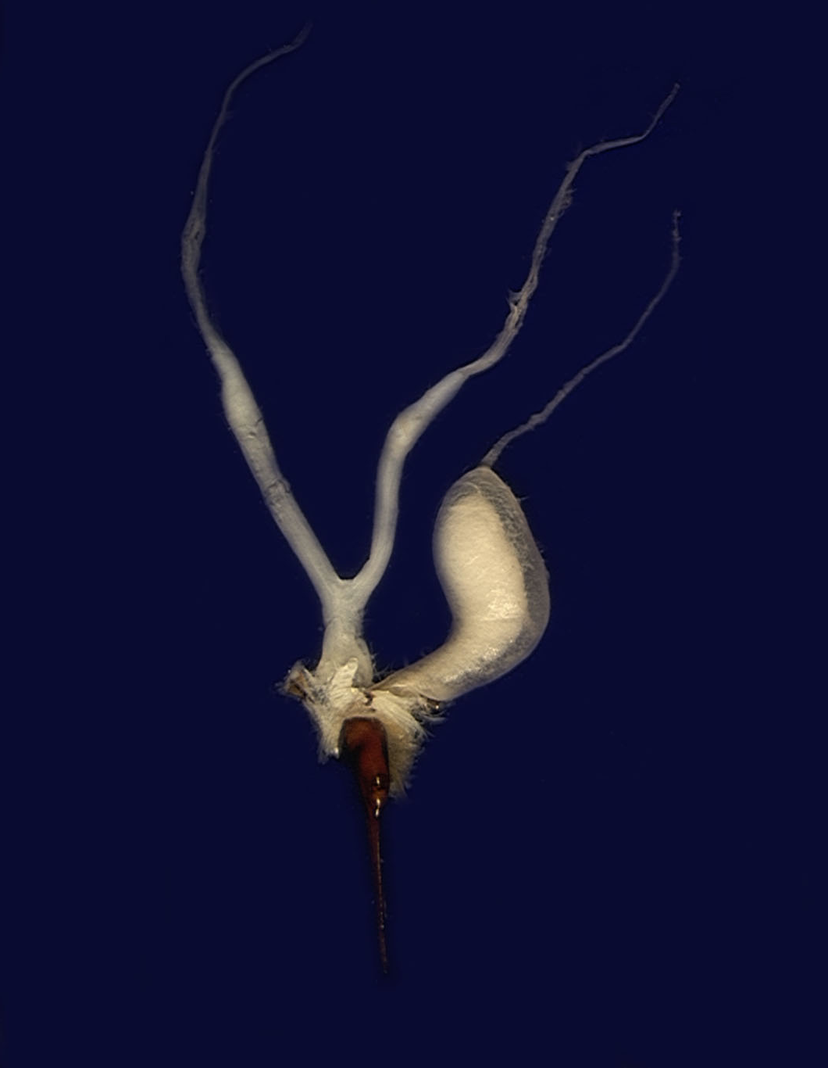
Paired Ovaries
Venom Gland
Lateral Oviduct
Venom Sac
Common Oviduct
Sting
Figure 2. Dissected worker reproductive system (Photo: M. Taylor)

Slide 26
The Drone

Slide 27
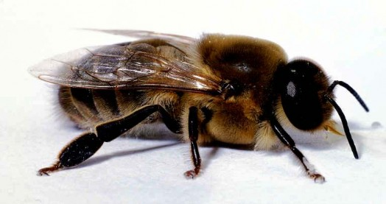
Male bees – only job is to mate with a virgin queen
No stinger, larger than workers, smaller than queen
No wax glands or any other helpful hive skills
In the fall, workers kick them out of the hive

Slide 28
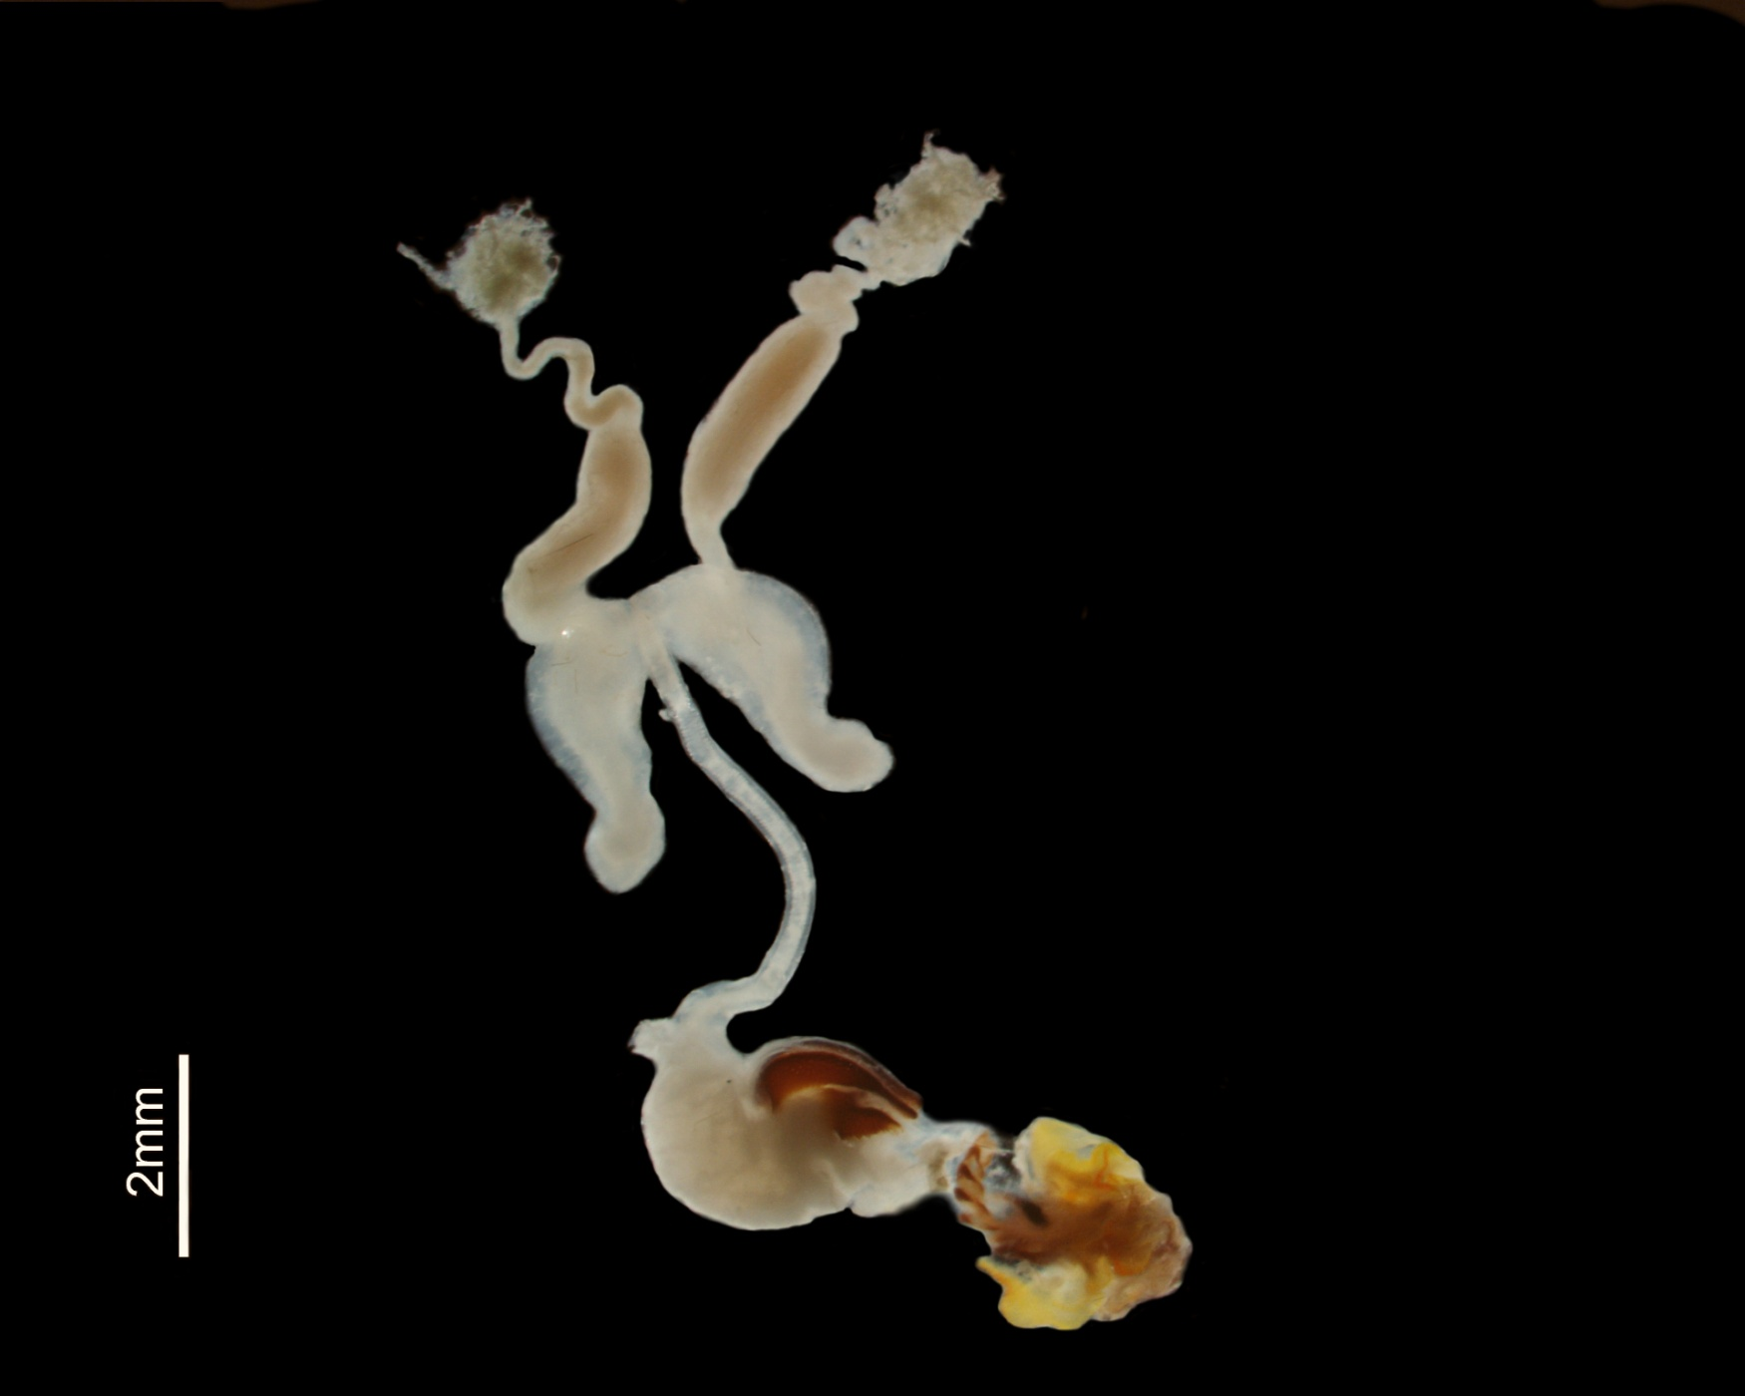
Remnants of Testis
Vas Deferen
Seminal Vesicle
Mucus Gland
Ejaculatory Duct
Bursal Cornua
Bulb
Endophallus
Cervix of Penis
Figure 4. Reproductive organs of a mature drone (Photo: M. Taylor).

Slide 29
The Worker

Slide 30
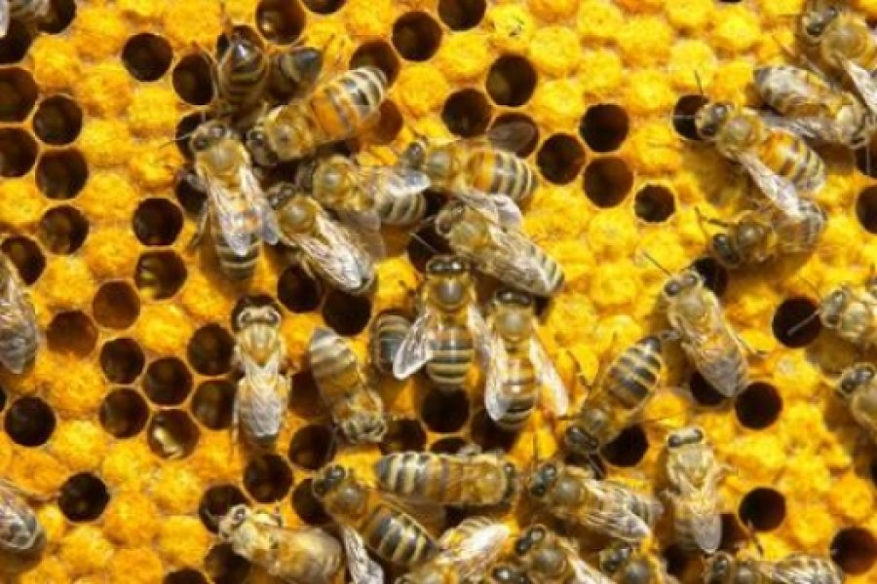
Female w/underdeveloped reproductive organs
Can lay eggs if hive dying, but produce only drones
Perform all tasks to maintain queen and colony
Clean hive
Gather and produce food (pollen & honey)
Make wax and build comb
Guard the hive
Feed brood, queen and drones

Slide 31
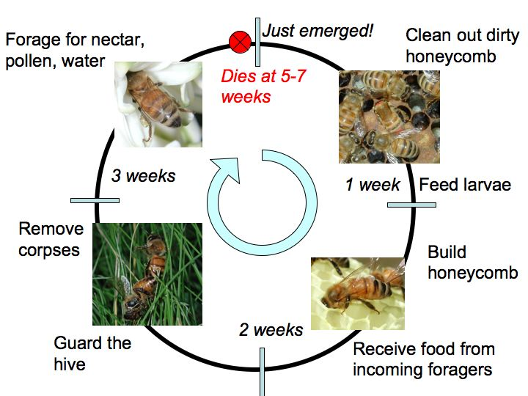
During summer, 60,000-80,000 bees reside in the hive

Slide 32
Honey Bee
Products

Slide 33
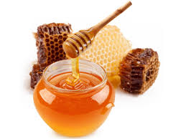
Honey
Made from plant nectar
Bees’ source of energy (carbohydrates)
<18% water

Slide 34
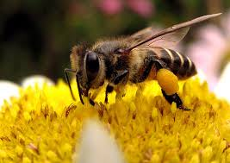
Pollen
Gathered by bees in pollen baskets – 30kg/yr
Bee protein
Needed for rearing brood

Slide 35
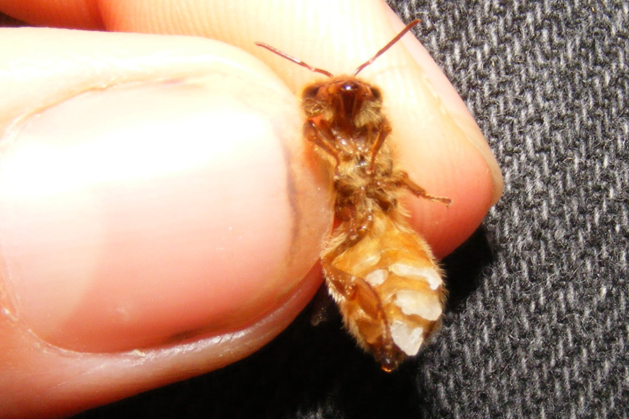
Bees Wax
Secreted from glands on abdomen
Requires 7-10 lbs of honey for 1 lb of wax

Slide 36
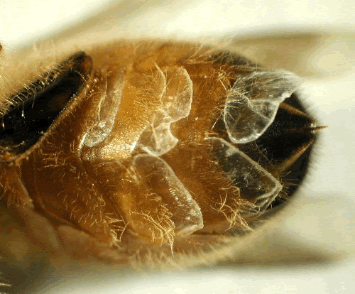

Slide 37
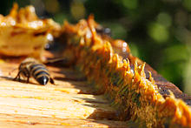
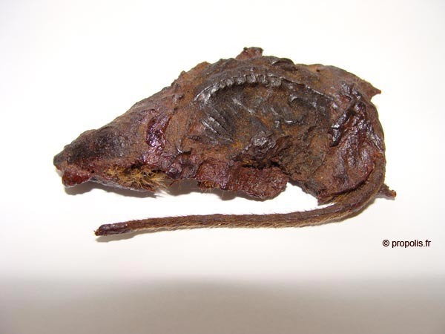
Propolis
aka bee glue
Made from pitch and old wax
Used to plug holes, reinforce frame, narrowing entrance or covering dead invaders
Anti-microbial properties

Slide 38
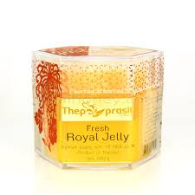
Royal Jelly
Secreted from gland on worker’s head
Fed to all larvae, but queen receives 20% more

Slide 39
Questions/Problems/Concerns Advice
Margo Buckles
509-280-3116
Margo.L.Buckles@gmail.com

