Slide 1
BEEKEEPING FOR THE SIDELINER

Slide 2
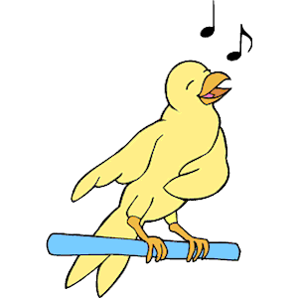
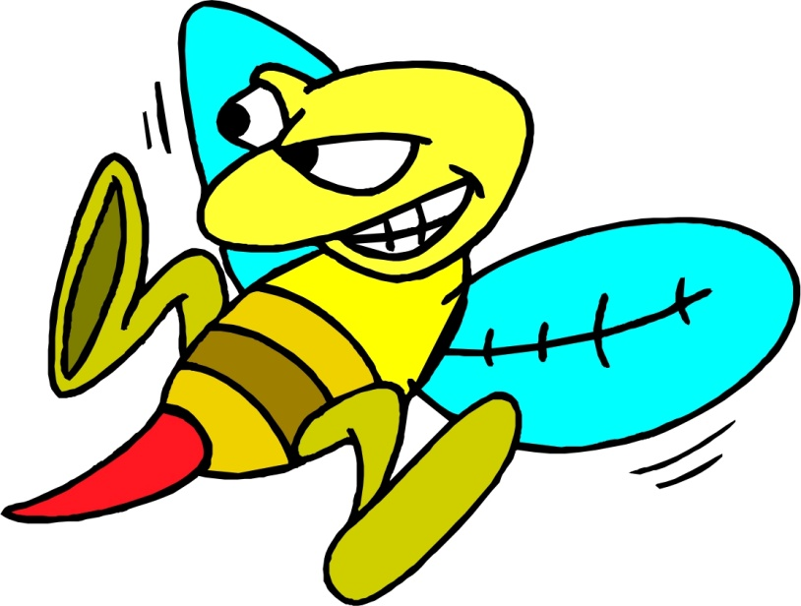
JUST A LOT OF B.S
BIRDS AND BEES
THE BIRDS Sing AND THE BEES Sting

Slide 3
BEE SPECIES
There are nearly 20,000 known species of bees in 7 to 9 recognized families.
Bees are one of the haplodiploid insects.

Slide 4
BEES AND THEIR SEX
QUEEN (FEMALE) –lays the eggs
WORKERS (FEMALE) do all the work
DRONES (Male) just hang around waiting
(So the queen determines the sex of the bees)

Slide 5
#1 - BEE STATISTICS
A GOOD HIVE CONSISTS OF ABOUT 10% DRONE COMB (with 60 to 80 thousand bees in it)
THE DRONES ONLY JOB IS TO MATE WITH A QUEEN
ONCE THIS JOB IS COMPLETED HE DIES
NOT MORE THAN ONE IN A THOUSAND DRONES GETS A CHANCE AT THIS TYPE OF SUICIDE!

Slide 6
#2 -BEE SAFETY
1.ALWAYS WEAR AT LEAST A VEIL WHEN WORKING WITH BEES. WEAR A BEE SUIT FOR GREATER PROTECTION.
2.WEAR GLOVES –ESPECIALLY IF YOU ARE ALLERGIC TO BEE STINGS.
3.ALWAYS CARRY A CELL PHONE WHEN WORKING WITH BEES.
4.MAKE YOUR BEE YARD’S COORDINATES KNOWN TO LOCAL EMT’S

Slide 7
# 2 (cont) - BEE SAFETY
5.ALWAYS CARRY AN EPIPEN; MAKE SURE IT IS IN CODE.
6.KNOW THE DIFFERENCES BETWEEN LOCAL AND SYSTEMIC REACTIONS SO YOU KNOW IF YOU NEED TO CONTACT EMERGENCY PERSONAL.
7. MAKE SURE SOMEONE KNOWS WHERE YOU ARE—OR TAKE A FRIEND WITH YOU.

Slide 8
# 3 - BEE SAFETY
ALWAYS CARRY AN EPIPEN

Slide 9
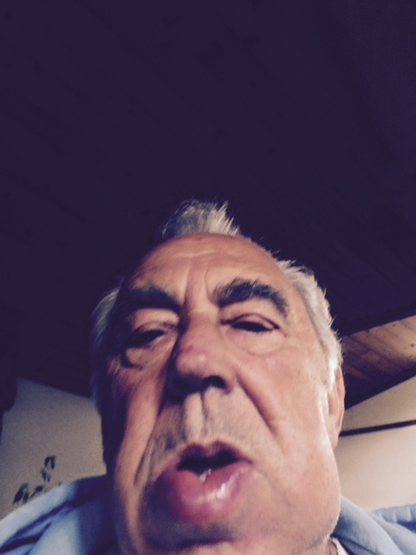
BEE STING
SYSTEMIC
OR LOCAL ?

Slide 10
# 4 - BEE STATISTICS
IN A BEE’S LIFE TIME, SHE GENERATES 1/12 OF A TEASPOON OF HONEY.
(therefore it takes 12 bees 6 weeks + or – to generate one teaspoon of honey).
So how many bees to generate one gallon of honey– you figure that one out.
IT TAKES 8 TO 12 POUNDS OF HONEY TO MAKE 1 POUND OF BEES WAX.
H2O CONTENT BY THE BEES IS 18%.

Slide 11
BEE SAFETY

Slide 12
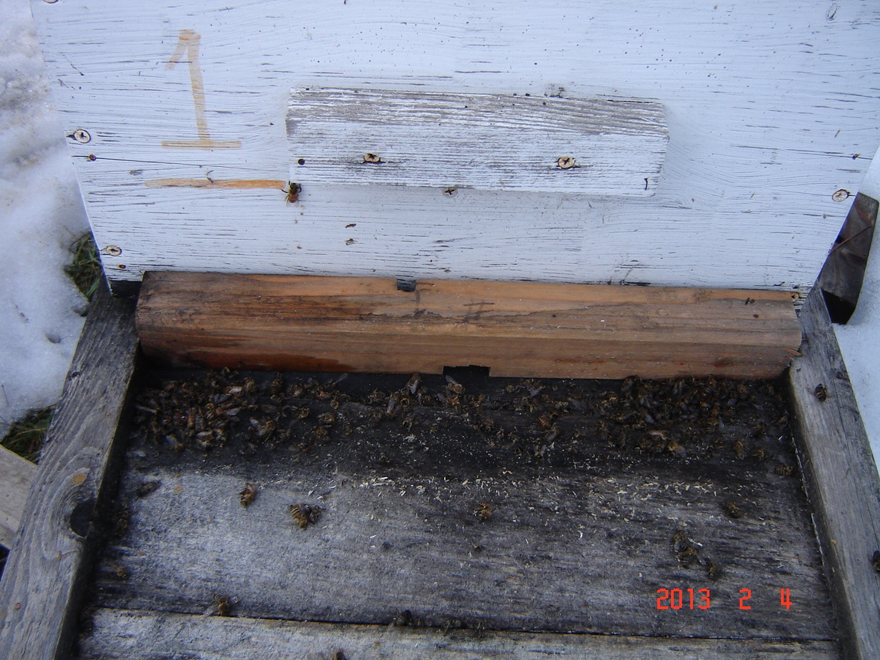
BEE SAFETY
BOTTOM BOARD BLOCKED WITH DEAD BEES

Slide 13
BEE SCREEN

Slide 14
BEE SAFETY PLUS BEE STUFF

Slide 15
BEE SAFETY

Slide 16
BEE FRAMES IN THE SUMMER

Slide 17
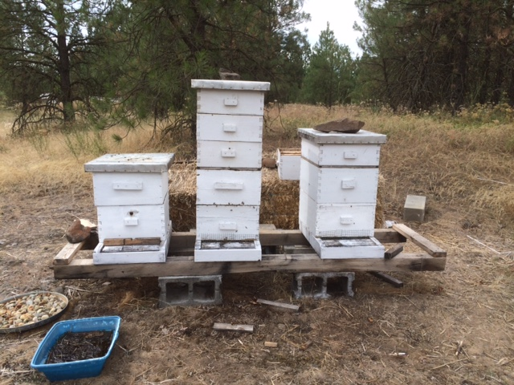
BALES OF STRAW
PICTURE

Slide 18
THIS IS BEE STUFF

Slide 19
BEE SOURCE

Slide 20
BEE STATISTIC # 4 (CONT )
48 tsp PER CUP
4 CUPS = 1 qt (4 X 48 = 192)
192 tsp in 1 qt
4 qts = 1 GALLON
4 X 192 = 768 tsp IN 1 GALLON
768 X 12 = 9,216 BEES

Slide 21
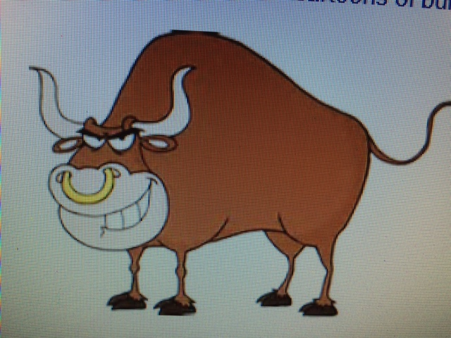
SUMMARY
BEEKEEPERS NEED TO KNOW A LOT OF B.S.!

Slide 22
CREDITS
TO MARILYN FOR ALWAYS TELLING ME THAT I’M FULL OF B.S.

