Slide 1

Introduction to Urban Beekeeping 2017
Notes:
1

Slide 2
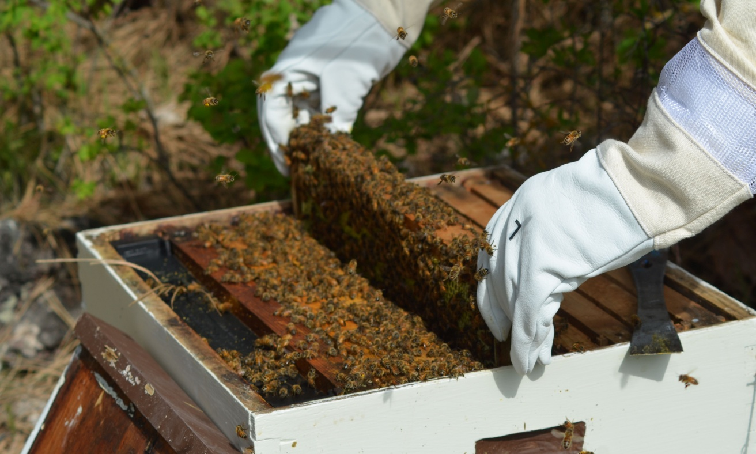
Why Keep Bees?
  Interesting Hobby
  Pollination
  Sustainability
  Help Bees
  Honey
Notes:
2

Slide 3
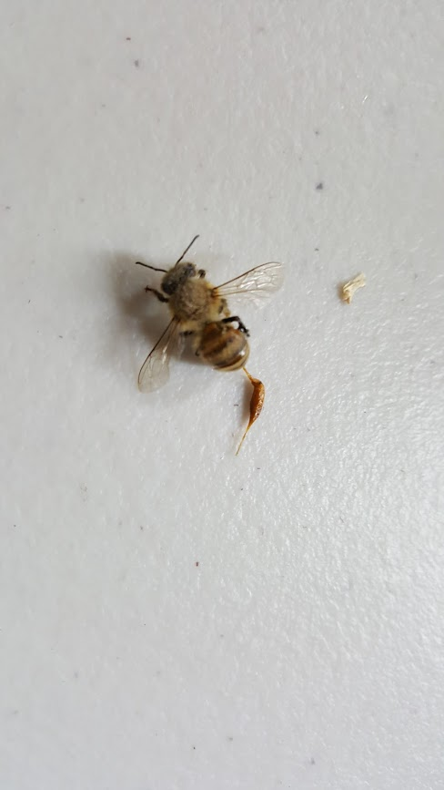
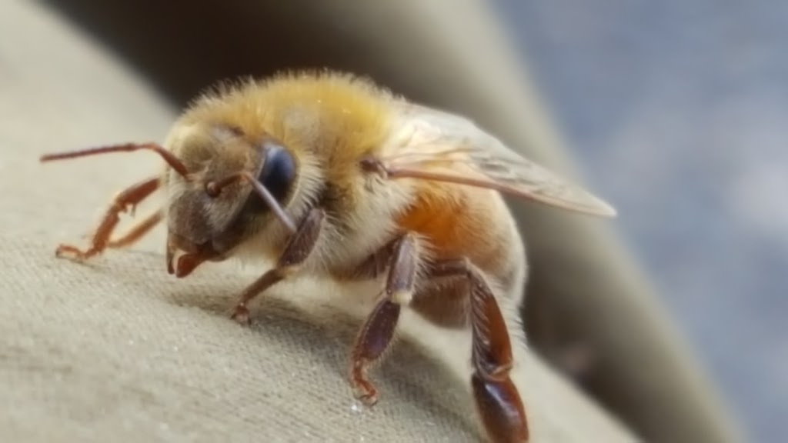
Why Not Keep Bees?
You will get stung
You will lose hives
There is work involved
There is a learning curve
Cost
Notes:
3

Slide 4

Before Committing: Things to Think About
Beekeeping Regulations
Time Commitment
Expense
Notes:
4

Slide 5

Beekeeping Regulations
Washington State – WAC 16-602-025 (apiary registration) 1-5 hives: $5.00; 6-25 hives: $10.00
*Spokane County (unincorporated areas) – see following
Airway Heights – not allowed
Cheney – no ordinance
Deer Park – no ordinance
Liberty Lake – no ordinance
Medical Lake – no ordinance
*Spokane City – see following
*Spokane Valley – see following
Notes:
5

Slide 6
Spokane County Ordinances:
4. Beekeeping (LDR, LDR-P, MDR, HDR zones)
a. Beekeeping is allowed as an accessory use on any lot or parcel occupied by a single family residence.
b. The keeping of bees shall meet the requirements of the Washington State Department of Agriculture RCW 15.60
or as hereafter amended.
c. The number of colonies allowed is limited to two (2) for the first 4,356 square feet of lot area, and one (1) for every
4,356 square feet of lot area thereafter. There is no limit on the number of Nucs/Nuclei.
d. Beehives shall be setback a minimum of twenty-five (25) feet from any abutting side or rear property line or public
right-of-way, except that beehives may be setback up to five (5) feet from any abutting side or rear property line
when the beekeeper establishes and maintains a flyway barrier as provided in section (e) below.
e. A flyway barrier shall be at least six (6) feet in height consisting of a solid wall, solid fencing material, dense vegetation
or combination thereof that is parallel to such side and/or rear property line(s) and extends beyond the beehive(s)
in each direction so that bees are forced to fly at an elevation of at least six (6) feet above ground level over the
property lines in the vicinity of the colony.
7. Beekeeping (LTA, STA, F zones)
a. Beekeeping is allowed as a primary or accessory use on any lot or parcel.
b. The keeping of bees shall be consistent with the requirements of the Washington State Department of Agriculture
RCW 15.60 RCW or as hereafter amended.
c. There is no limit to the number of beehives, colonies, or nucs allowed per lot.
d. Beehives shall be setback a minimum o twenty-five (25) feet from any public right-of-way, private road, or improved
shared access easement.
e. Beehives shall be setback a minimum of five (5) feet from any side or rear property lines and minimum of fifty (50) feet
from any adjacent residence.
f. In cases where, due to lot size, a fifty (50) foot setback from an adjacent residence is not possible, beehives shall be
centrally located on the lot to the greatest extent possible.
g. The requirements of (d) and (e) above are waived in regard to any side of the property adjacent to a parcel not used for
residential purposes.

Slide 7
Spokane
Spokane Municipal Code
Title 17C Land Use Standards
Chapter 17C.310 Animal Keeping
  Section 17C.310.130 Beekeeping
    Where Permitted.
    Beekeeping is allowed as an accessory use on any lot occupied by a single-family residence that is in the RA, RSF, RTF, RMF and RHD zones. Beekeeping for educational or research purposes by an institution such as college, high school or agricultural extension office is allowed as a Type II conditional use permit in all zones, subject to the requirements of subsection (B)(1) through (5) below.
    Standards Applicable to Beekeeping.
    Beekeeping is subject to the following standards:
      Location, Density and Maintenance of Colonies.
        The number of colonies is limited to one colony per four thousand three hundred fifty square feet of lot area, up to a maximum of eight colonies; and
        Colonies shall be setback a minimum of twenty-five feet of any property line, except that a colony may be situated within ten feet of a side lot line or rear lot line provided the following provisions are met:
        The beehives are isolated from public access by a security fence as required under SMC 17C.110.230(F); and
        The beekeeper establishes and maintains a flyway barrier at least six feet in height consisting of a solid wall, solid fencing material, dense vegetation or combination thereof that is parallel to the property line and extends ten feet beyond the colony in each direction so that all bees are forced to fly at an elevation of at least six feet above ground level over the property lines in the vicinity of the colony; or
        The colony is situated ten feet or more above the grade of the nearest adjoining property line.
      Colonies shall be maintained in movable-frame hives with adequate space and management techniques to prevent overcrowding and swarming.
      In any instance in which a colony exhibits aggressive or swarming behavior, the beekeeper must ensure that the colony is re-queened. Aggressive behavior is any instance in which unusual aggressive characteristics such as stinging or attacking without provocation occurs.
      Every beekeeper shall maintain an adequate supply of water for bees located close to each colony.
      Registrations and Training.
        All colonies shall be registered with the director of the state department of agriculture pursuant to RCW 15.60.021 no later than April 1st of each year.
        The beekeeper shall have completed the requirements for apprenticeship level of the Washington State Beekeeper’s Association master beekeeper certification program.
  Date Passed: Monday, September 24, 2007
  ORD C34109 Section 4

Slide 8
Spokane Valley Municipal Code
19.40.150 Animal raising and keeping
Where permitted, the keeping of poultry and livestock (excluding swine and chickens) is subject to the following conditions:
A. Minimum Lot Requirements.
1. In residential zones, the lot or tract must exceed 40,000 square feet;
2. In mixed-use zones, on lots or tracts with legally established residential uses that exceed 40,000 square feet;
B. The keeping of swine is not permitted;
C. Beekeeping for noncommercial purposes is limited to 25 hives
D. …..

Slide 9
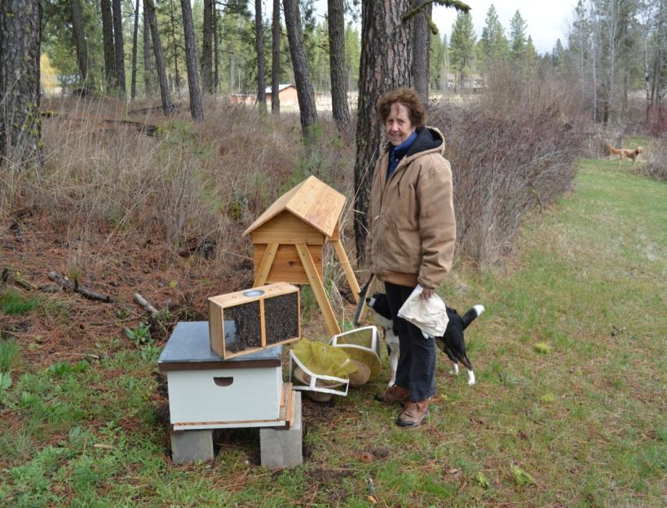
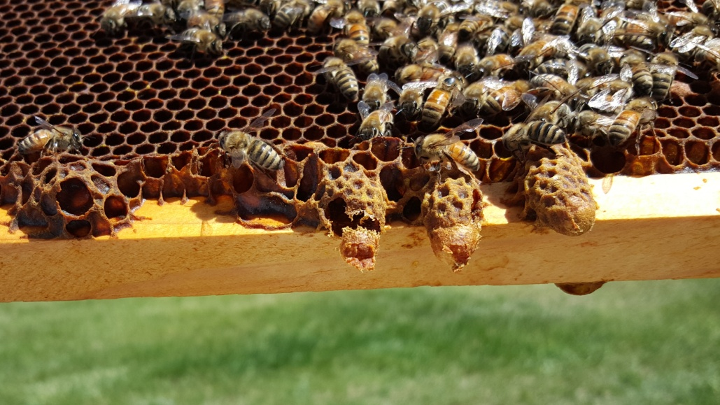
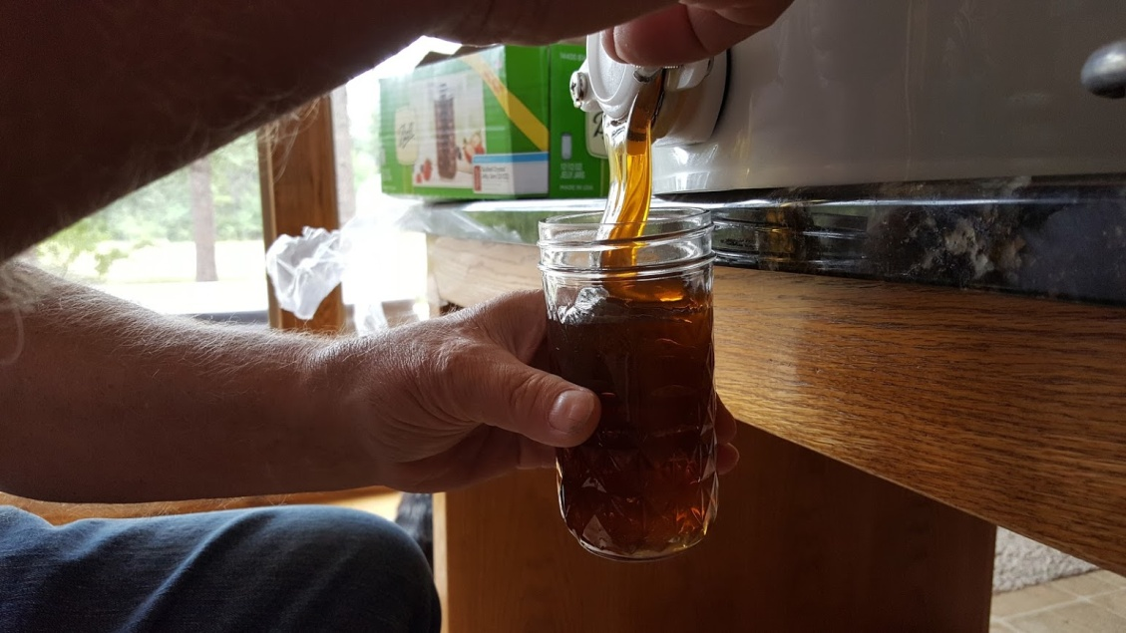
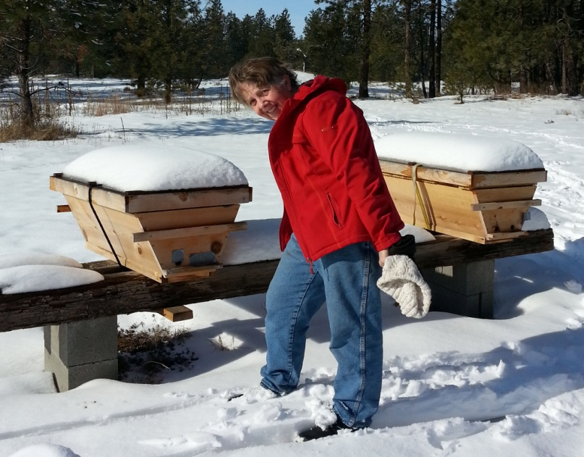
Time Commitment
April Spring - Summer
August - September Winter - Spring
Notes:
9

Slide 10
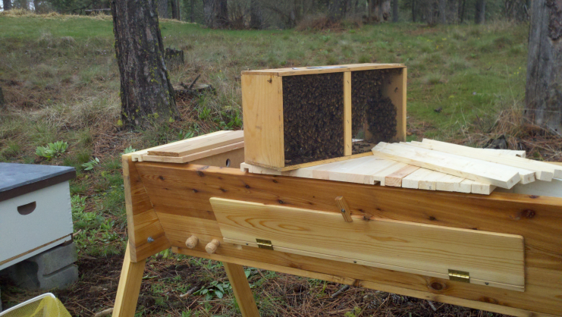
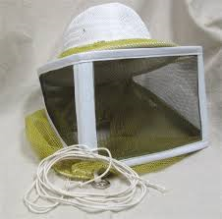
Expenses
Bees
Equipment
Protective Clothing

Slide 11
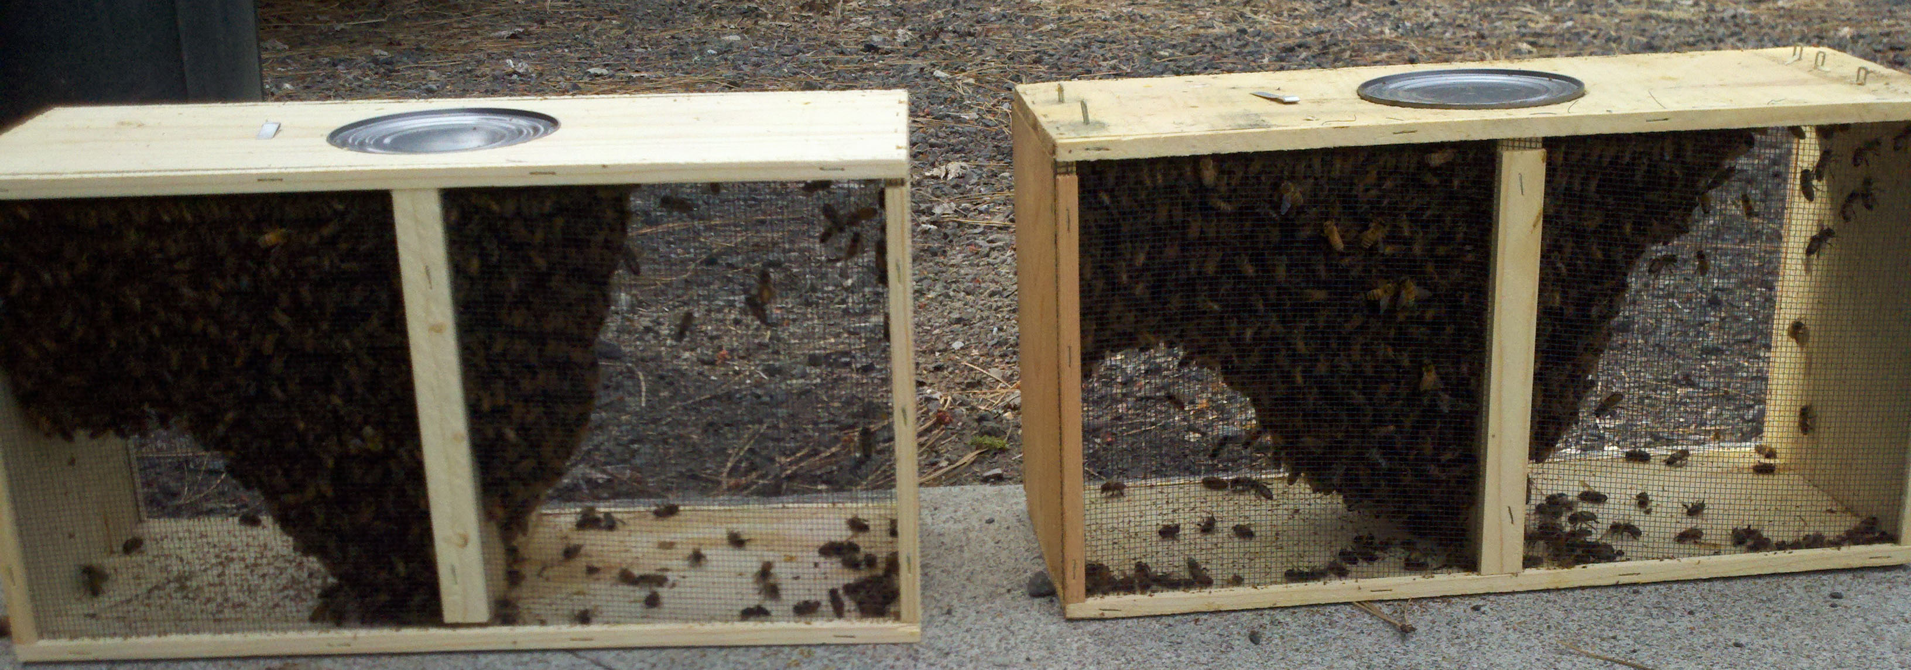
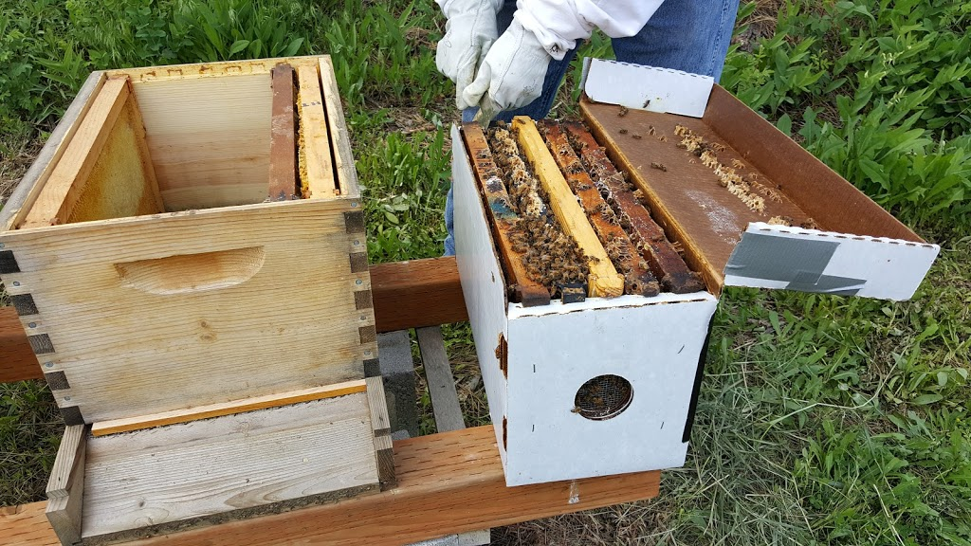
Honeybees
Kinds
    Carniolan
    Caucasian
    Italian
Options
    3 lb. Package
    Nucs
Notes:
11
Carniolan: Dark bees with gray hair, mild, medium honey producers, over winter okay, begin brood rearing later in spring. Caucasian: Dark with gray hair, slightly smaller than Carniolans, gentle, over winter well, use more propolis. Italians: yellow, good honey producers, consume more stores over winter

Slide 12
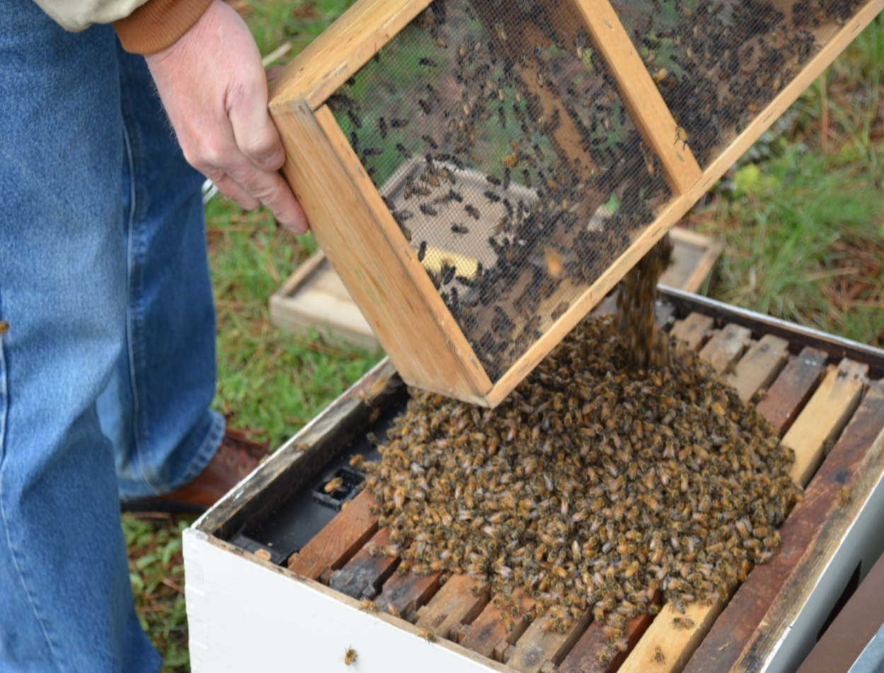
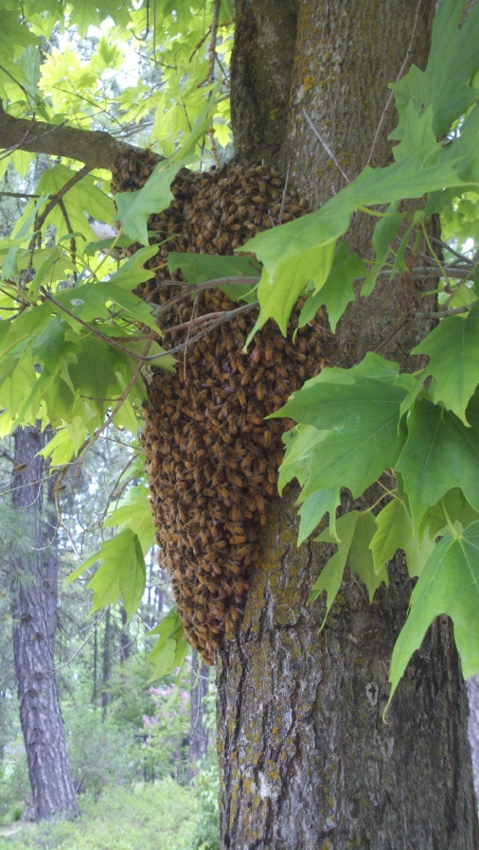
Where to get them
  Local Suppliers
    BeeManiacs info@beemaniacs.com
    Miller’s Homestead 509-299-9085
    Tate’s Honey Farm 509-924-6669
  Swarms

Slide 13
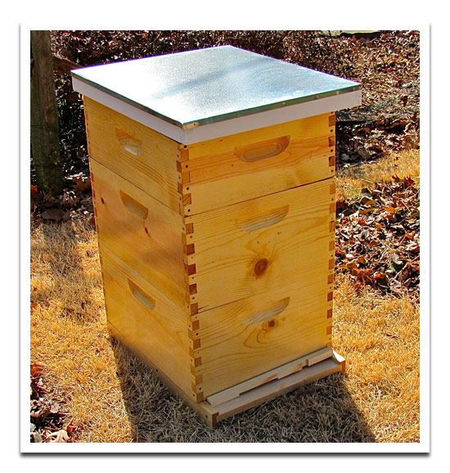
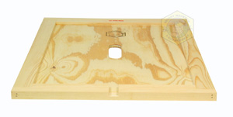
Equipment
      Hive bodies
      Supers
      Bottom Boards
      Telescoping Covers
      Inner Covers
Notes:
13

Slide 14
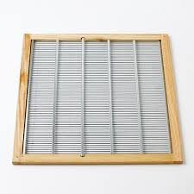
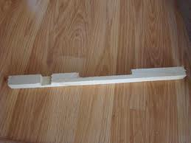
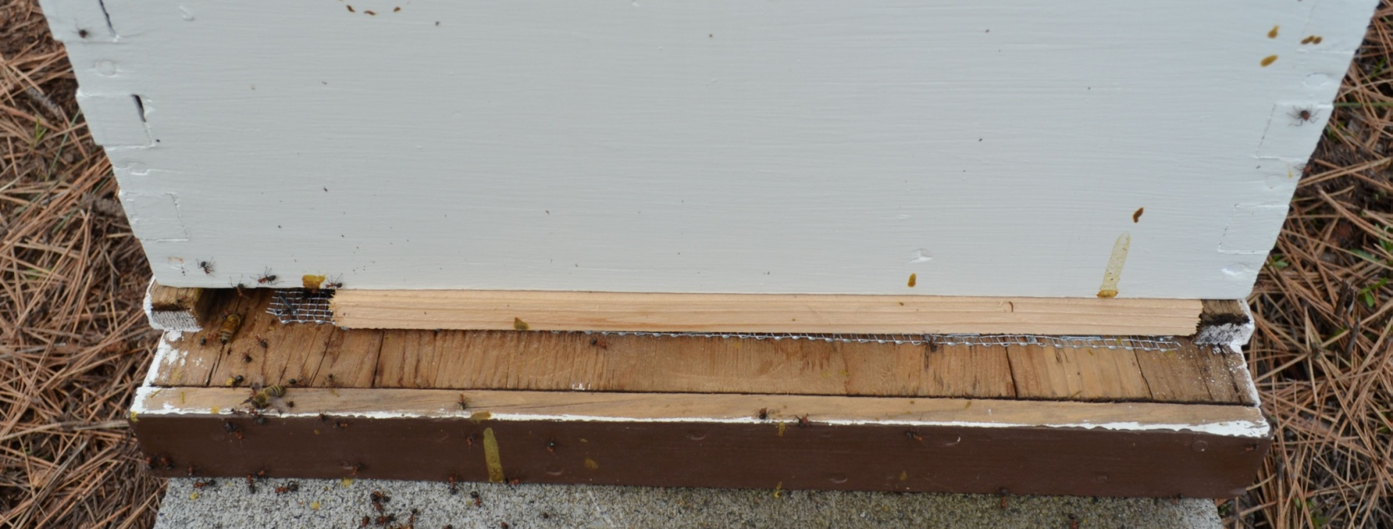
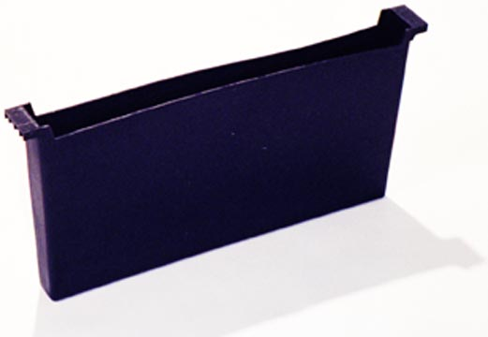
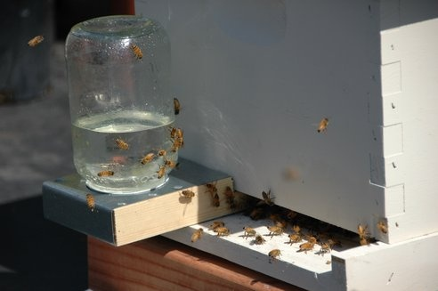
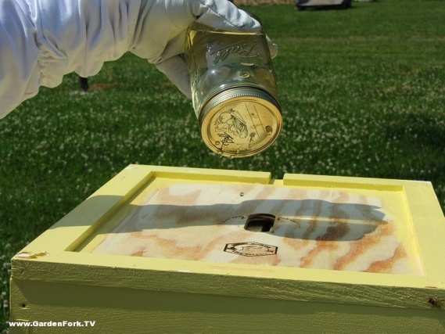
Hive Equipment (cont.)
      Queen Excluders
      Entrance Restrictors
      Feeders

Slide 15
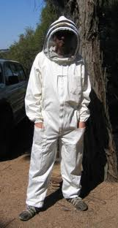
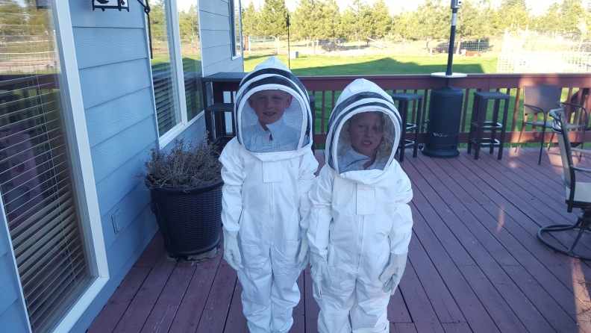
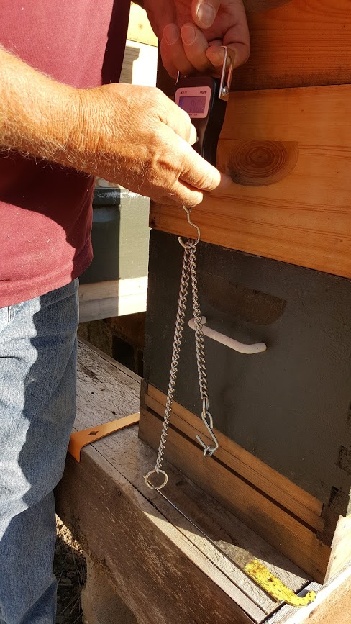
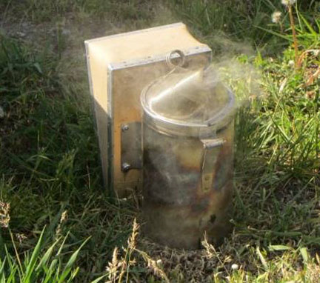
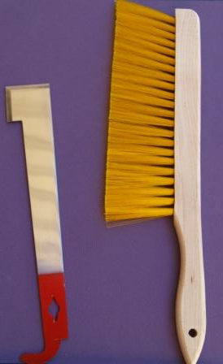
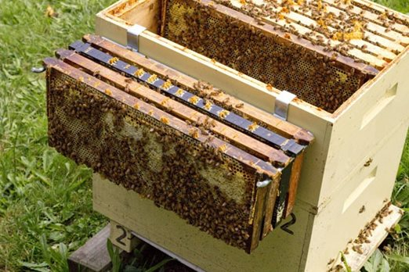
Protective Clothing and Tools
Hats, Veils, Suits, Gloves
Hive Tool, Bee Brush, Frame Hanger, Scale, Smoker

Slide 16
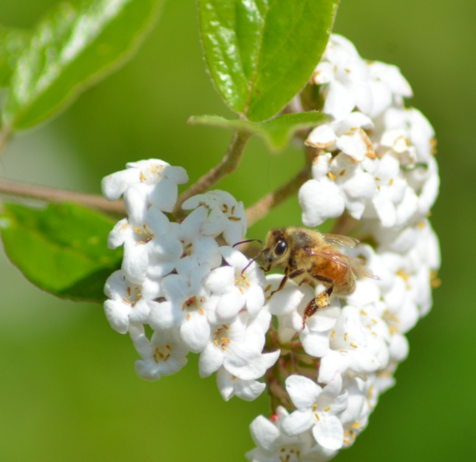
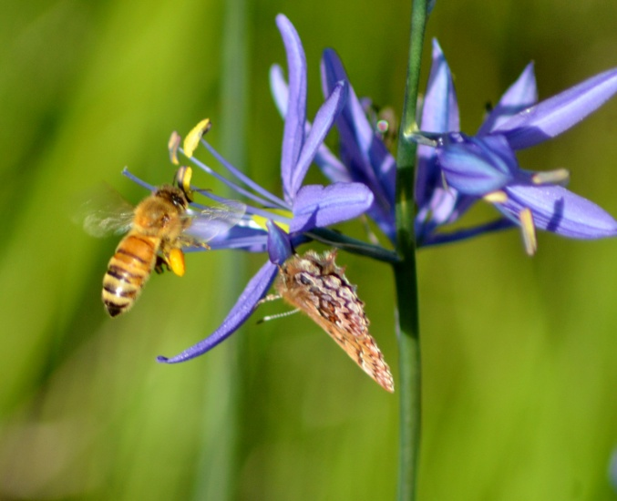
Resources
Bee Associations
Backyard Beekeepers
Inland Empire Beekeepers
West Plains Beekeepers
Washington State Beekeepers
Your Library
The Web
Notes:
16

Slide 17
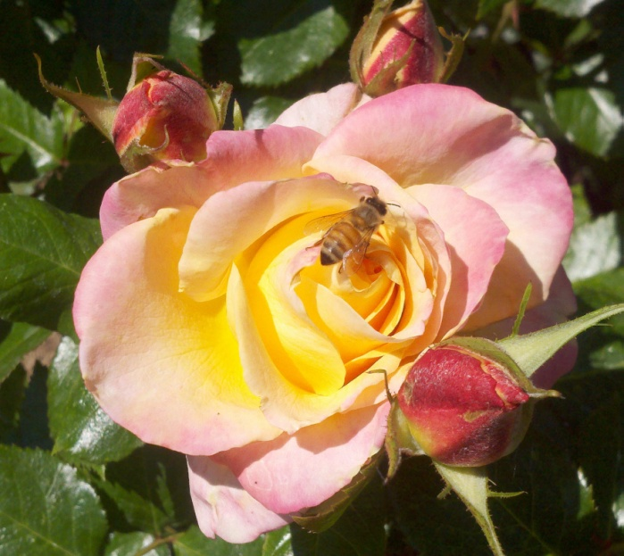
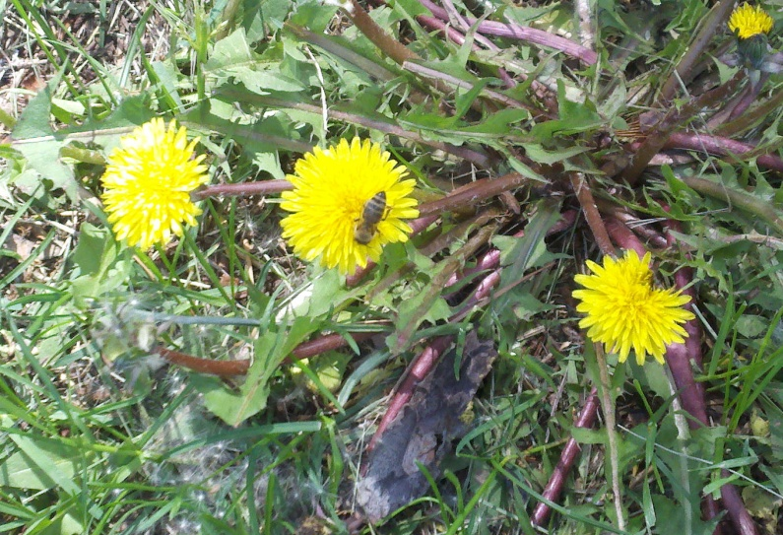
Recommended Books
Re
Backyard Beekeeper – Revised and Updated: an Absolute Beginner’s Guide to Keeping Bees in Your Yard and Garden, by Kim Flottum, 2010.
Beekeeping for Dummies, by Howland Blackiston, 2015.

Slide 18
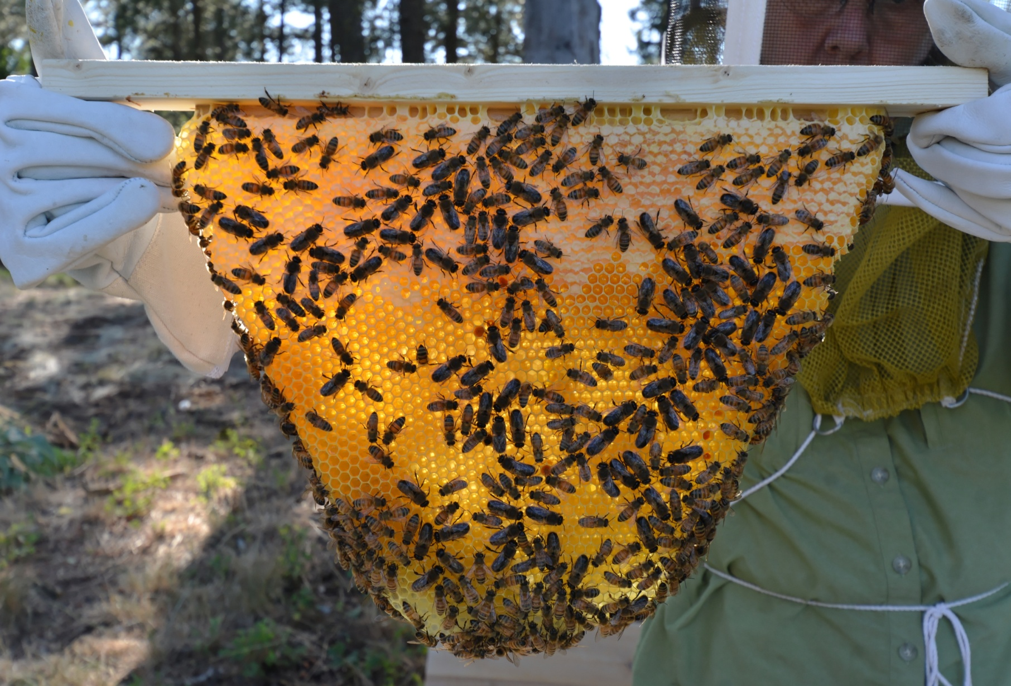
Summary

