Slide 1
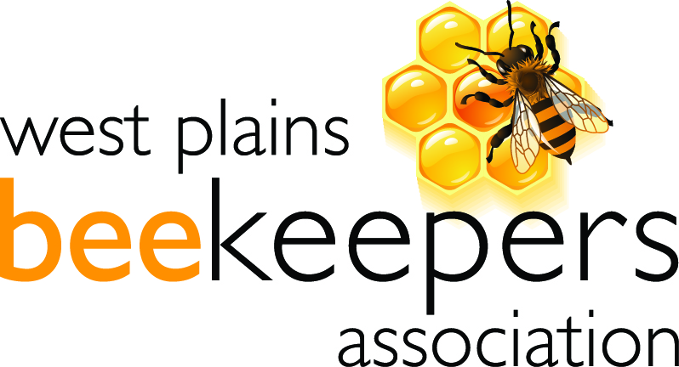
Honeybee Communications:
Dancing Bees

Slide 2
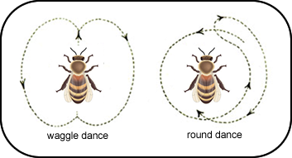
Dance Communication - Introduction
Kinds of Dances
  Round Dance
  Wagtail Dance
  Sickle Dance
  Where to Live Dance
Dialects
  Carniolan
  Italian

Slide 3
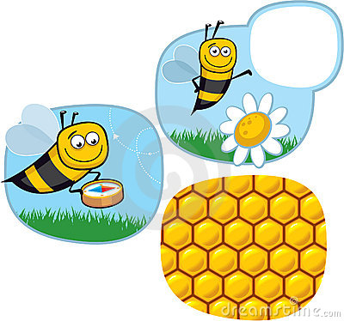
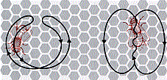
The Round Dance
Carniolan Dialect
  Food or Water
  <80 meters
  Several seconds to a minute
  Various places on the comb
  Liveliness -> Source Richness
  Samples

Slide 4
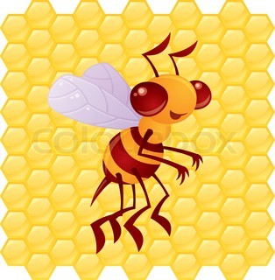
Wagtail Dance
Carniolan Dialect
Food or Water
>80 meters
Fuel to Source
Direction to Source
Samples
Profitability of Source

Slide 5
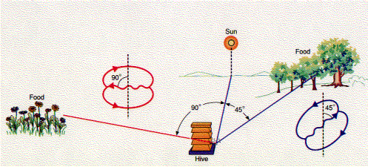
Waggle Dance

Slide 6
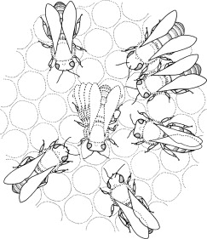
Wagtail Dance
Carniolan Dialect (cont.)
The energy (fuel) needed to reach the source is a function of the length of time a 250Hz sound is produced during the waggle.
  Flight conditions such as head or tail winds are accounted for
A second is very roughly 1000 meters
Note: Root talks about turns in a 15 second period correlated to distance.

Slide 7
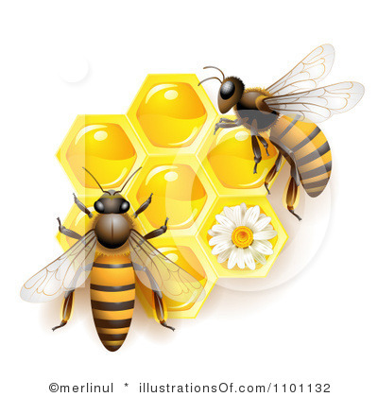
Wagtail Dance
Carniolan Dialect (cont.)
The direction to the food source is the straight line direction in relation to the sun, even if a obstacle prevents straight line flight.
A waggle straight up the comb is a direction straight toward the sun and a waggle down the comb is a direction away from the sun.
A waggle 30 degrees to the left of vertical is a direction 30 degrees to the left of the sun.

Slide 8
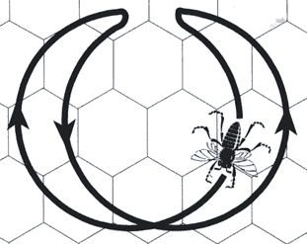
Sickle Dance
Italian Dialect
Food or Water
Transition between Round and Wagtail Dance
  At 10 meters it resembles a Round Dance
  At 30 meters it resembles a Wagtail Dance

Slide 9
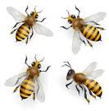
Nuances
The more scout bees are dancing and the more often they dance is related to the quality (high sugar content) and quantity of the source.
The dancing changes as the nectar supply changes.

Slide 10
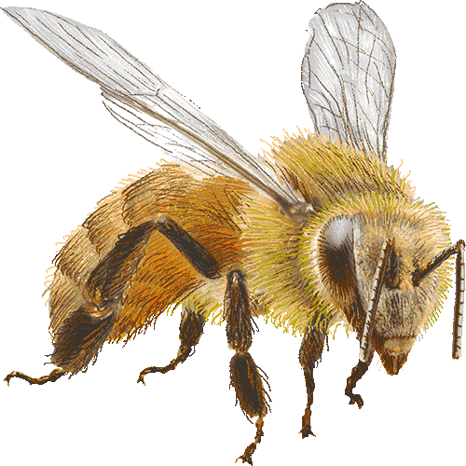
Dialect Differences
Carniolan bees do not do a Sickle Dance but change to the Wagtail Dance at about 90 meters.
Italian and Caucasian bees change to the Wagtail Dance at about 40 meters
The races use the same direction language but distance is wrongly interpreted.

Slide 11
Dialect Differences (cont.)
Species Differ in Language
Apis Cerana (Eastern Honey Bee) uses the Round Dance up 3 meters and the rhythm is much slower
Apis dorsata (Giant Honey Bee) is closer to mellifera and uses the Round Dance up to 4 or 5 meters.
Apis Florea (Dwarf Bee) Dances horizontally on the landing place with a slow rhythm.

Slide 12
Dialect Differences (cont.)
Distance in Meters Comparison
Race Round Sickle Wagtail
Carniolan 0-80 None 80-90
Italian 0-6 6-8 34-36
German 0-20 20 64-66
Caucasian 0-10 10 35
Egyptian 0-5 5 10-12

Slide 13
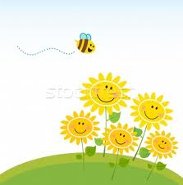
Directional Dance Accuracy
Von Frisch Fan Experiment
24
8
2
3
3
0
0
Sources at 200 m and 15 degrees apart

Slide 14

Distance Dance Accuracy
Von Frisch Step Experiment
4 0 5 17 F 30 12 2 0 2
500m 750m 1000m 1500m 2000m 2500m
Food source at 750 m

Slide 15
Von Frisch Arguments
As food is shifted from 2 to 100 meters and from Round to Wagtail Dance the accuracy of finding food improved.
When the sun’s position is blocked searching for food is random as is the direction of the Wagtail Dance.
Detour experiments show that when a scout goes around an obstacle she supplies information on the direct path and recruits initially fly direct.
If an experiment forces bees to walk to a food source the dancing gives information on energy expended.

Slide 16
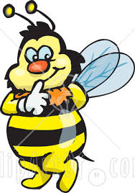
Deciding Where to Live
Factors
10 Gal in volume
>= 15 ft off the ground,
narrow defensible opening
Seeley set up five boxes of different sizes. Four of the boxes were mediocre while one was a dream home. In 80 percent of the trials, the swarms chose the dream home.

Slide 17
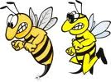
Decision Making
Principles honeybees use to make decisions
Enthusiasm - A scout coming back from an ideal cavity will dance with passion, making 200 circuits or more and waggling violently all the way. But if she inspects a mediocre cavity, she will dance fewer circuits.
Attention - Enthusiasm translates into attention. An enthusiastic scout will inspire more bees to go check out her site. And when the second-wave scouts return, they persuade more scouts to investigate the better site.

Slide 18
Decision Making (cont.)
Principles honeybees use to make decisions
Flexibility. Once a scout finds a site, she travels back and forth from site to hive. Each time she returns, she dances to win over other scouts. But the number of dance repetitions declines, until she stops dancing altogether. Seeley and his colleagues found that honeybees that visit good sites keep dancing for more trips than honeybees from mediocre ones.
This decaying dance allows a swarm to avoid getting stuck in a bad decision. Even when a mediocre site has attracted a lot of scouts, a single scout returning from a better one can cause the hive to change its collective mind.

Slide 19
Decision Making (cont.)
The Quorum
Scouts purposefully ram one another head-on while deciding on a new nest location. They head-butt scouts coming from other locations causing the rammed bee to stop dancing. As more scouts dance for a popular site, they drive down the number of dancers for other sites.
Once the scouts reach a quorum of 15 bees all dancing for the same location, they start to head-butt one another, silencing their own side so that the swarm can prepare to fly.

Slide 20

Questions?

Slide 21
Bibliography
ABC and XYZ of Bee Culture by A.I. Root
Honey Bee Biology and Beekeeping by Dewey M. Caron
Honeybee Democracy by Thomas D. Seeley

