Slide 1
FOULBROOD melissococcus plutonius
European

Slide 2
What is European Foulbrood?
European Foulbrood is a bacterial disease that effects Honeybee larvae before it is capped.
First identified by GF White in 1908

Slide 3
Causes
European Foulbrood is mainly due to poor nutrition.
Monoculture crops as seen with commercial pollination crops such as almonds, blueberries and cranberries.
Or the lack of adequate floral sources at certain seasons, such as spring, accompanied by cool damp weather along with the stress that these seasonal changes bring.

Slide 4
How it perpetuates
The disease is passed by infected bees that feed, nurse and care for the young newly hatched larvae.
The bacterium in concentrated and grows in the mid-gut of the nurse bee.
Varroa Destructor may be a vector of EFB by feeding on the bee.
Honey stores??? Honey stores can be infected. Safe for human consumption though should not be shared with other colonies

Slide 5
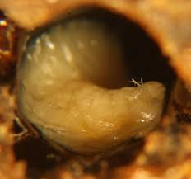
How to Identify
The dead and dying larvae turn and curl upwards.

Slide 6
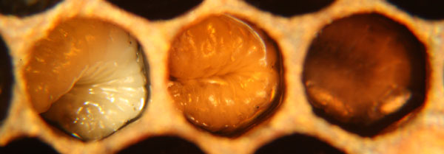
How to Identify
The color varies from white yellow, orangey yellow to brown with a dried out rubbery look.

Slide 7
Natural Progression
The larvae soon dies if the bacteria grows faster than the floral sources grow and provide acquit food nutrition. Generally a mid season honey flow corrects the problem.
The good news is that Honeybees can outrun EFB if their food source is abundant and solid enough
One complication of a nectar flow in the spring is the change of rank that occurs. It creates an imbalance in the ratio of forage, house and nurse bees. There are more larvae than enough nurse bees to care for them. Later in the season when the ratio equalizes and remains stable and the nutrition levels improve the symptoms tend to disappear.

Slide 8
Natural Progression continued
However in sever cases European Foul brood does not always clear up and go away, and colony death may soon follow.
Yearly reoccurrences have been seen due to infected comb. The bacterium stays in the wax and the old brood comb from prior bees that have pupated.
Larva that go onto survive EFB poo and then pupate leaving behind a contaminated comb for many years
Surviving infected larva have a lower weight and take longer to pupate and emerge

Slide 9
Treatment
Treatment is Not always necessary
Chemical control- Oxytetracycline HCl
Soluable powder- Trade name Terramycin
Only approved control available today
Method of Delivery: Powdered cane sugar dry sprinkled across the top of the brood box

Slide 10
Treatments continued
Shook Swarm Technique in conjunction with antibiotics into new equipment
Re-Queen- break in brood cycle
To burn or not to burn

Slide 11
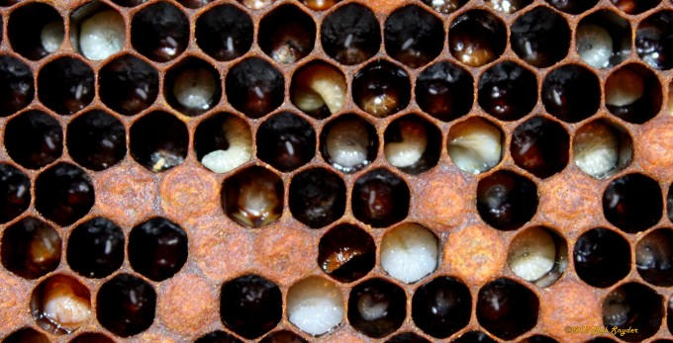
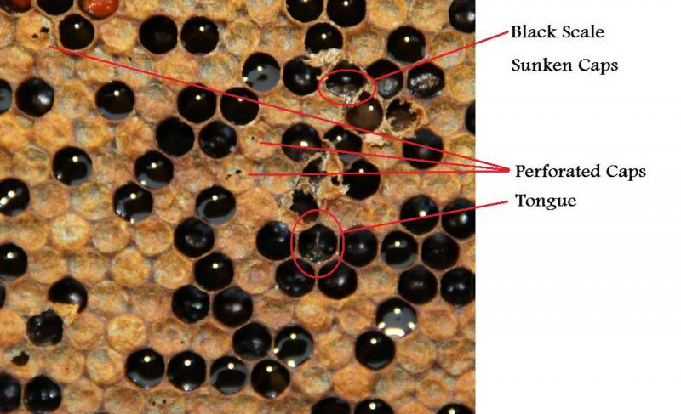
Identification: European vs. American Foulbrood
European Foulbrood | American Foulbrood
Can be slightly ropey with threads less than 1.5 cm, but usefully not ropey | Coffee color, ropey with fine thread about 2.5 cm
Odor: sour or none | Odor: sulfurous, "Chicken house"
Scale: brown to black; rubbery | Scale: brown to black; brittle
Stage of Brood: Before capped | Stage of Brood: After capped
Appearance: twisted, dull to yellow to dark brown, tracheal tubes often visible | Appearance: chocolate brown to black perforated cappings

Slide 12
American Foulbrood
AFB spores can remain alive up to 40 years
Chemical Treatment Controversial
Only cure for AFB is to burn bees in hive in its entirety and bury

Slide 13
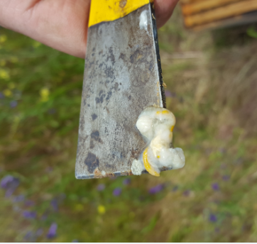
Images from Suspect Colony

Slide 14
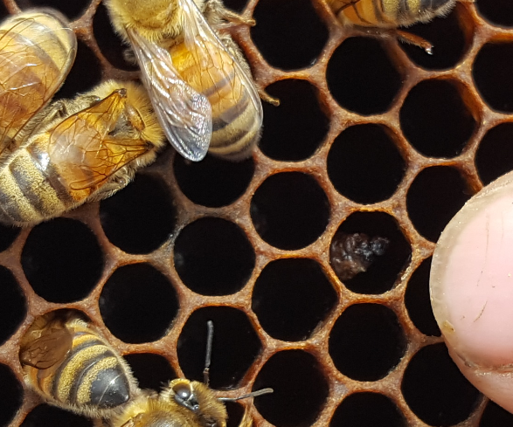
Images from Suspect Colony

Slide 15
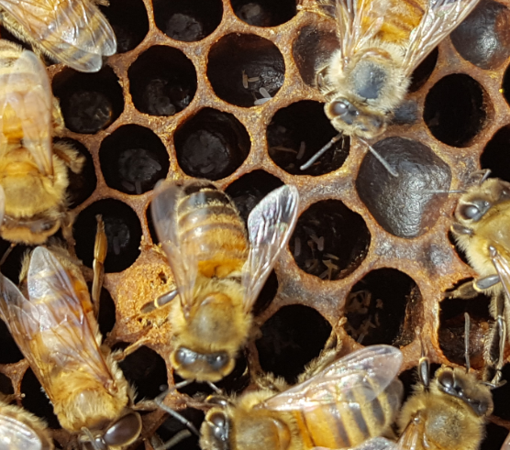
Images from Suspect Colony

Slide 16
Images from Suspect Colony

Slide 17
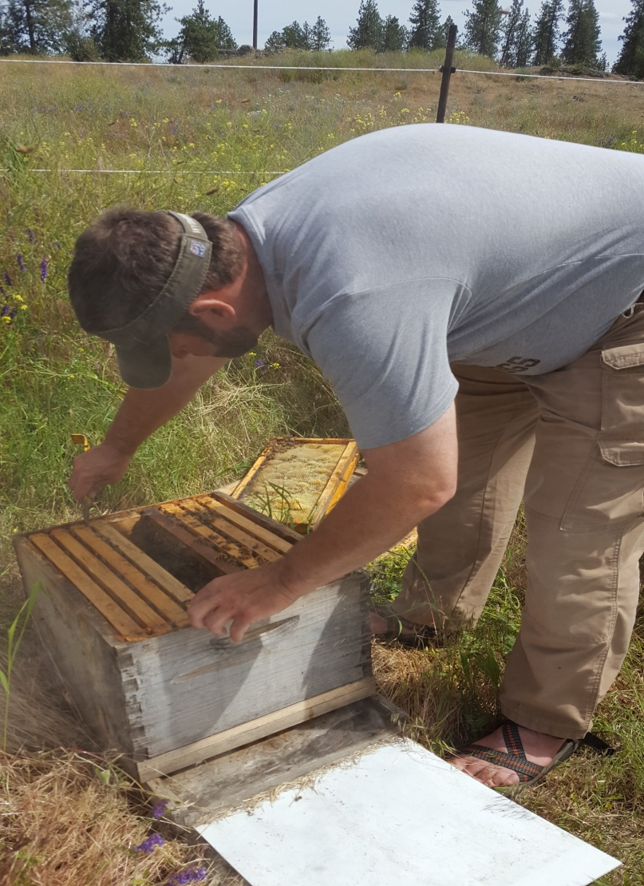
Questions
Questions and Comments
Thank you!

