Slide 1
Honeybees and Flowers: Photos from West Plains Area of Eastern Washington
Marilyn Geiger and Ellen Miller
January 2016

Slide 2
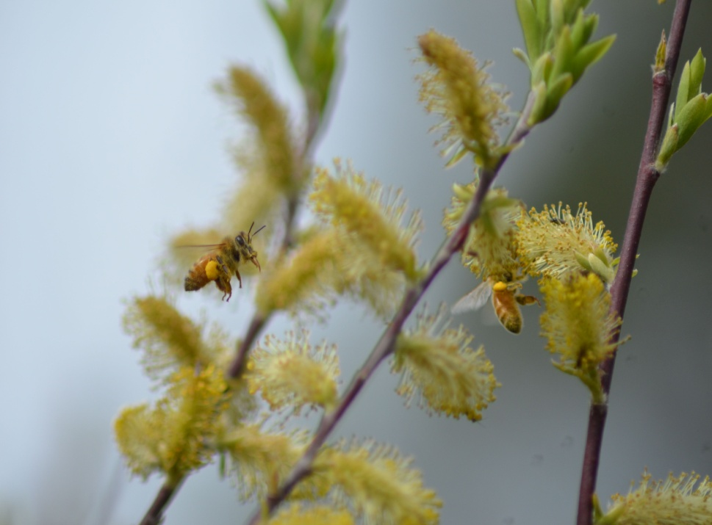
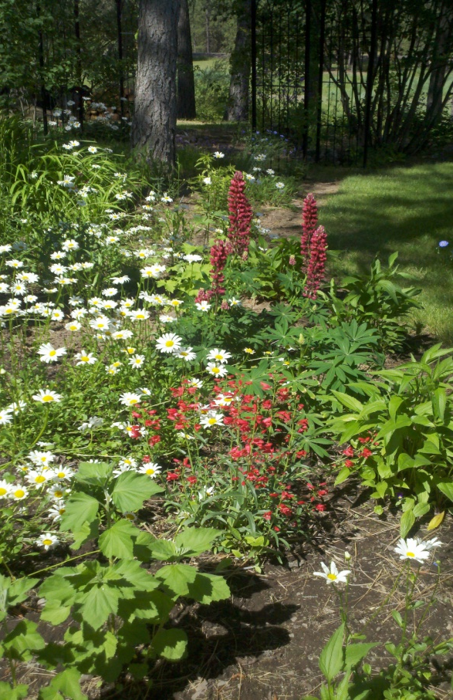
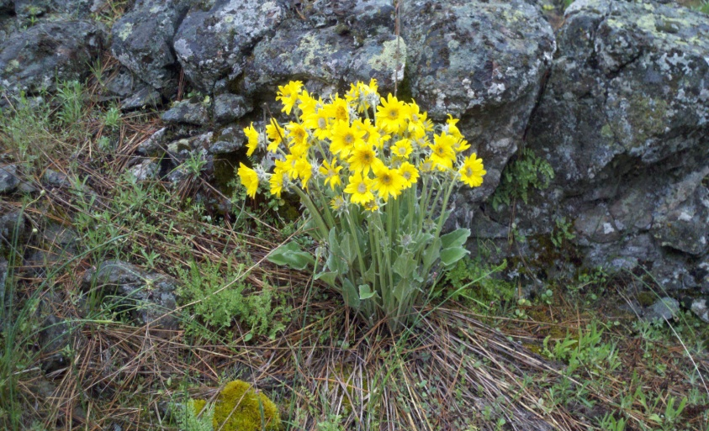
Honeybees and Flowers
Goal: Through photographs, identify native and domestic flowers in the West Plains area frequented by honeybees.
Notes:
Photos by Jack Miller and Ellen Miller

Slide 3
Native Plants: March - April
Salt and Pepper
Notes:
Sometimes in late February. Haven’t gotten a photo of a honeybee on a buttercup yet.
Photos by Ellen Miller

Slide 4
Native Plants: March - April
Grass Widow
Notes:
Photo by Ellen Miller

Slide 5
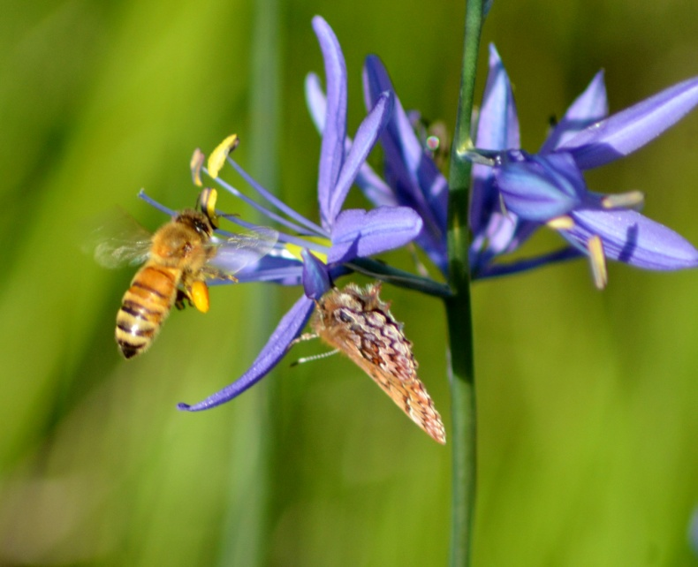
Native Plants: April - May
Camas
Arrow Leaf Balsam Root
Notes:
Note both nectar and pollen gathering on the Camas
Photos by Ellen Miller

Slide 6
Native Plants: April - May
Rooster Head/Shooting Star
Notes:
Photos by Ellen Miller

Slide 7
Native Plants: April - May
Large Fruited Biscuit Root
Notes:
Photo by Ellen Miller

Slide 8
Native Plants: April - May
Pussy Willow
Notes:
Native pussy willow are a great source of early pollen
Photos by Ellen Miller

Slide 9
Native Plants: April - May
Red Twig Dogwood
Notes:
Note the heavy pollen bags
Photos by Ellen Miller

Slide 10
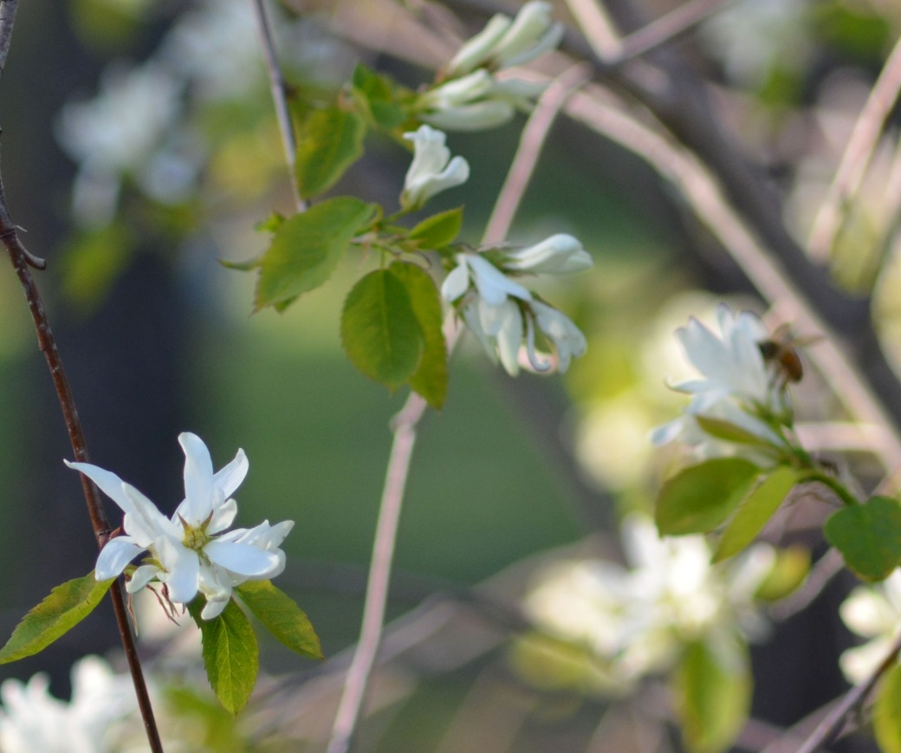
Native Plants: April - May
Mock Orange
Oregon Sunshine/Wooly Sunflower
Notes:
Mock Orange sometimes known as Syringa
Photos by Diane Stutzman and Ellen Miller

Slide 11
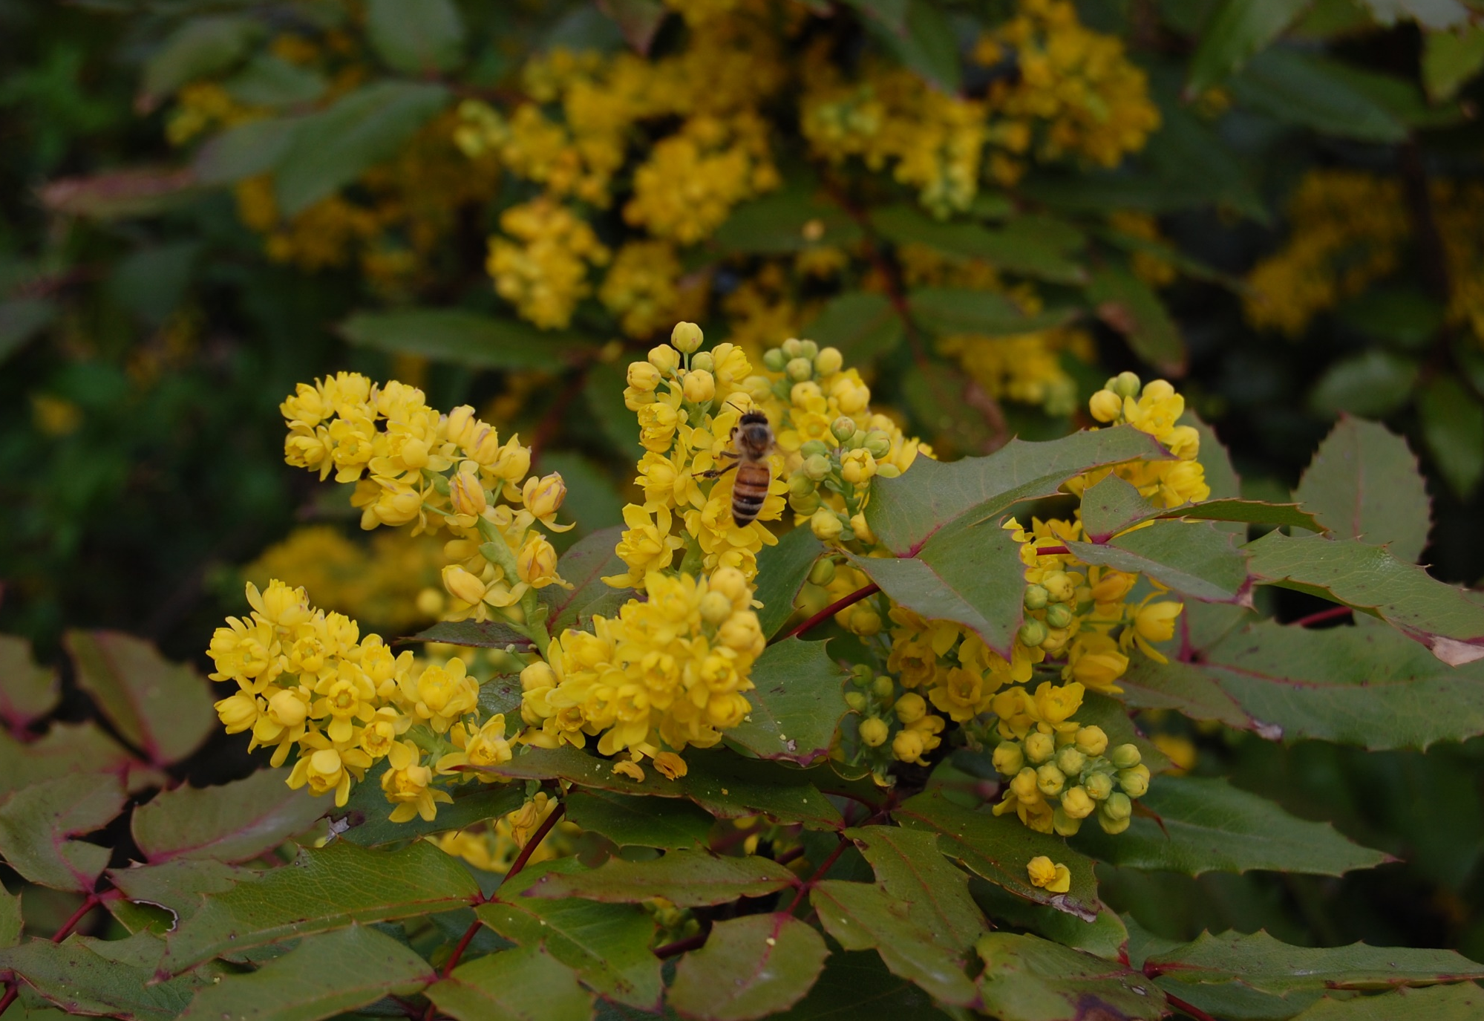
Native Plants: April - May
Pasque Flower
Oregon Grape
Notes:
There are native and domestic varieties
Photos by Ellen Miller and Diane Stutzman

Slide 12
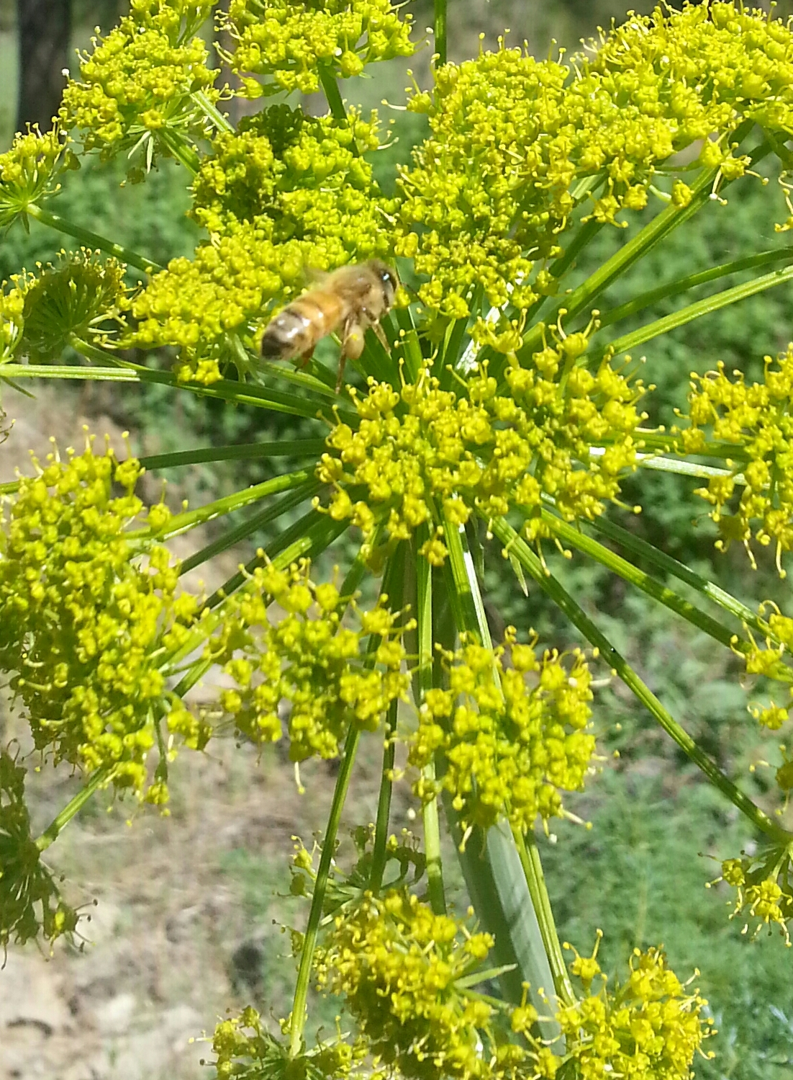
Native Plants: April - May
Red Current
Desert Parsley
Notes:
Red Current heavy favorite of humming birds and butterflies as well as bees. Drought tolerant.
Photos by Ellen Miller and Gina Jackson.

Slide 13
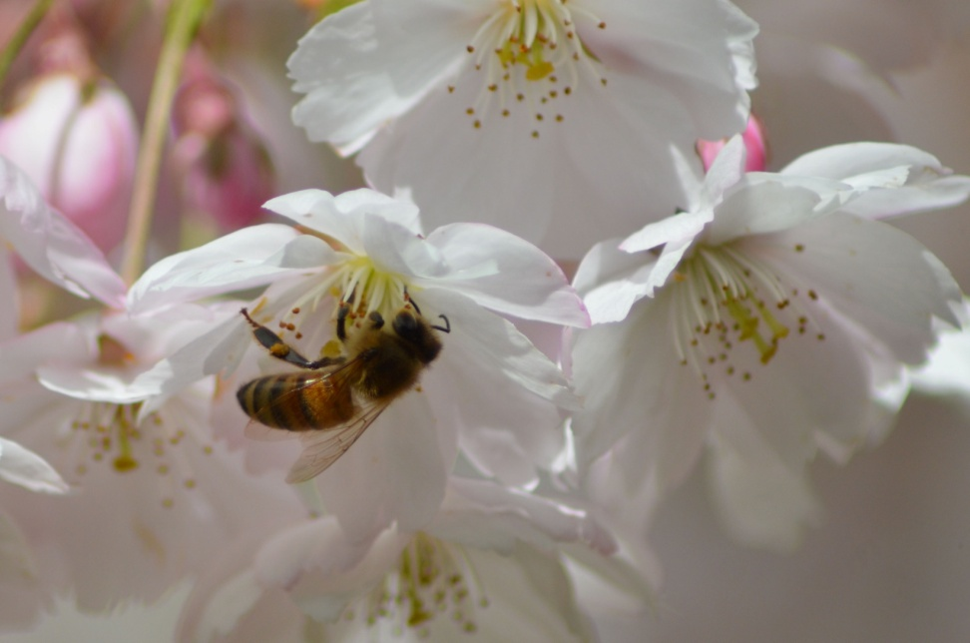
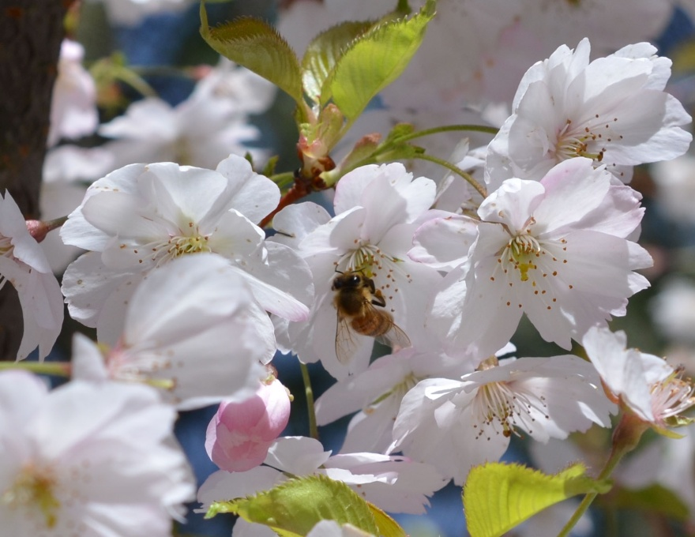
Domestic Plants: April - May
Fruit Trees
Notes:
All fruit trees used by honeybees
Photos by Ellen Miller

Slide 14
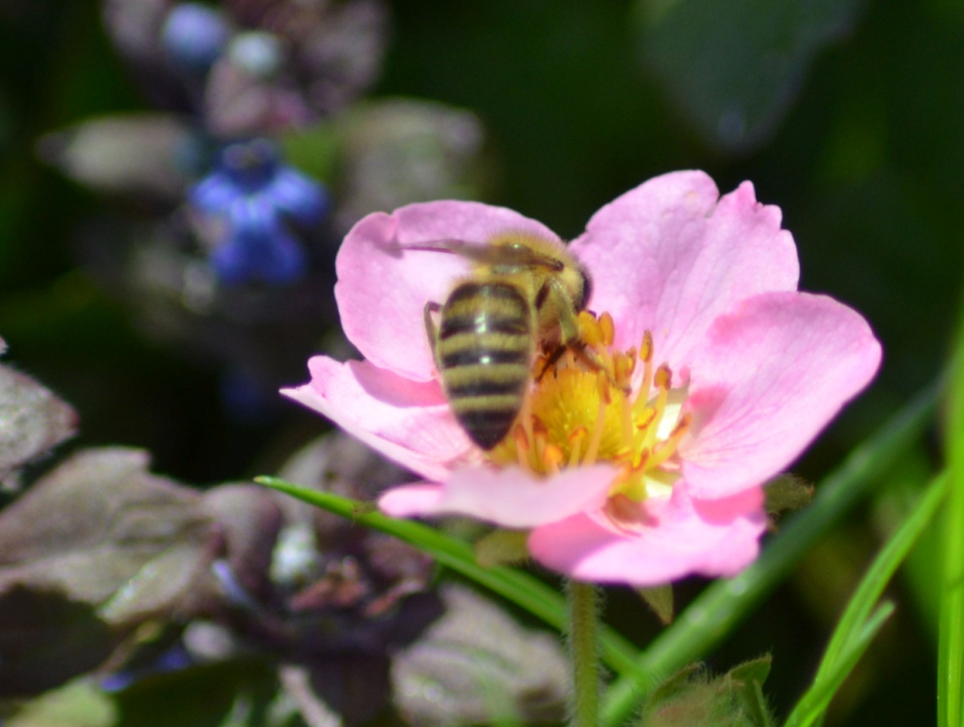
Domestic Plants: April - May
Tulip Tarda
Pink Strawberry
Grape Hyacinth
Forsythia
Notes:
Photos by Ellen Miller

Slide 15
Domestic Plants: April - May
Caragana
Notes:
Bumblebee sharing with a honeybee. Available through the Spokane County Conservation District tree/shrub sale.
Photo by Ellen Miller

Slide 16
Domestic Plants: April - May
Dandelion
Rock Daphne
Notes:
Dandelion is considered a weed, but is an important food source for honeybees.
Photos by Ellen Miller

Slide 17
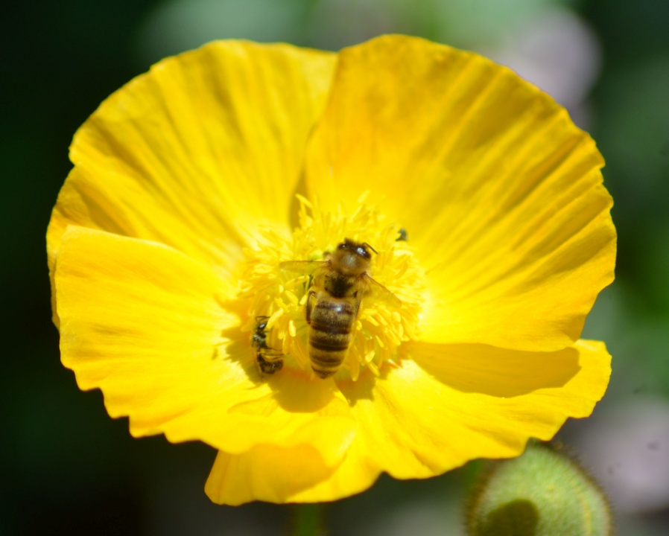
Domestic Plants: April - May
Genesta
Bleeding Heart
Iceland Poppy
Notes:
Photos by Ellen Miller.

Slide 18
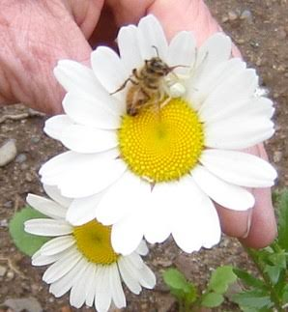
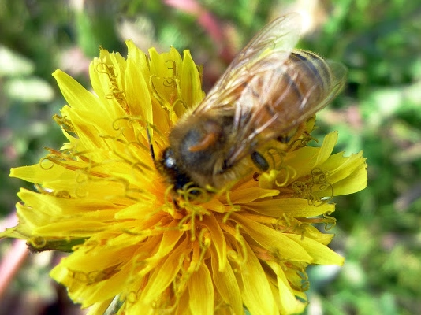
Domestic Plants: April - May
Daisy
Notes:
Daisies of all kinds are frequented by pollinators and there are both native and domestic plants. Note the Ghost Spider catching the honeybee on the white daisy.
Photos by Karen Momany and Marilyn Geiger.

Slide 19
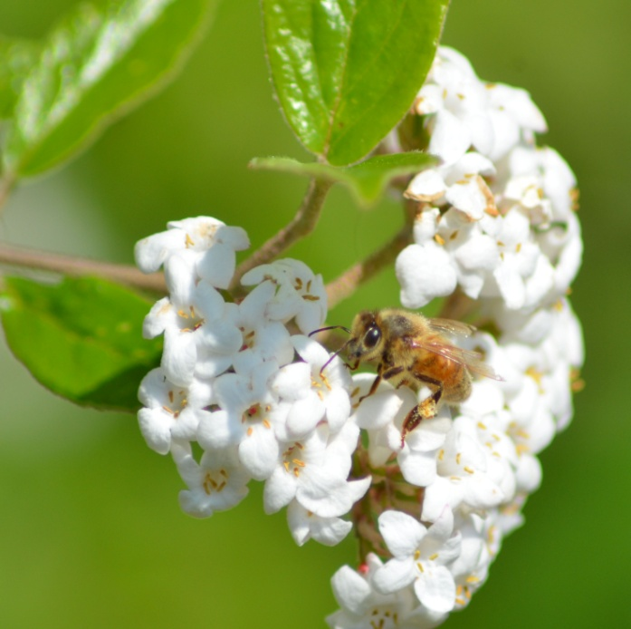
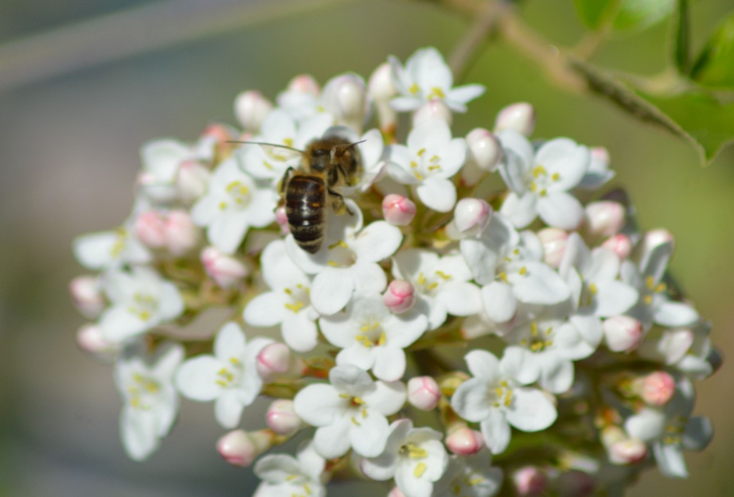
Domestic Plants: April - May
Viburnum
Notes:
Photos by Ellen Miller

Slide 20
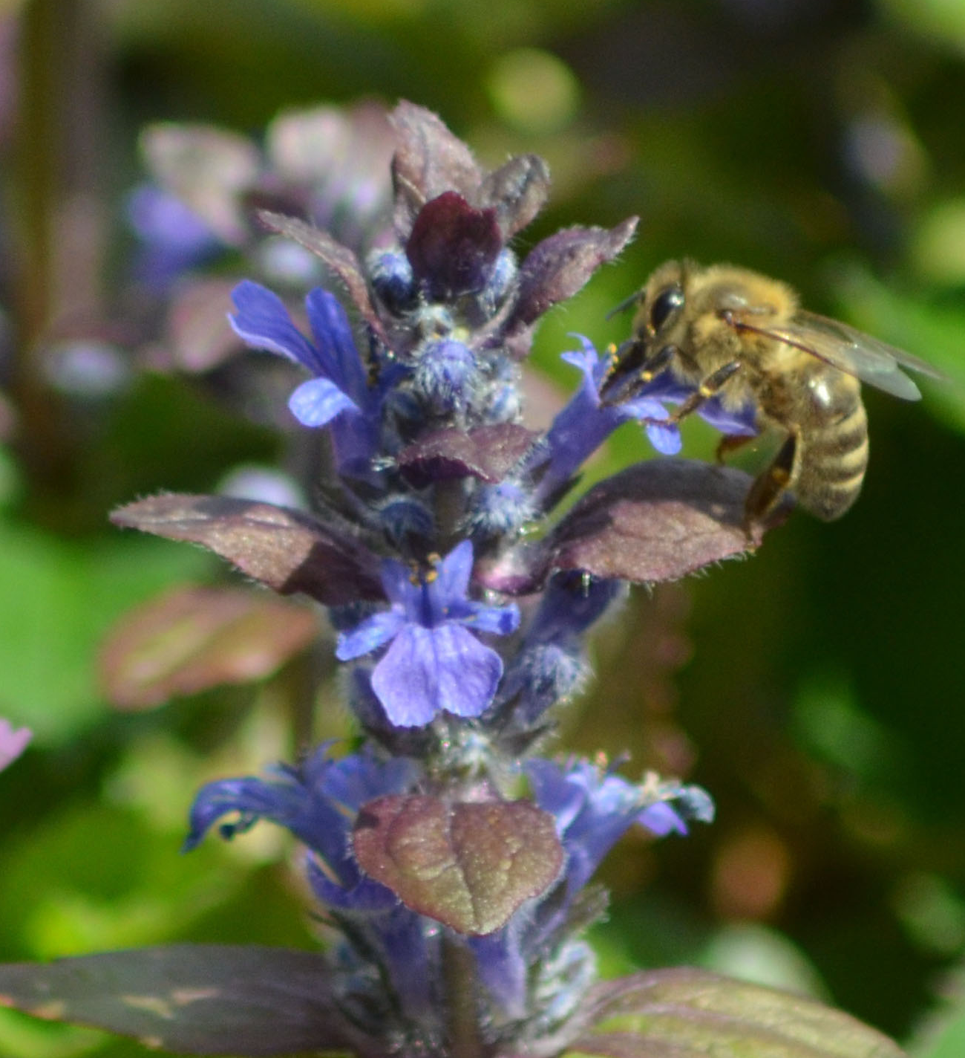
Domestic Plants: April - May
Lamium (Dead Nettle)
Blue Bugle
Notes:
Easy grown ground covers.
Photos by Ellen Miller

Slide 21
Domestic Plants: April - May
Hearty Geranium
ORNITHOGALUM NUTANS
(Silver Bells)
Notes:
Hearty Geranium has many shapes and colors from white to purple. Easy to grow.
Photos by Ellen Miller

Slide 22
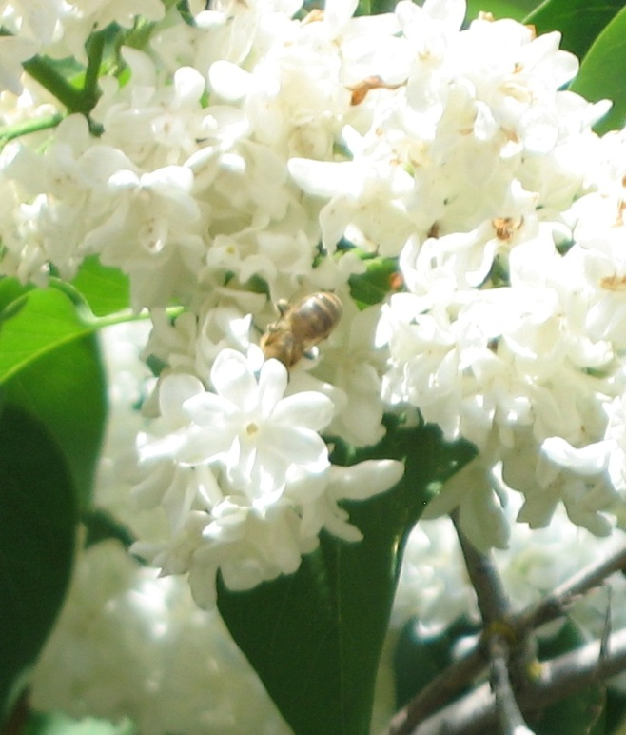
Domestic Plants: April - May
Lilac
Notes:
Available from the Spokane County Conservation District tree/shrub sale.
Photos by Ellen Miller and Marilyn Geiger.

Slide 23
Domestic Plants: April - May
Honeysuckle
Notes:
Blooms for several months depending on location and moisture.
Photos by Ellen Miller

Slide 24
Domestic Plants: April - May
Rhubarb
Notes:
Letting garden plants go to seed provides bee food.
Photo by Ellen Miller

Slide 25
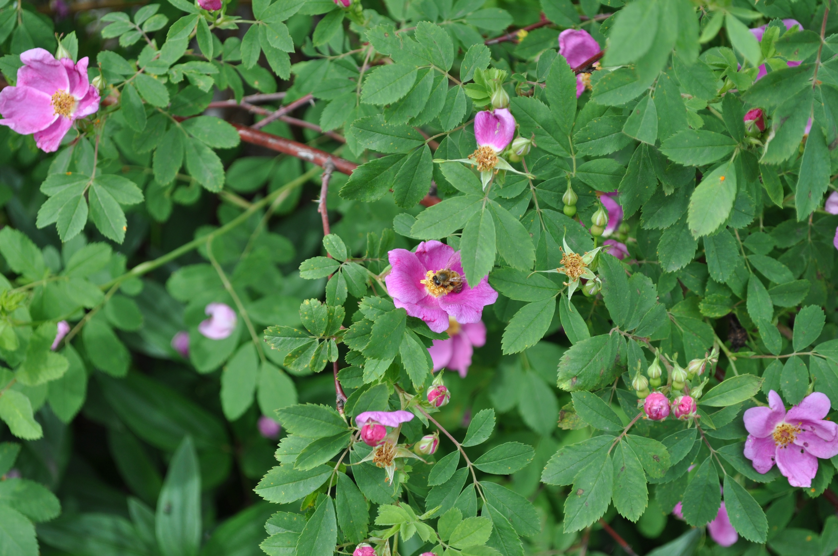
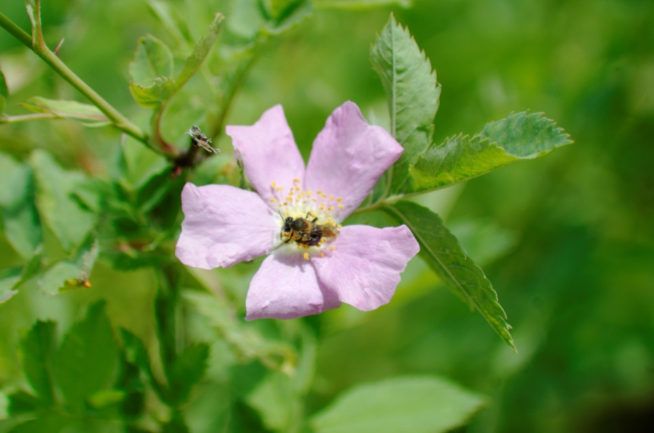
Native Plants: June – July
Nootka Rose
Notes:
Photos by Gina Jackson and Ellen Miller

Slide 26
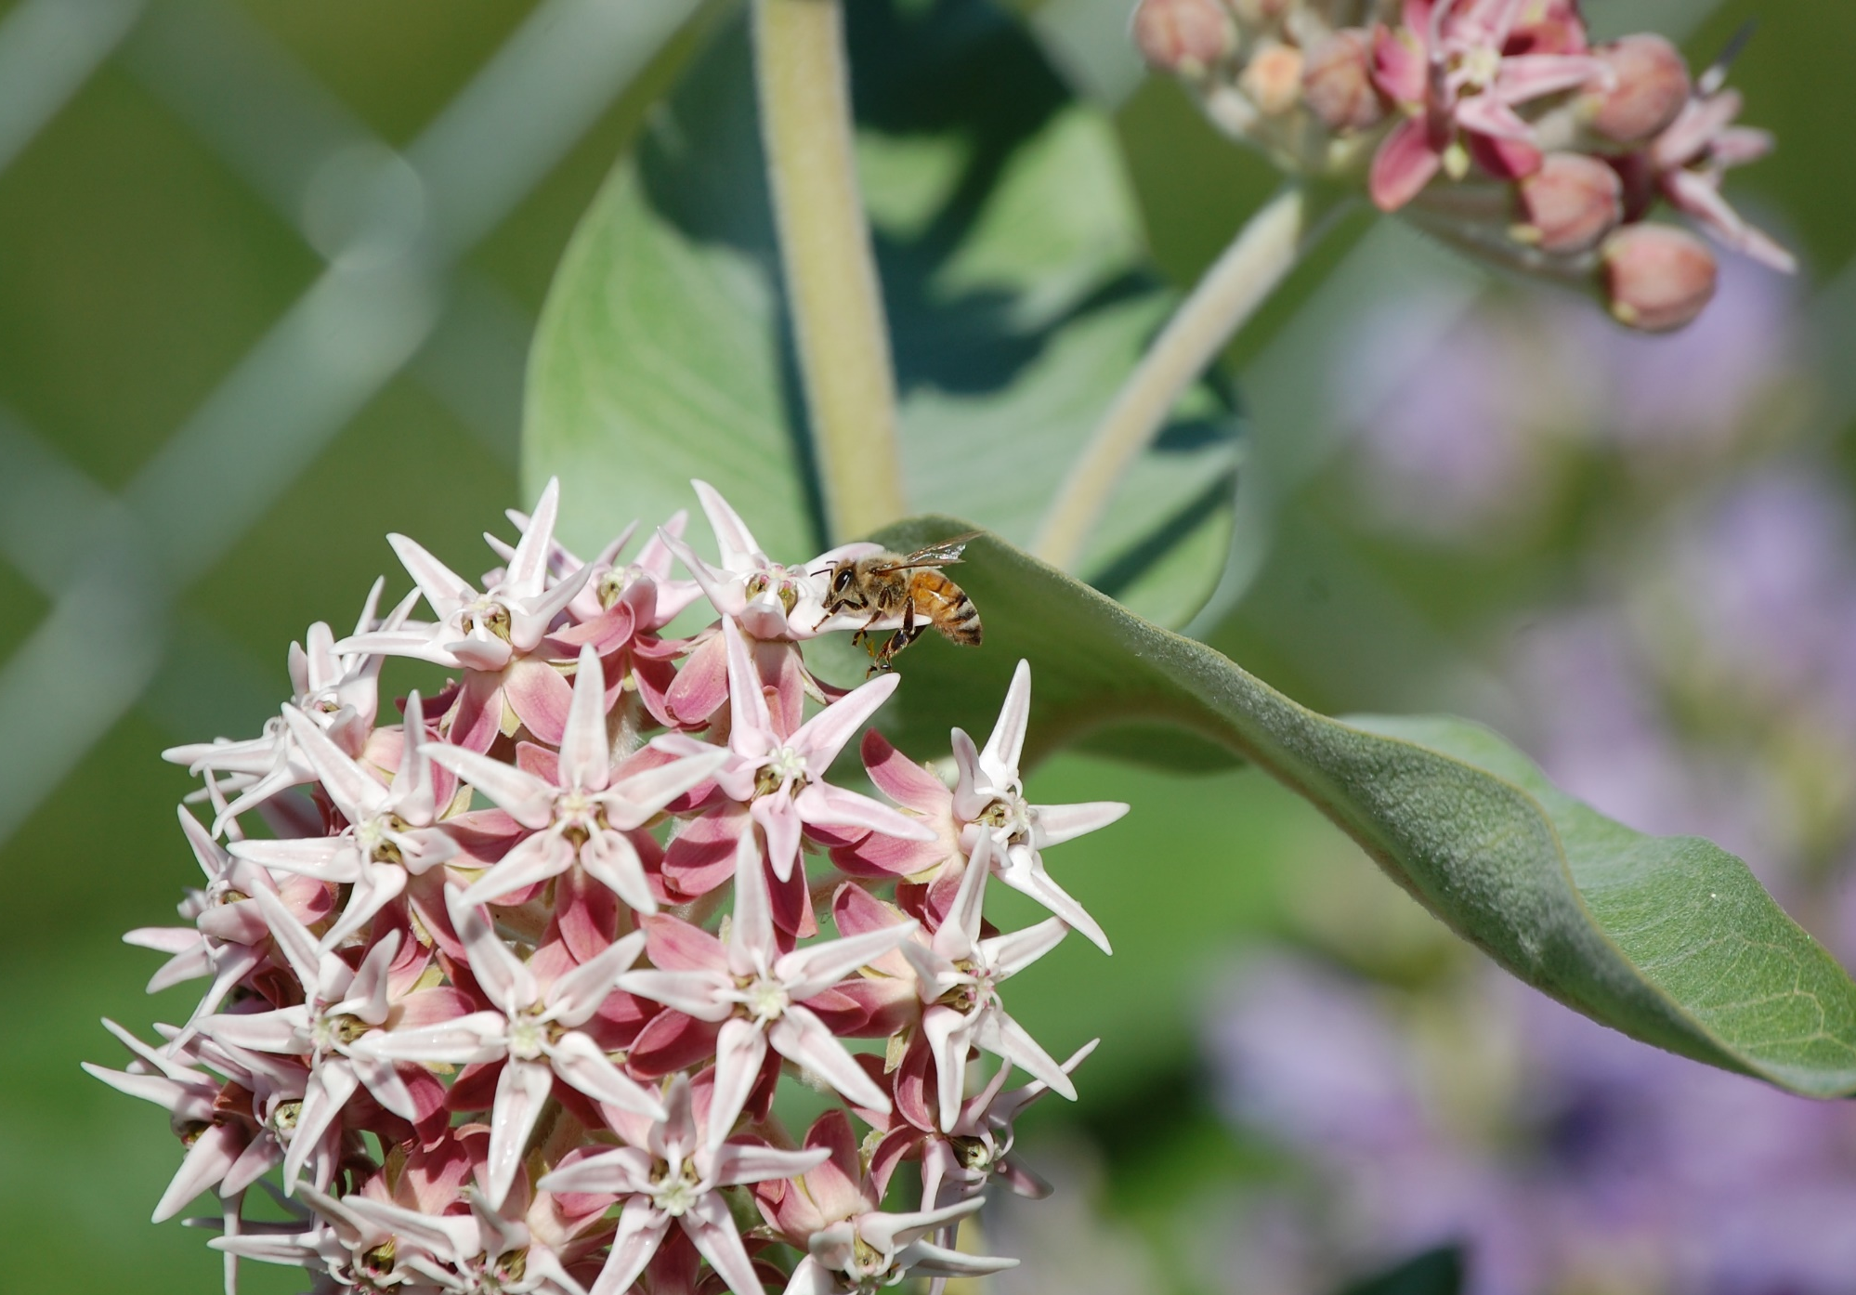
Native Plants: June – July
Milkweed
Notes:
Some native species are considered weeds. Even the name Milkweed indicates its status, however it is an important source of food for bees as well as the Monarch butterfly.
Photos by Ellen Miller
Photos by Ellen Miller and Diane Stutzman

Slide 27
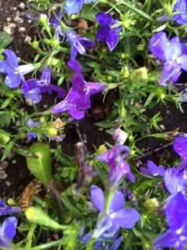
Native Plants: June – July
Penstemon
Notes:
Both native and domestic Penstemon plants. Large variety. Easy to grow. Start blooming in early May but bloom through to frost.
Photos by Diane Stutzmand and Marilyn Geiger

Slide 28
Native Plants: June – July
Sticky Geranium
Notes:
Note the Ghost spider that has laid a trap and caught the honey bee.
Photo by Diane Stutzman

Slide 29
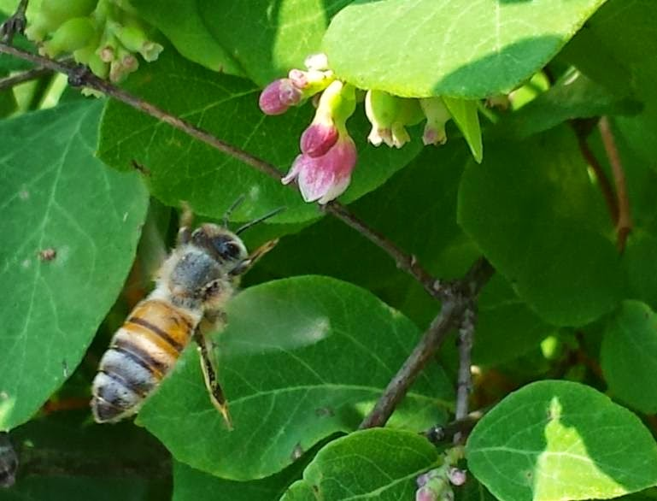
Native Plants: June – July
Snowberry
Notes:
Snowberry can bloom in the spring and again in the late summer/fall depending on temperature and moisture.
Photos by Will Olson and Marilyn Geiger.

Slide 30
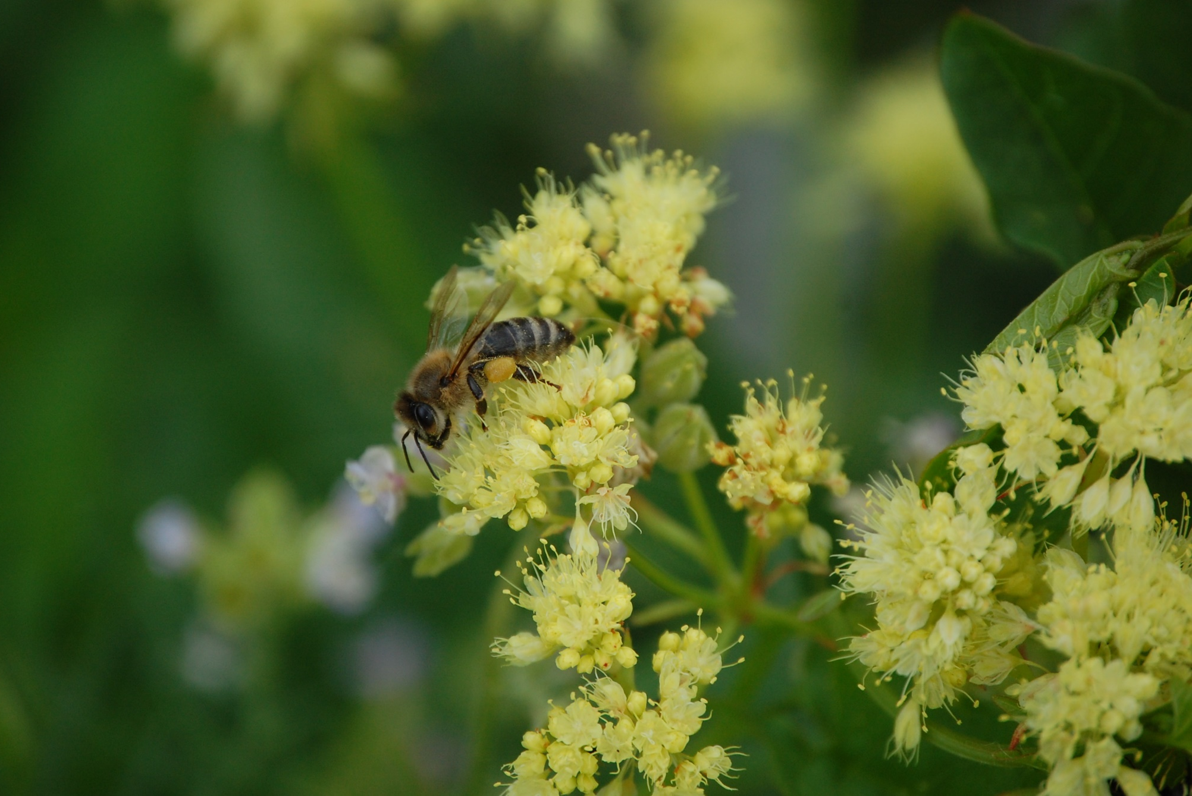
Native Plants: June – July
Lewisia
Northern Buckwheat
Notes:
Photos by Diane Stutzman

Slide 31
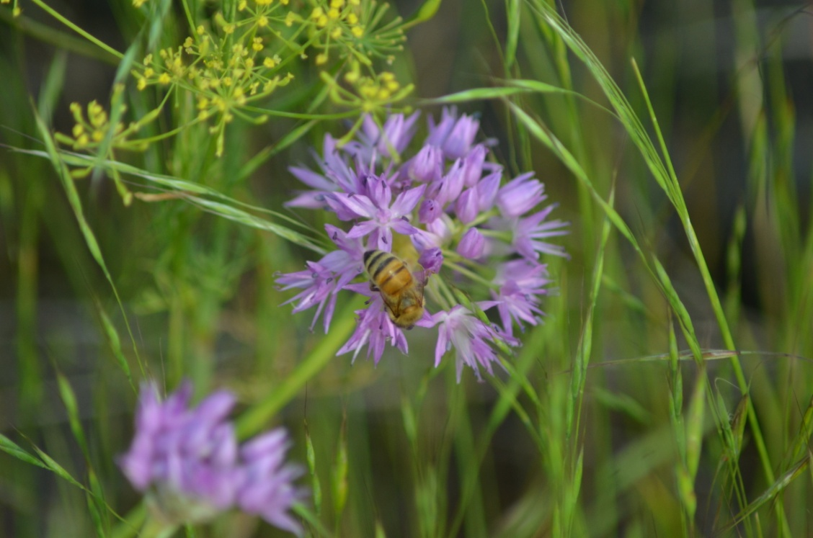
Native Plants: June – July
Cone Flower
Douglas Onion
Apache Plume
Heals All
Notes:
Heals All looks very similar to domestic Spanish Lavender.
Photos by Diane Stutzman, Ellen Miller

Slide 32
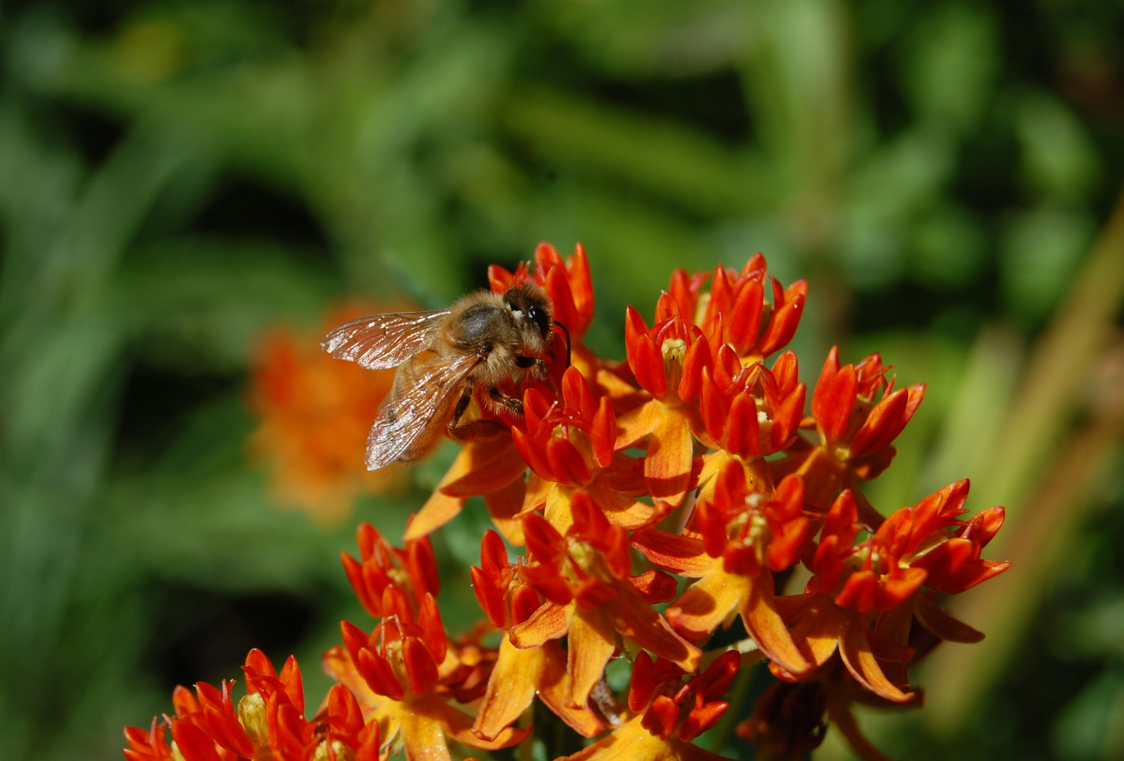
Native Plants: June – July
Ocean Spray
Asclepias
Notes:
Asclepias are native to the mid-west but do well in our area and bloom from late June sometimes to frost with good supply of nectar.
Photos by Will Olson and Diane Stutzman

Slide 33
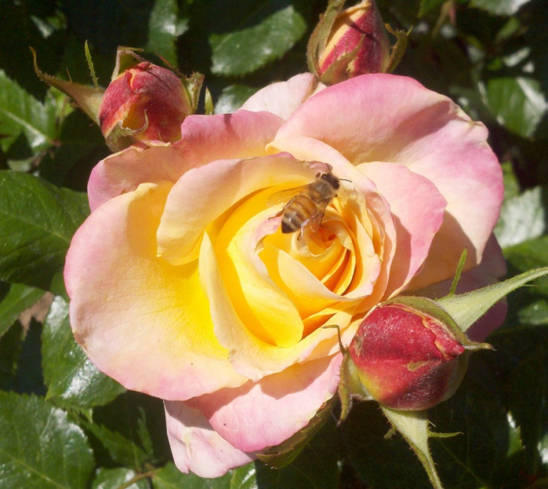
Domestic Plants: June - July
Rose
Notes:
Photos by Ellen Miller

Slide 34
Domestic Plants: June - July
Allium
Honeysuckle
Notes:
Photos by Ellen Miller

Slide 35
Domestic Plants: June - July
Bachelor Button
Notes:
Photo by Ellen Miller

Slide 36
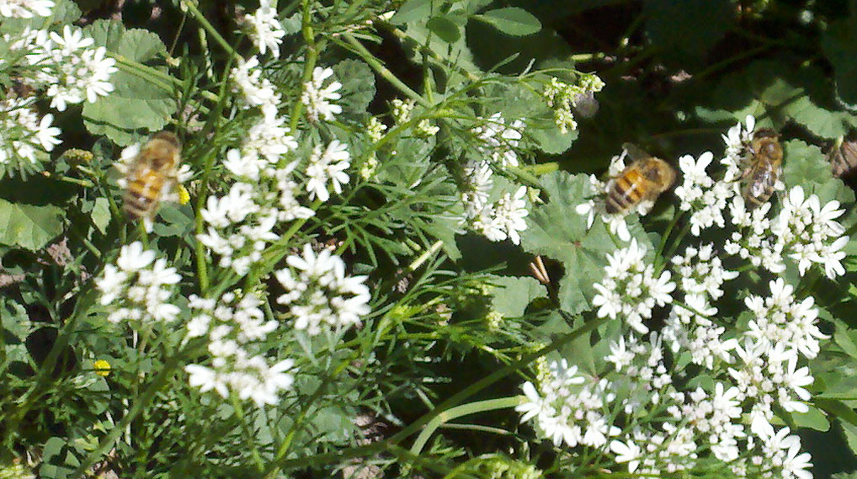
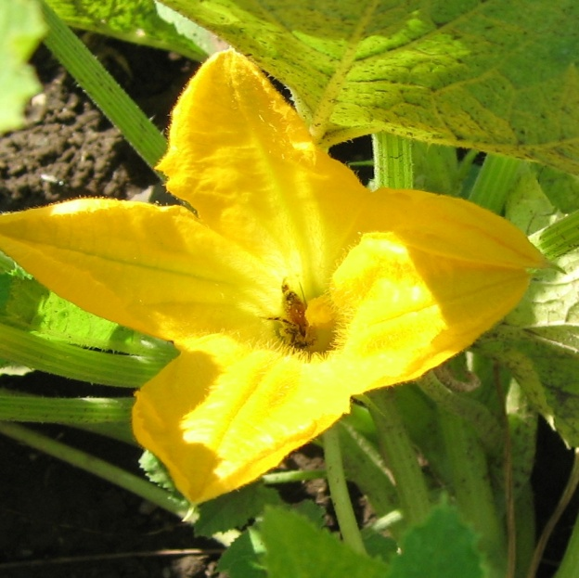
Domestic Plants: June - July
Cilantro
Squash
Notes:
Garden plants frequented by honeybees.
Photos by Marilyn Geiger, Margo Buckles, Ellen Miller

Slide 37
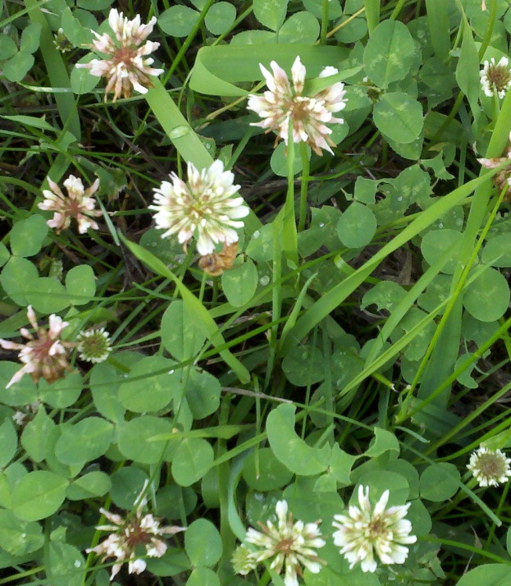
Domestic Plants: June - July
Dutch Clover
Sweet Clover
Notes:
Clovers sometimes considered weeds depending on where they appear, but enjoyed by honeybees.
Photos by Ellen Miller

Slide 38
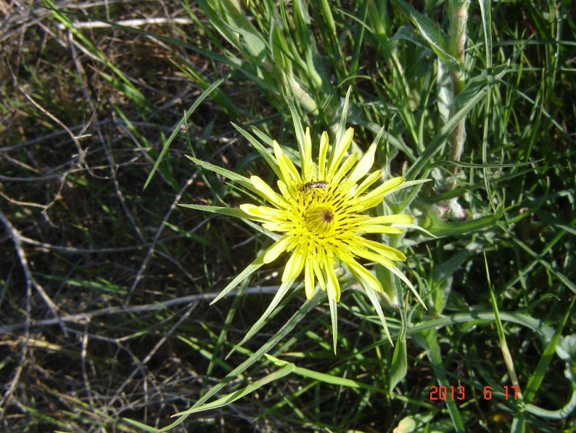
Domestic Plants: June – July
Salsify
Blue Weed
Notes:
Blue Weed is considered a Class B Noxious weed in Washington State. Also known as Viper’s Bugloss. Intent is to keep it contained. Salsify is not considered a weed in Washington State.
Photo by Marilyn Geiger.

Slide 39
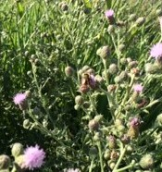
Domestic Plants: June – July
Common Mallow
Knapweed
Notes:
Common Mallow is a weed that is relatively easily controlled in healthy turf or by hand weeding in beds. Knapweed is another common weed in our area.
Photo by Ellen Miller and Marilyn Geiger.

Slide 40
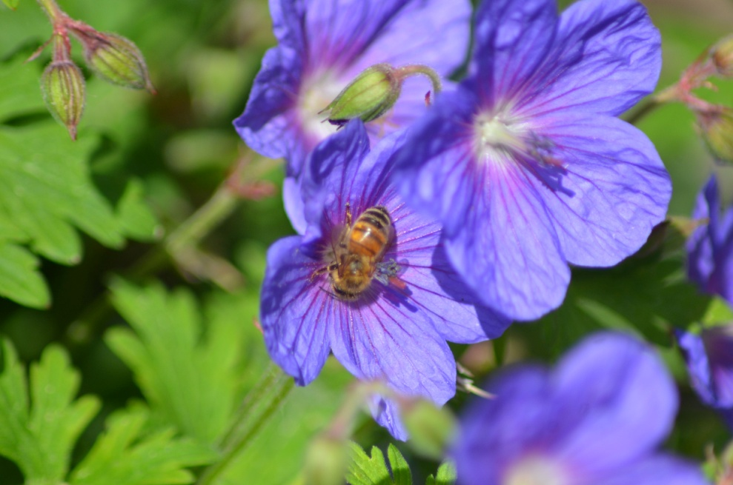
Domestic Plants: June - July
Mallow
Notes:
Mallows that are popular in flowerbeds.
Photos by Ellen Miller

Slide 41
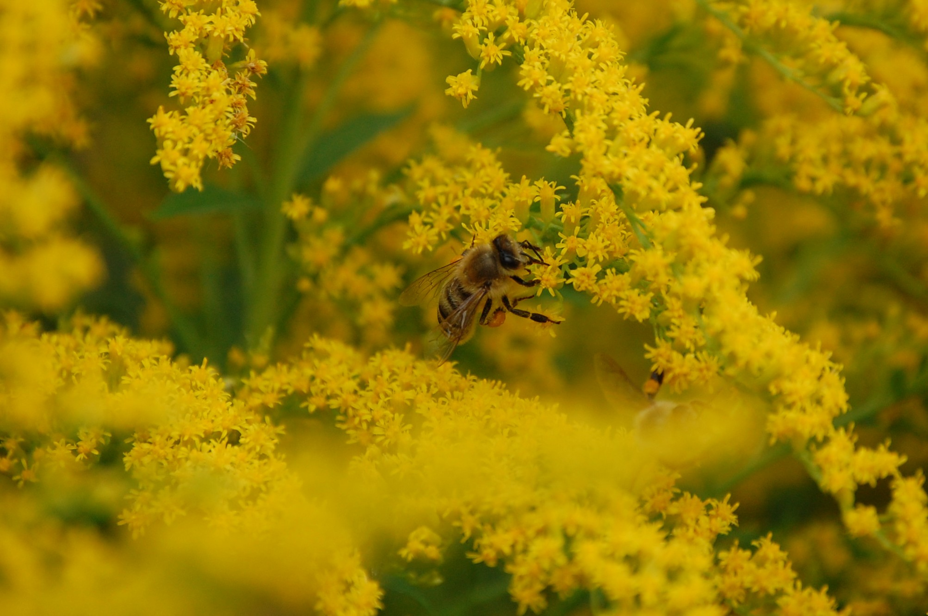
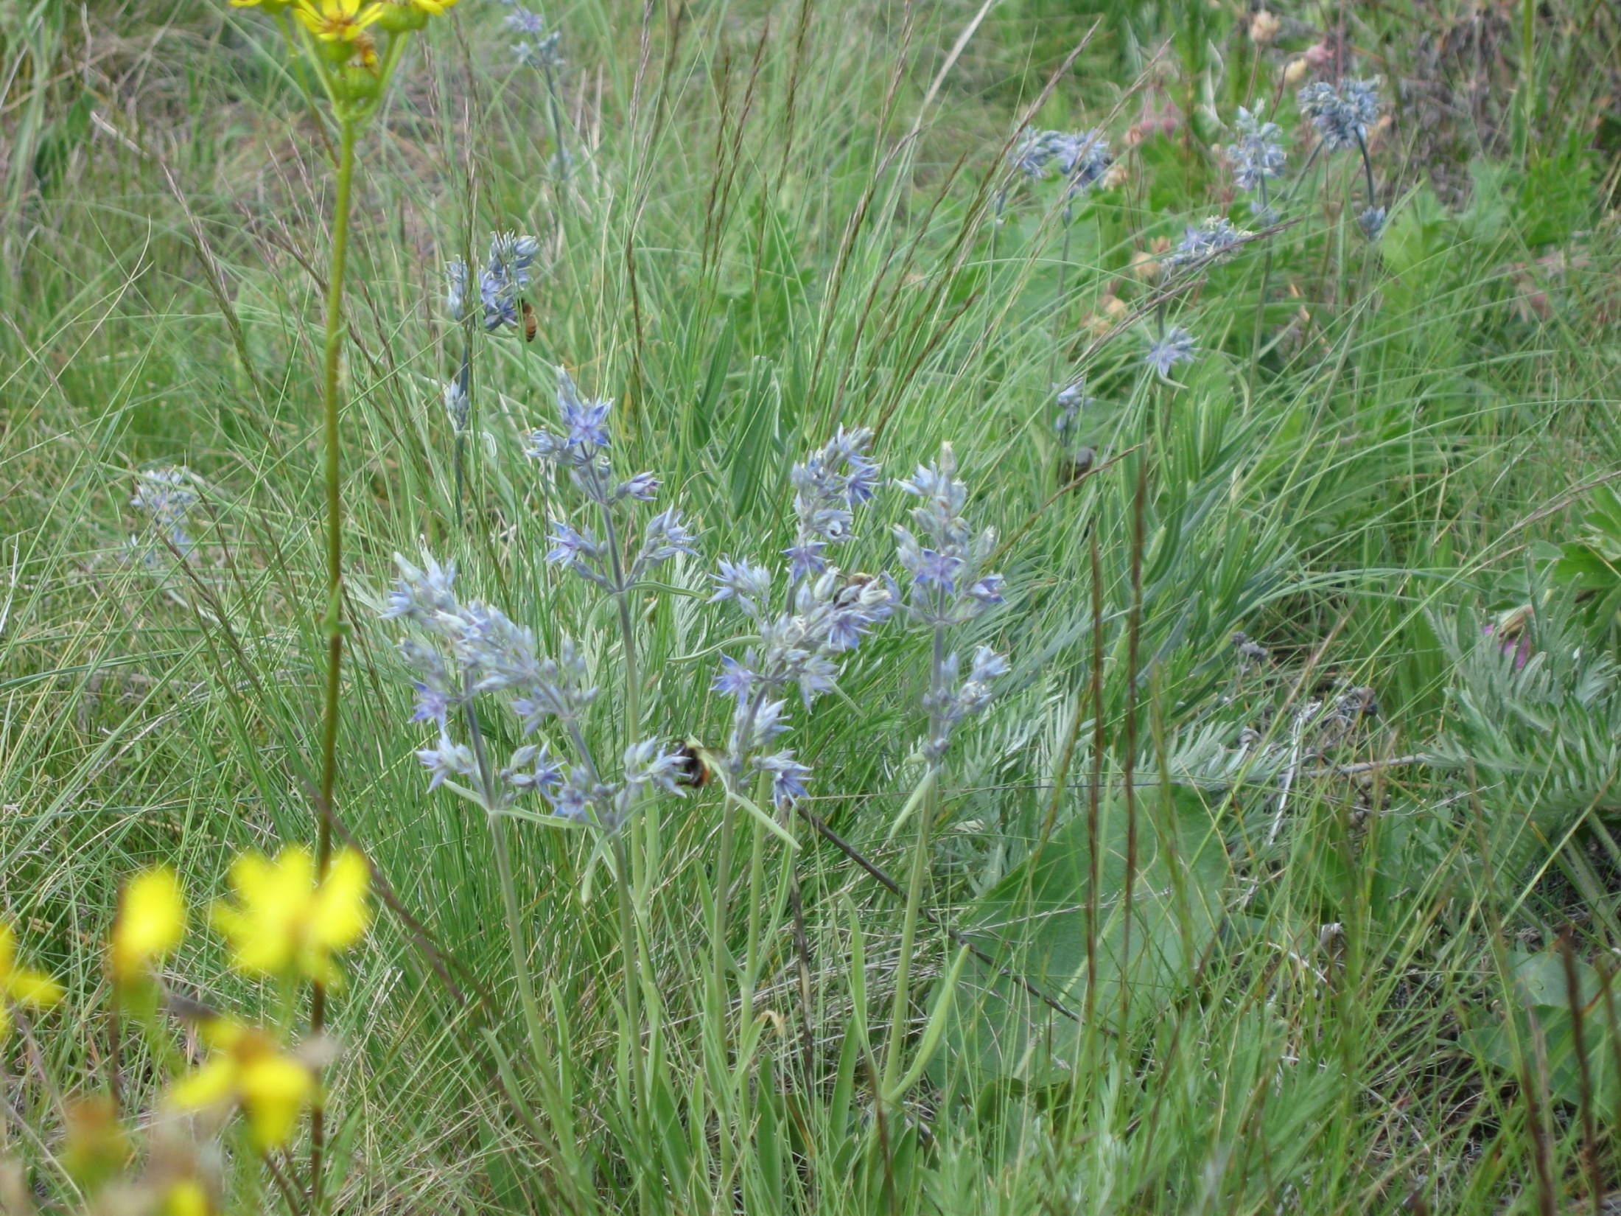
Native Plants: August - September
Golden Rod
Frasera
Notes:
Frasera named for John Fraser, a botanist. Goldenrod is a member of the aster family.
Photos by Marilyn Geiger and Diane Stutzman.

Slide 42
Native Plants: August - September
Rabbit Bush
Notes:
Photos by Diane Stutzman

Slide 43
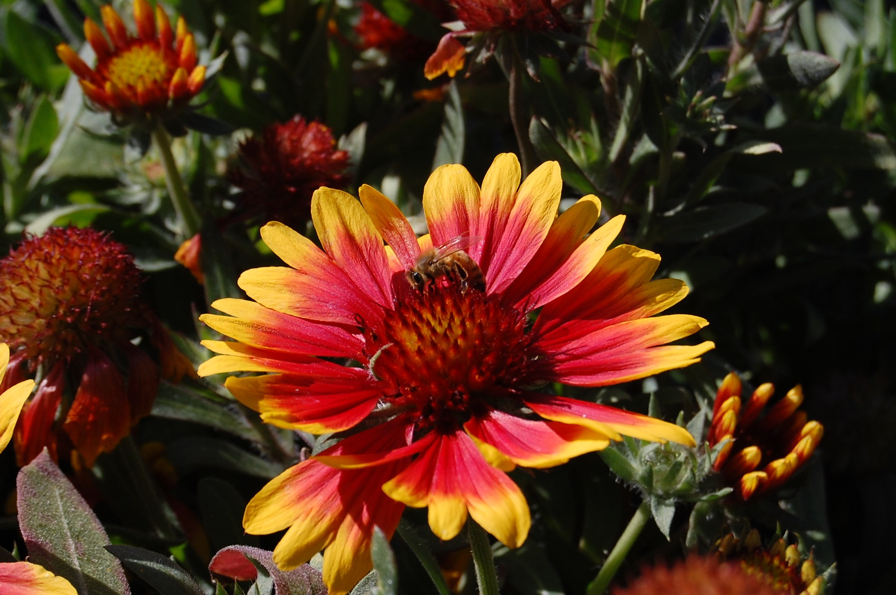
Native Plants: August - September
Blanket Flower
Autumn Joy Sedum
Notes:
Can find both of these in nurseries and are attractive perennials.
Photos by Diane Stutzman

Slide 44
Native Plants: August - September
Slender Buckwheat
Notes:
Photos by Diane Stutzman

Slide 45
Native Plants: August - September
Douglas Knotweed
Snowberry
Notes:
Late blooming snowberry. Douglas Knotweed is a very tiny plant with small flowers. The weight of the bee bends the stem. Blooms through late frost.
Photos by Ellen Miller

Slide 46
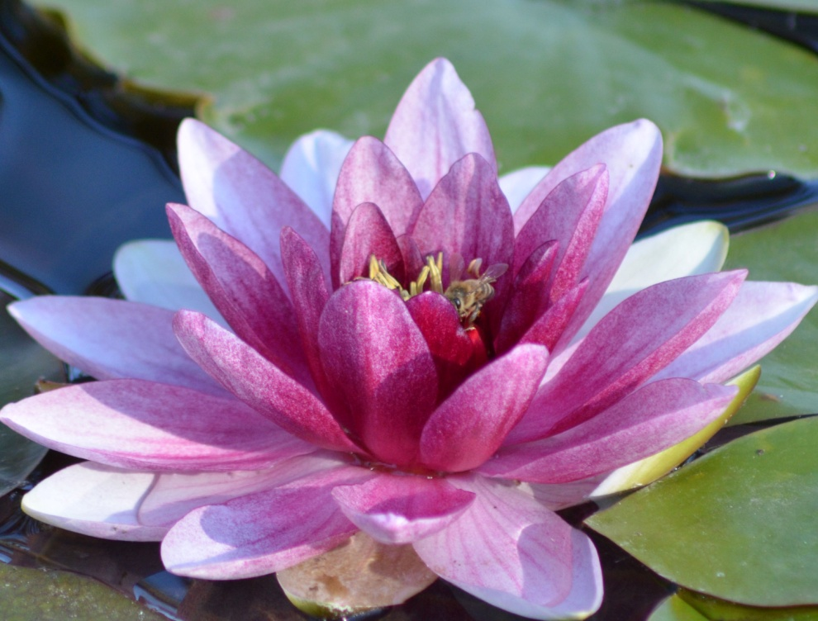
Domestic Plants: August-September
Water Lily
Cone Flower
Notes:
Photos by Ellen Miller

Slide 47
Domestic Plants: August-September
Blue Globe Thistle
Notes:
Non-invasive. Very attractive to honeybees.
Photo by Ellen Miller

Slide 48
Domestic Plants: August - September
Star Thistle
Notes:
Washington State Class B Noxious Weed
Photo by Diane Stutzman

Slide 49
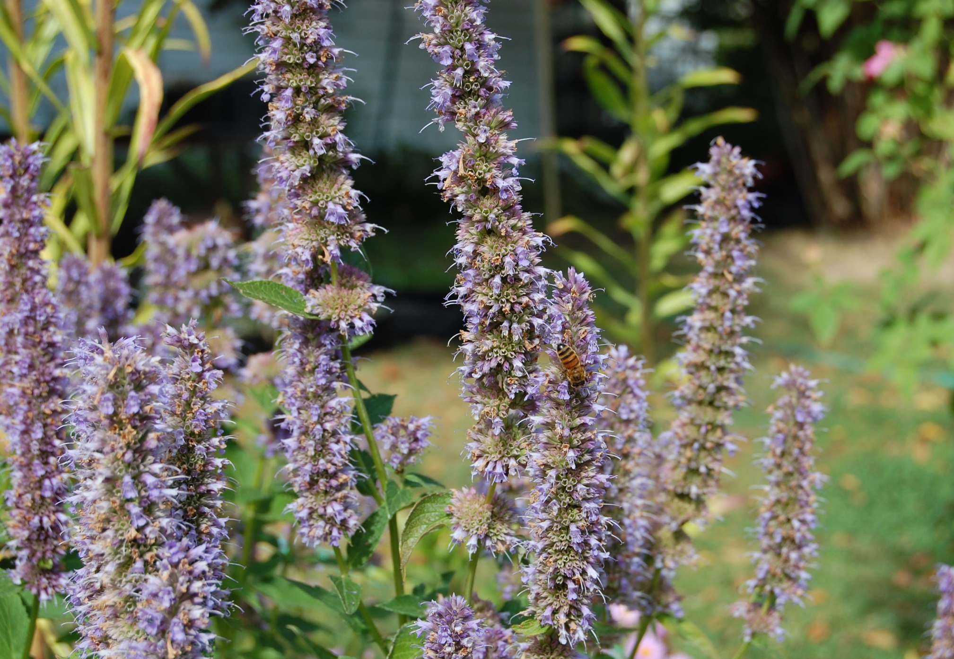
Domestic Plants: August-September
Common Borage
Anise Hyssop
Notes:
Photos by Diane Stutzman

Slide 50
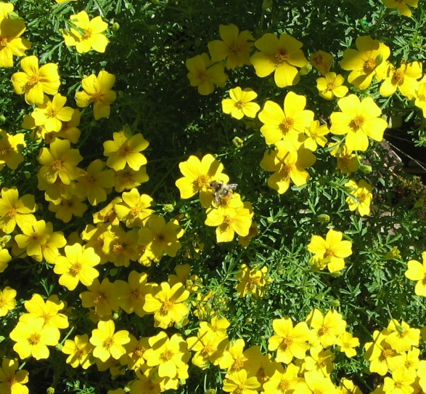
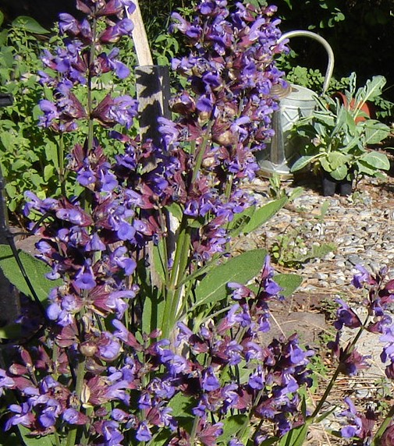
Domestic Plants: August-September
Potentilla
Liatris
Domestic Sage
Notes:
Bumblebee on Potentilla.
Photos by Diane Stutzman and Marilyn Geiger

Slide 51
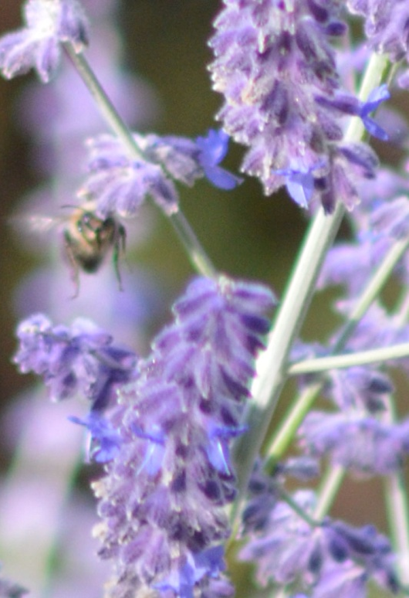
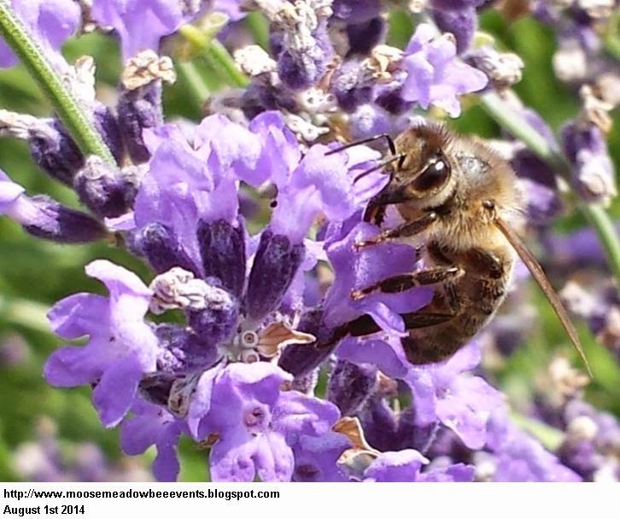
Domestic Plants: August-September
Catmint
Lavender
Notes:
Photos by Diane Stutzman and Will Olson

Slide 52
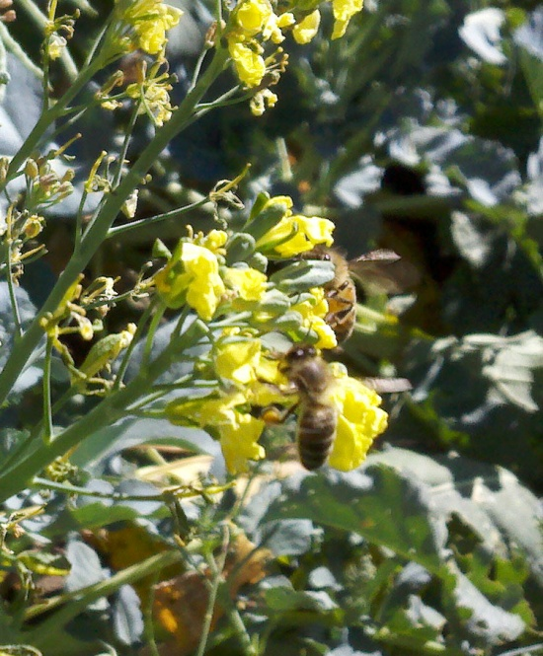
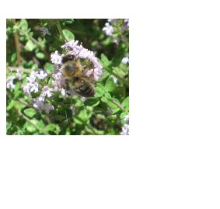
Domestic Plants: August-September
Radicchio
Broccoli
Oregano
Notes:
Photos by Marilyn Geiger and Ellen Miller

Slide 53
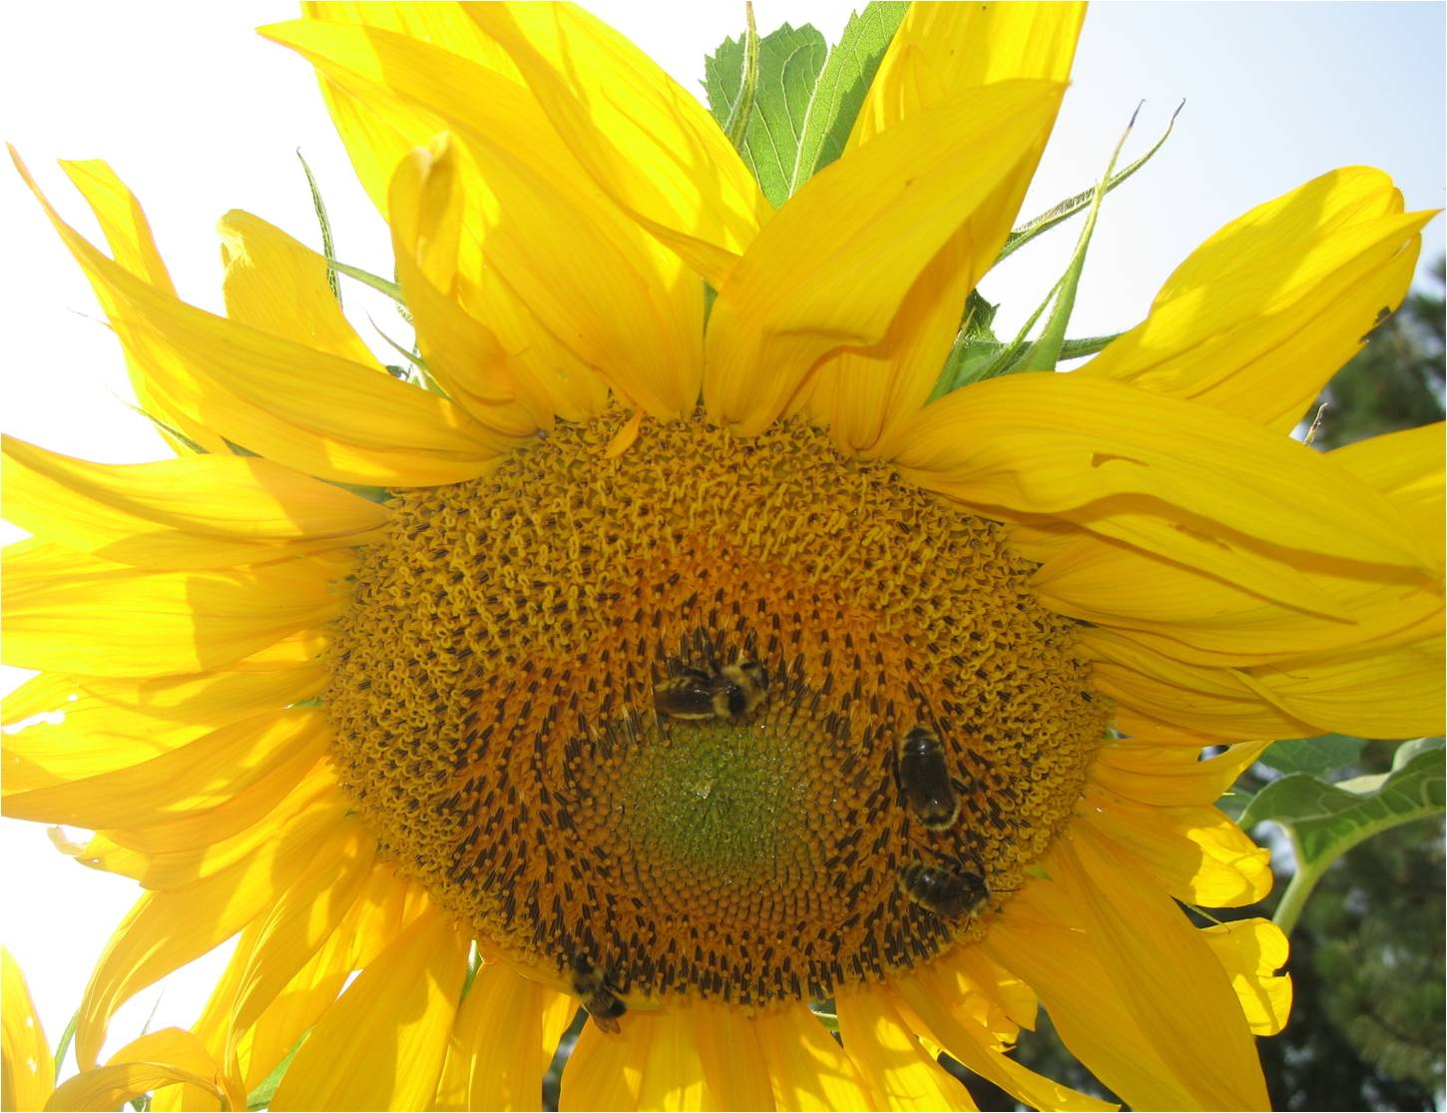
Domestic Plants: August-September
Sunflowers
Notes:
Photos by Ellen Miller and Marilyn Geiger

Slide 54
Domestic Plants: August-September
Corn
Notes:
Popular for pollen in the late summer/fall
Photo by Ellen Miller

Slide 55
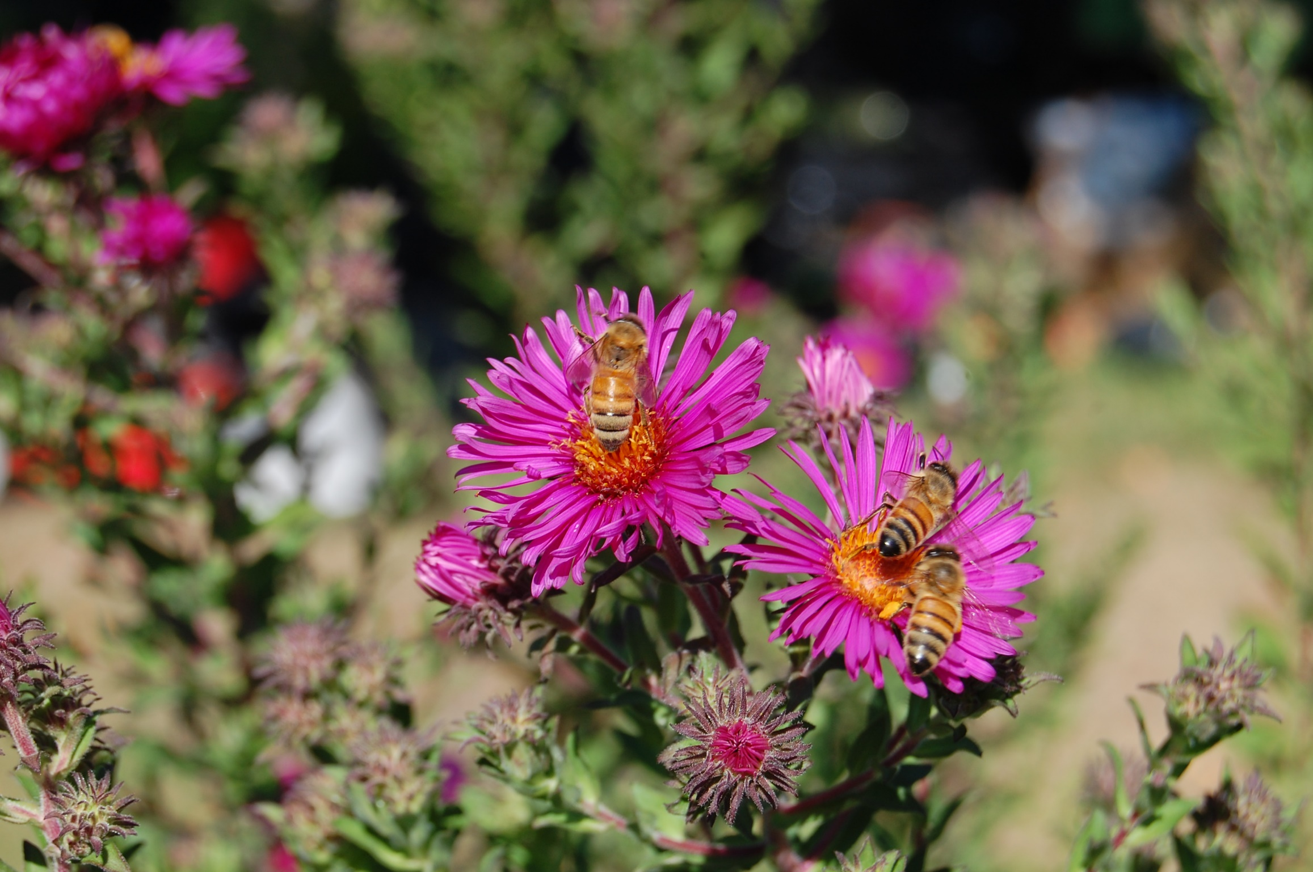
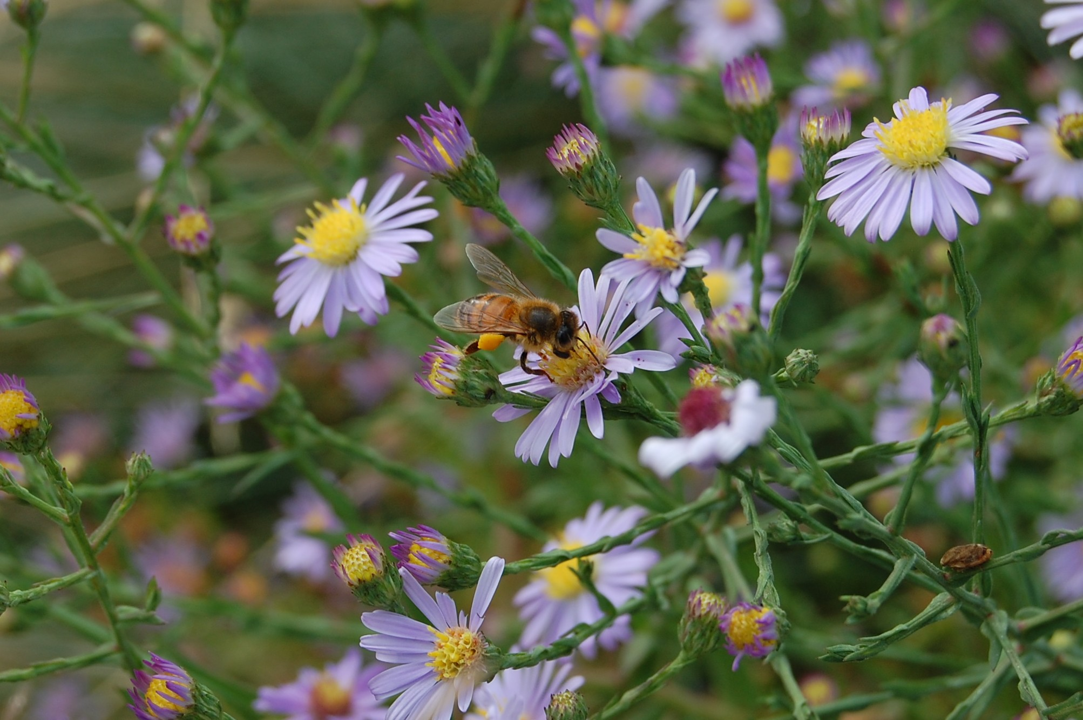
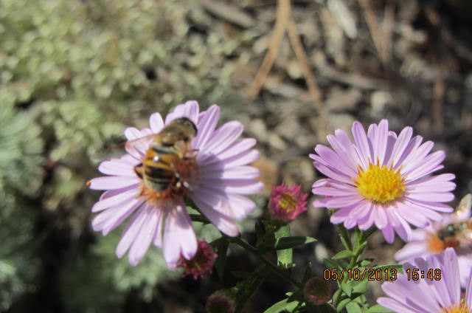
Native Plants: October - December
Asters
Notes:
Photos by Diane Stutzman, Margo Buckles, Ellen Miller

Slide 56
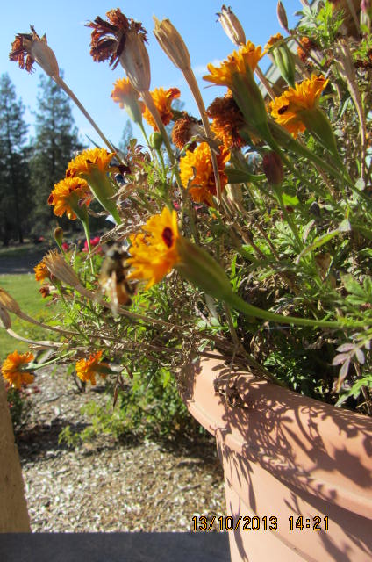
Domestic Plants: October - December
Rose
Marigold
Notes:
Photos by Margo Buckles

Slide 57
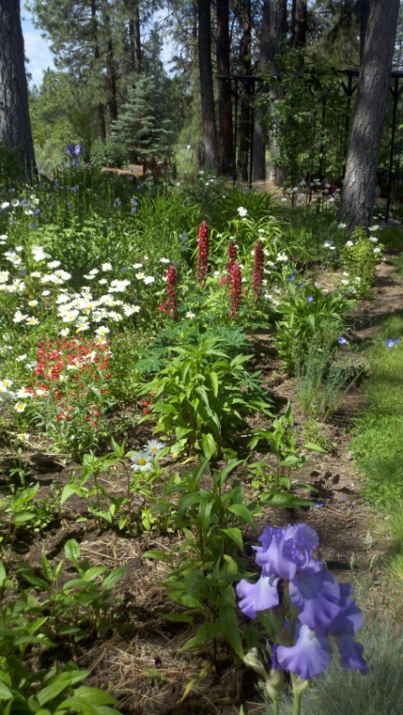
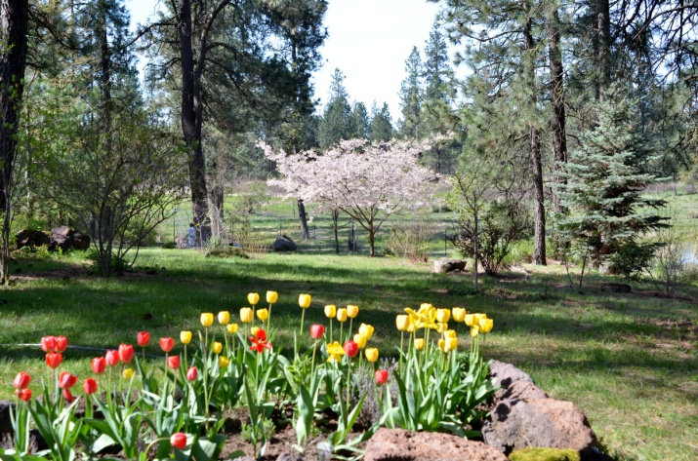
Honeybees and Flowers
Summary: a work in progress
Location: West Plains
Native and Domestic
Weeds
Garden
Weather conditions
Mixture of plants for all seasons
Notes:
This project is on-going. We are looking for local photos of honeybees on flowers. If you are willing to share your photos please contact us. We are including both native and domestic plants/trees and flowers from weeds as well as gardens. We all know that weather conditions influence blooming time as well as the amount of nectar a plant produces. There is an attachment that indicates native plant blooming times for the year 2014. It is not inclusive and varied by at least 2-3 weeks in 2015. Having sources of food for honeybees that is available to them from the point when it is warm enough for them to start flying in the late winter/early spring through the late Fall.
Photos by Ellen Miller

Slide 58
Additional Resources
Washington State University, Cooperative Extension Service
Master Gardeners http://mastergardener.wsu.edu/
Publications https://pubs.wsu.edu/ListCategories.aspx?TopicID=6
Spokane County Conservation District
Tree and shrub sale http://treesale.sccd.org/
Washington State Native Plant Society
– Spokane http://www.wnps.org/plant_lists/counties/spokane/spokane_county.html
Local stores
Blue Moon Nursery http://www.bluemoonplants.com/
Desert Jewels http://www.desertjewelsnursery.com/
Northwest Seed and Pet http://nwseed.com/

Slide 59
Photo Credits
Margo Buckles
Joe Geiger
Marilyn Geiger
Gina Jackson
Ellen Miller
Jack Miller
Karen Momany
Will Olson
Diane Stutzman
Notes:
Photo by Ellen Miller

Slide 60
Appendix
Chronological Wild Flowers 2014
Butter Cup March 6 -- May 6
Salt and Pepper Parsley March 23 -- May 8
Grass Widow March 31 -- May 6
Besseya Ruba (Red Kitten Tails) March 31 -- May 8
Yellow Bell April 4 -- May 5
Diamond Leaf Saxifrage April 8 -- May 14
Dandelion April 11 -- May 23
Rooster Head April 16 -- May 8
Mountain Blue Bell April 16 -- May 6
Wood Violet April 16 -- May 30
Gray's Desert Parsley April 19 -- June 5
Large Fruited Biscuit Root April 19 -- May 18
Maiden Blue-eyed Mary April 19 -- May 16
Prairie Smoke April 19 -- June 13
Woodland Star April 20 - May 20
Arrow Leaf Balsam Root April 23 - May 30
Knickanick April 23 -- May 14
Dwarf Hesperochiron April 27 -- May 26
Strawberry May 1 -- June 6
Camas May 3 -- May 23
Lupine May 5 -- July 15
Pucccoon, Lemonweed, Wayside Gromwell May 5 - June 5
Phlox May 8 -- June 16
Larkspur May 8 -- June 16
Douglas Buckwheat May 9 --July 14
Notes:
Photo by Marilyn Geiger

Slide 61
Rosy Pussy Toes May 9 -- July 14
Large Fruited Biscuitroot/Desert Parsley May 11 -- May 23
Star Solomon's Seal May 10 -- May 23
Rocky Mountain Iris May 14 -- June 15
Bitterroot May 15 - June 5
Large-flowered Brodiaea (Triteleia Grandiflora) May 16 -- June 15
Northern Suncup May - May 31
Marsh Yellowcress May 16 - May 31
Threadleaf Phacelia May 18 - June 3
False Solomon's Seal May 18 - May 31
Death Camas May 23 - June 5
Threadleaf Fleabane May 23 -- July 13
Rocky Mountain Butterweed May 23 -- July 20
Sierra Sanicle May 23 - June 10
Long Stalked Starwort May 23 - June 6
Douglas' Onion May 23 - June 6
Sticky Geranium May 29 -- July 20
Dutch Clover May 29 -- August 4
Yellow Salsify May 28 -- July 13
Graceful Cinquefoil May 29 -- August 4
Blue Eyed Grass June 1 - June 24
Stone Crop June 2 - July 1
Dalmatian Toad Flax June 4 -- July 30
Wild rose June 3 - July 4
Vetch June 4 - July 5
Blanket Flower June 6 - August 4
Whitestem Frasera June 6 -- July 13
Herb garden enjoyed by more than bees
Notes:
Photo by Marilyn Geiger

Slide 62
Lady Slipper June 6 - June 12
Snowberry June 3 - July 2
Yellow Penstemon June 5 - July 20
Common Tumble Mustard June 6 - July 20
Round leafed Alumroot June 12 - July 13
Sharp toothed cinquefoil June 9 - August 4
Pineapple weed June 15 - August 4
Bed Straw June 14 - July 31
Creeping Butter cup June 17 - July 14
Cusick's Yellow Paintbrush June 19 - July 1
Heals All June 21 - August 1
Small Flowered Penstemon June 23 - July 15
Western Blue Flax June 23 - July 10
Lovely Clarkia June 25 - July 11
Water Smartweed June 29 - July 10
Showy Milkweed June 29 - July 13
Checker Mallow July 2 - July 30
Ocean Spray June 27 - July 1
Goldenrod July 2 - August 23
Nettleleaf Horsemint July 10 - August 30
Chicory or Blue Sailors July 10 - August 1
Harebell or Bluebell of Scotland July 14 - Aug 30
Eaton's aster, Oregon aster Aug 4 – September 5
Douglas' aster Aug 4 – September 7
Mullien July 30 - Aug 30
Blue Penstemon Sept 5 – September 10
Bee on Penstemon
Notes:
Photo by Marilyn Geiger

