Slide 1
Essential oils
How to use them

Slide 2
History of essential oils (EO)
Looking back in time and reading the bible and other books on ancient history. we find that dozens of different types of eo have been used.
Egyptians used eo for purification and embalming rituals.
Other oils like cinnamon, cloves and lemon, were found to be antiseptics hundreds of years before synthetic medicines were developed.
Modern medication has turned towards the prescription drugs.
Today people are starting to turn towards eo.
The therapeutic potential of eo is enormous and is only beginning to be tapped.

Slide 3
What are essential oils
Eo are aromatic volatile liquids distilled from shrubs, flowers, trees, roots, bushes and seeds.
The chemistry of eo is very complex.
  Each one consists of hundreds of different chemical compounds.
Distillation makes the eo very concentrated.
  A plant only produces a single drop of eo
EO are different then corn oil, peanut oil, and olive oil.
they don’t clog the pores of the skin like the oils listed above.

Slide 4
Grades of essential oils
What determines the purity of eo?
  The parts of the plant that are used.
  Soil conditions
  Fertilizer (organic or chemical)
  Regions
  Climate altitude
  Harvesting methods
  Distillation processes.

Slide 5
Distilling essential oils
The plant should be distilled in a stainless steel container
The plant should be free of herbicides and agrichemicals.
  These can react on the eo and produce a toxic compound.
In using eo make sure they are not altered. They could be toxic.
The eo that are shown here have been graded by afnor or IsO standards.
  Afnor – association French normalization organization regulation
  Iso – international standards organization

Slide 6
How to administer Essential Oils
There are three basic ways to administer eo
  Rubbing it on the skin
  Digesting
  Inhalation
The ability to work on the mind and body make eo unique for natural therapeutic agents.
Fragrance of some essential oils can be very stimulating, both psychologically and physically

Slide 7
What essential oils do I use with the honey bee?
Thyme
Lemon grass
Sweet orange
Peppermint
Tea Tree
Eucalyptus

Slide 8
Why do I feed essential oils to my bees?
They suffer from Nosema. Which is a disease of the intestines.
They sometimes become weak and lethargic
Infected by different diseases from mites

Slide 9
What are the benefit of each of these essential oils?
Thyme – Thymol (37-55%) – anti-aging, anti-microbial, antifungal, antiparasitic
Lemon grass – used for digestion, antifungal, antibacterial, improves circulation
Sweet orange – Proven to lower ph of honey bee
Peppermint – digestive stimulant, anti-inflammatory, antitumoral, antiparasitic antibacterial
Tea Tree – promotes cleansing and purity, antimicrobial and antiseptic
Eucalyptus – fungal infections, viral infections, analgesic, antiviral, insecticidal

Slide 10
I JUST GAVE YOU SOME IDEAS ON ESSENTIAL OILS
HOW CAN WE HELP THE HONEY BEES WITHOUT USING MANUFACTURED ESSENTIAL OILS?
GROW THE PLANTS THAT WILL HELP THE HONEY BEES AND THE ONES THEY LIKE.
I HAVE NINE FLOWER BEDS ON MY PROPERTY.
HOPEFULLY THIS YEAR I WILL INCREASE THAT NUMBER BY AT LEAST ONE.

Slide 11
Some of the FLOWERS HONEY BEES LIKE!
Alfalfa – spring to september
Aster – July to October Balsam – July to October
Bee balm – July to september Blackberry – may to September
Borage – April to October Butterfly bush – may to October
Catmint – may to september Charlock – April to July
Clover – may to september dandelion – march to October
Horse-chestnut – April to June thyme – may to august
Thistle – July to september potentilla – spring and summer

Slide 12
HONEY BEES LIKE JUST ABOUT ANY FLOWER.
YOU ARE GOING TO HAVE TO DO SOME RESEARCH
AND DETERMINE WHICH ONES YOU LIKE
AND WILL GROW GOOD IN YOUR AREA.

Slide 13
reference
Essential oils, desk reference, 4th edition, essential science publishing
Plants for bees, w. d. j. kirk & f. n. howes – international bee research assoc.
Rodale’s all new encyclopedia of organic gardening
Acute toxicity of essential oils and other natural compounds to the parasitic mite, ibra JAR vol 48(4) pp. 263 - 269
Maximizing the efficacy of a thymol based product against the varroa destructor, ibra, jar 47(2); 113-117 (2008)

Slide 14
Results of essential oils on Nosema and Varroa mites

Slide 15
Nosema, cold weather, package bees and death

Slide 16
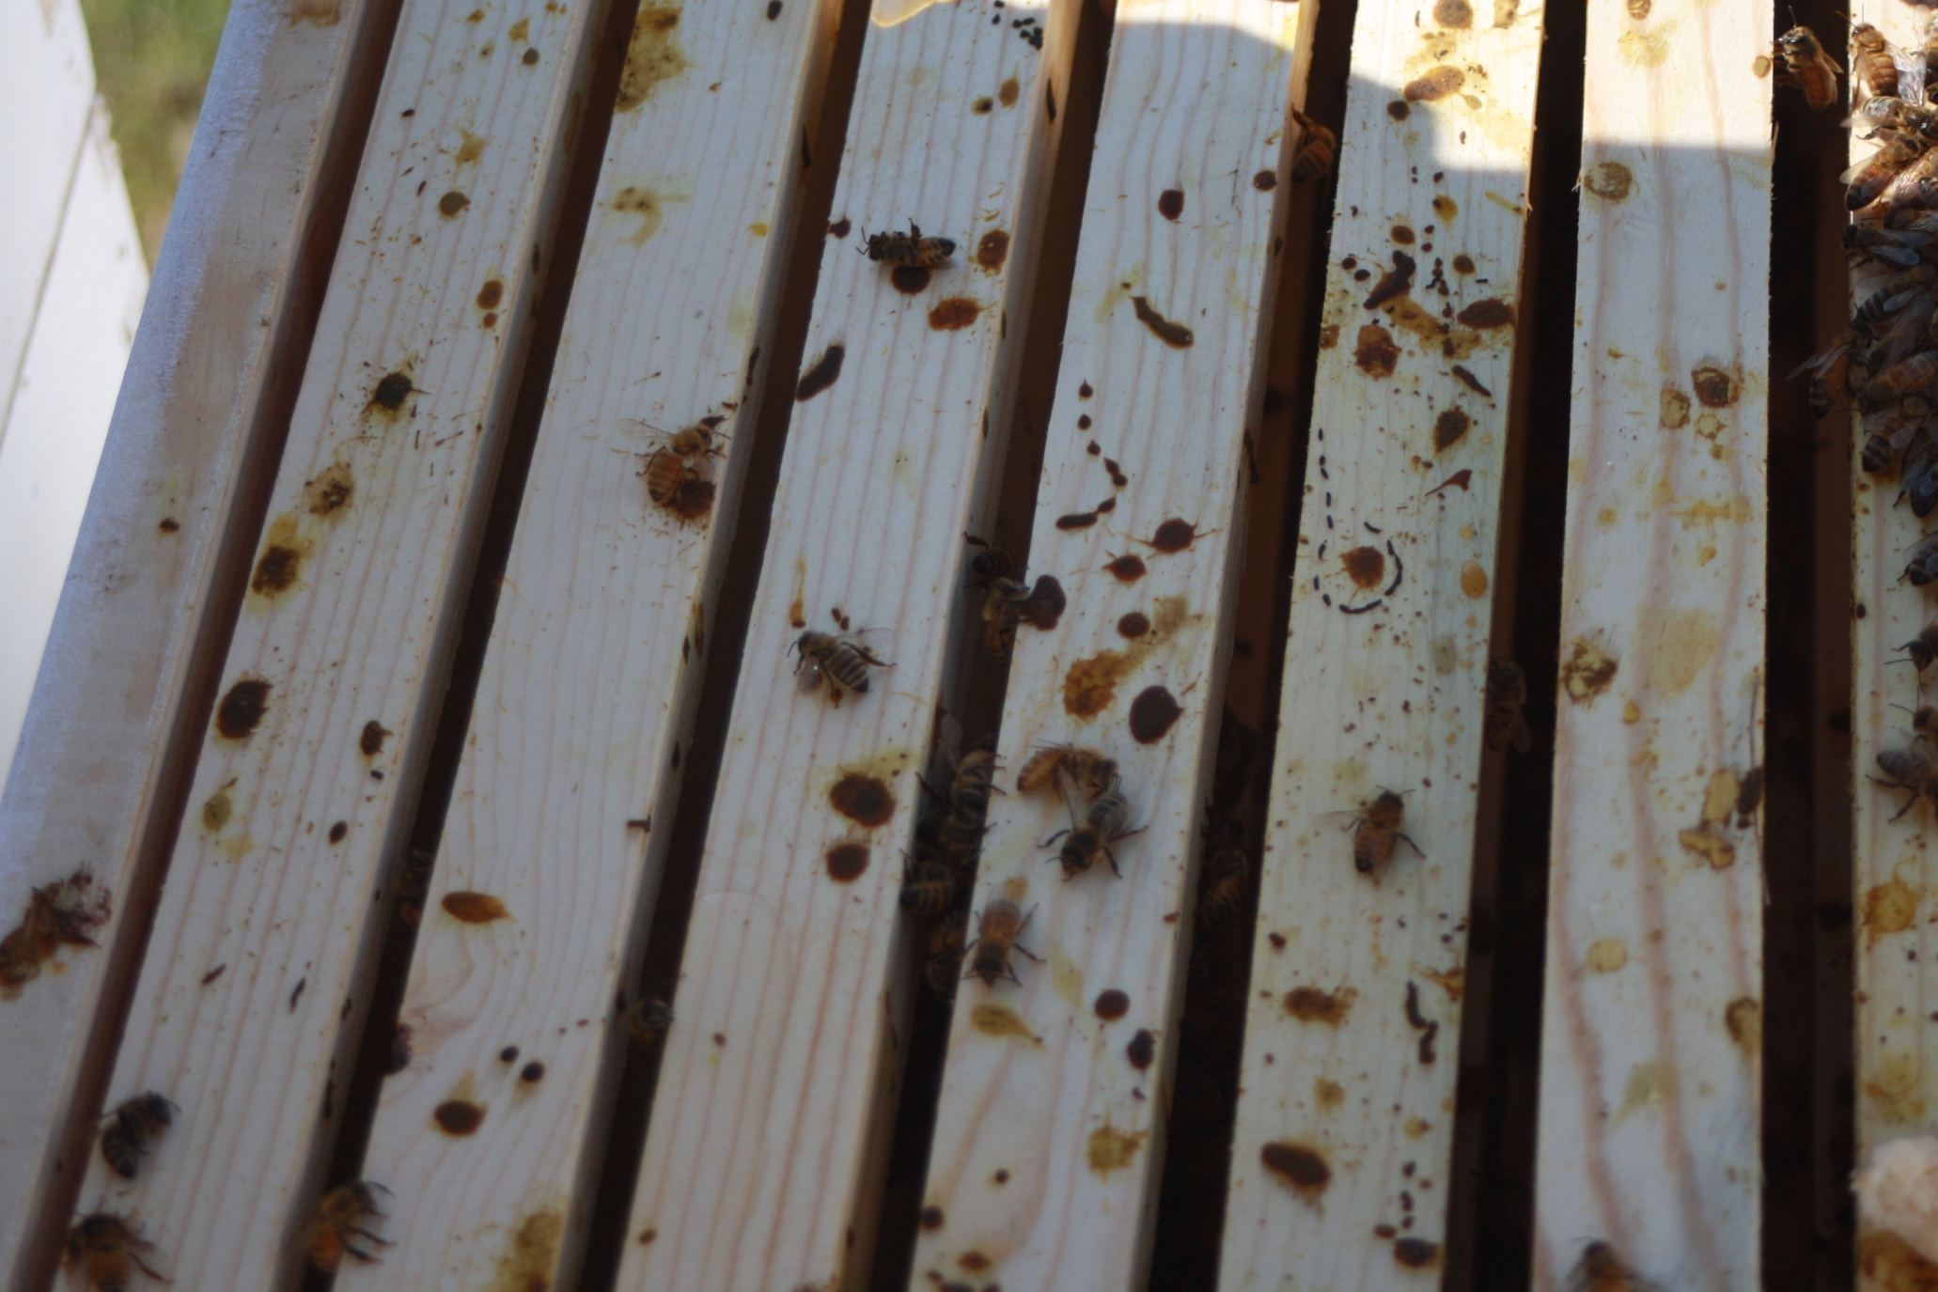
Evidence of Nosema on top boards. Very bad case of Diarrhea.

Slide 17
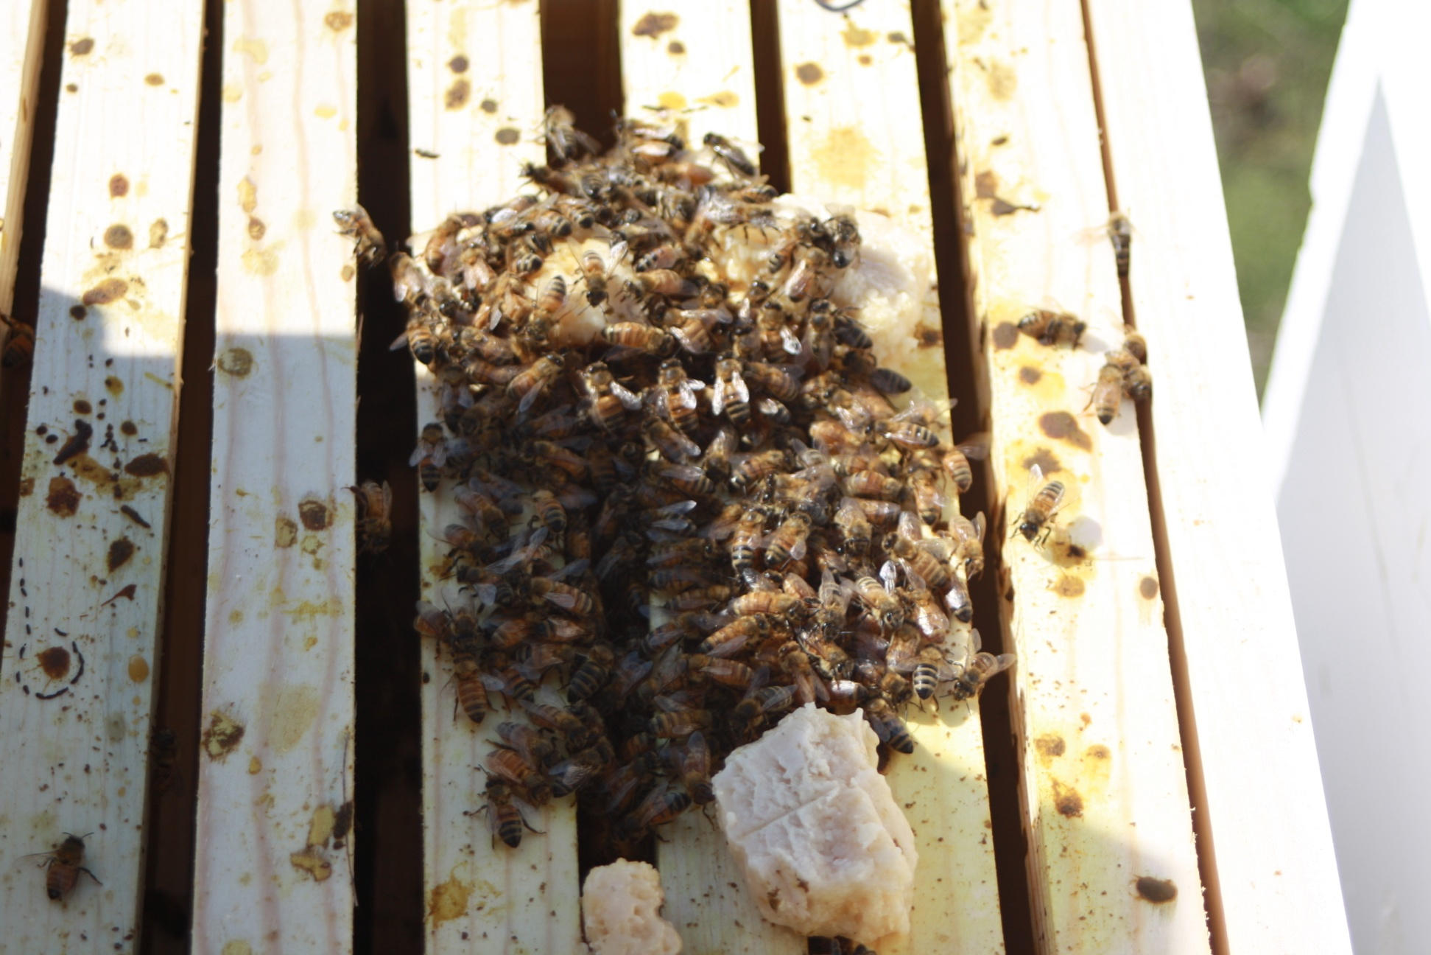
The remains of three pounds of bees after three days.

Slide 18
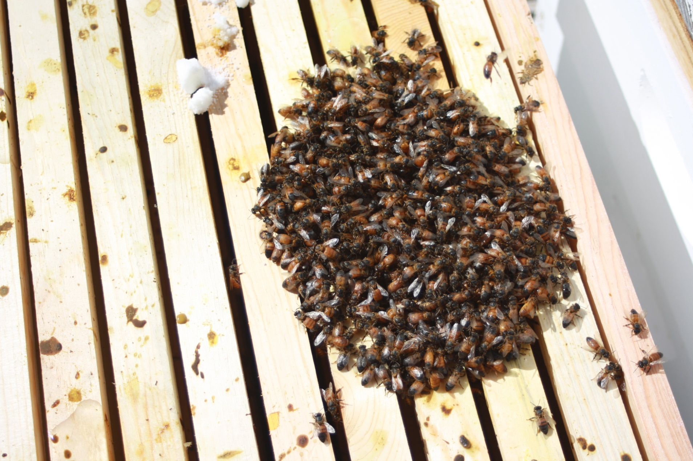
Day Five after installation. Very tight cluster. Wet looking. Bloated abdomens.
Remains of vitamin pill upper center white ball.

Slide 19
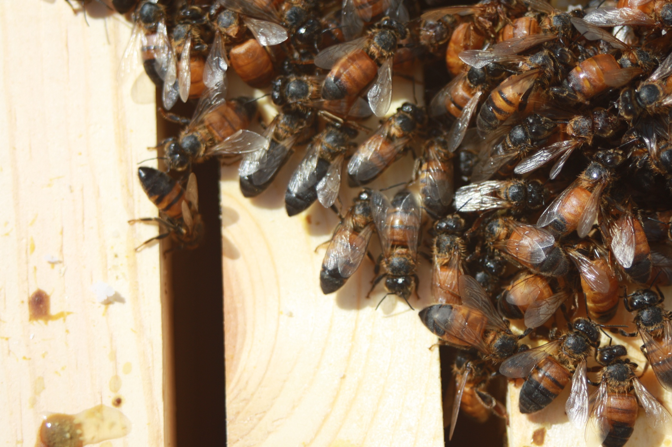
Bloated abdomens, wet greasy look, not active.

Slide 20
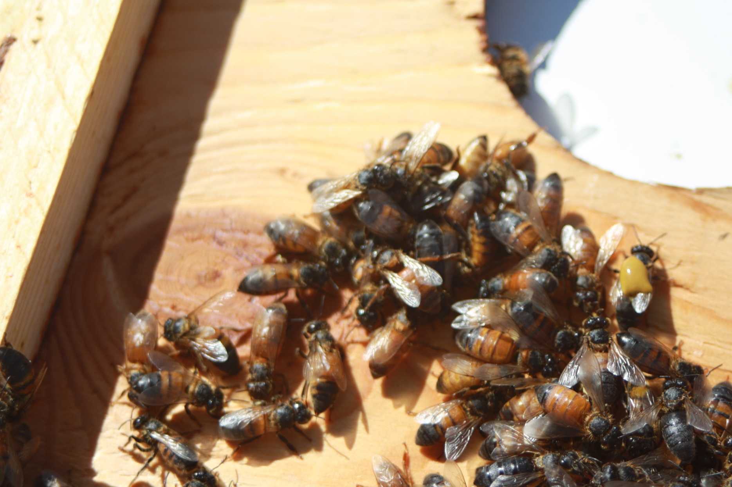
One bee relieved itself onto another bee

Slide 21
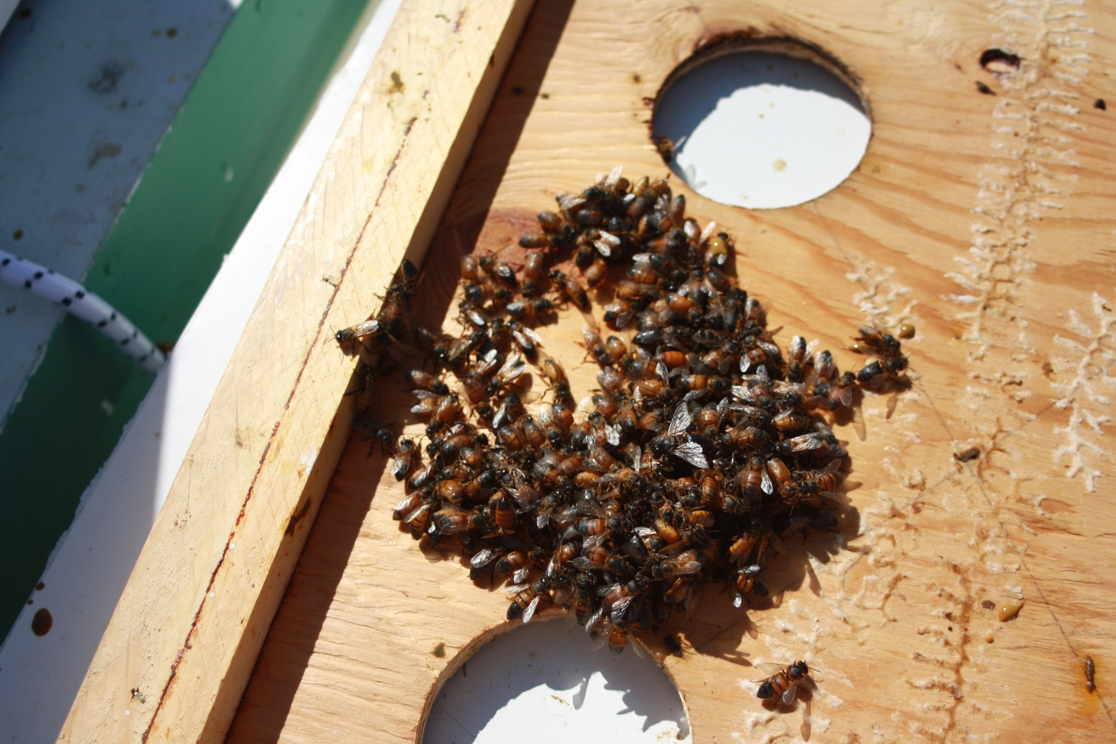
Just half of the cluster of honey bees with Nosema

Slide 22
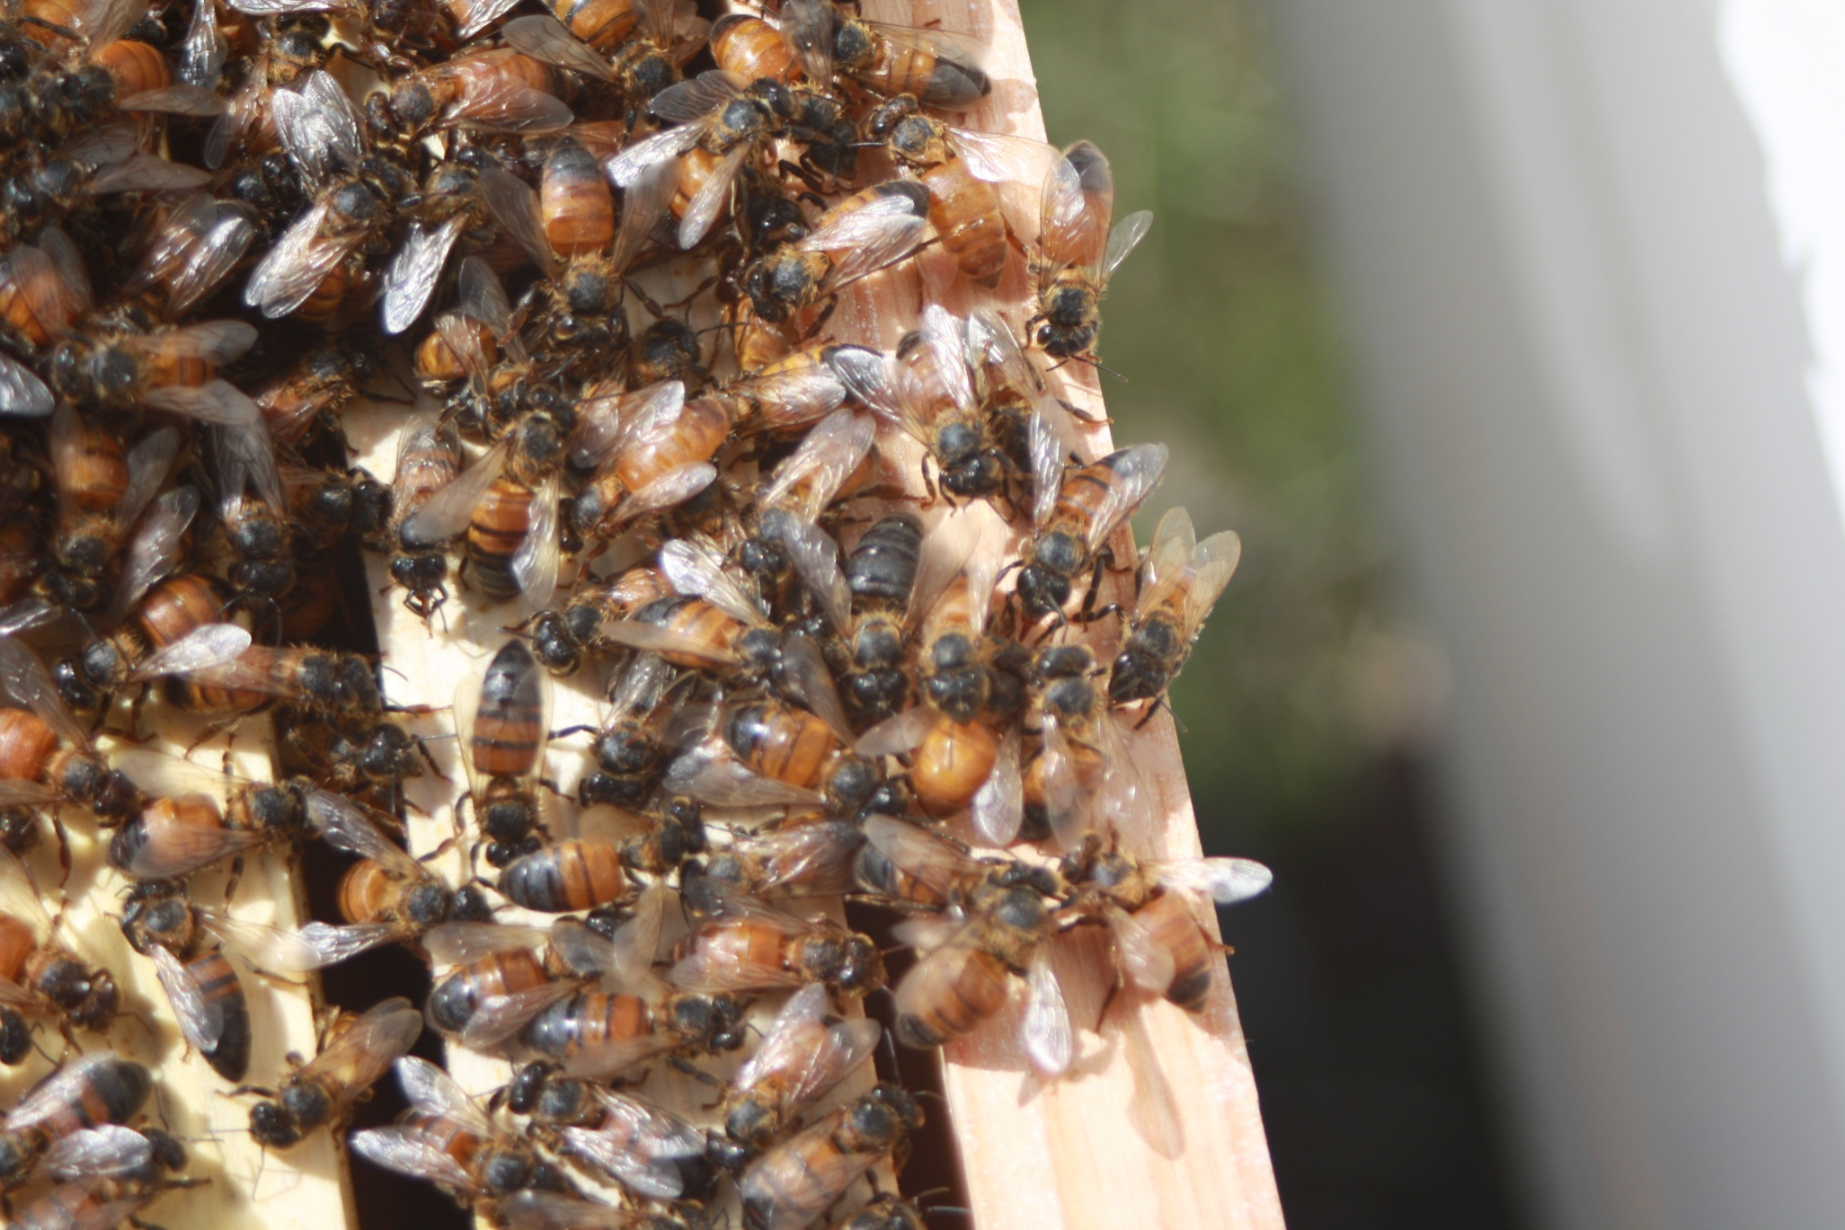
The other half of the sick cluster

Slide 23
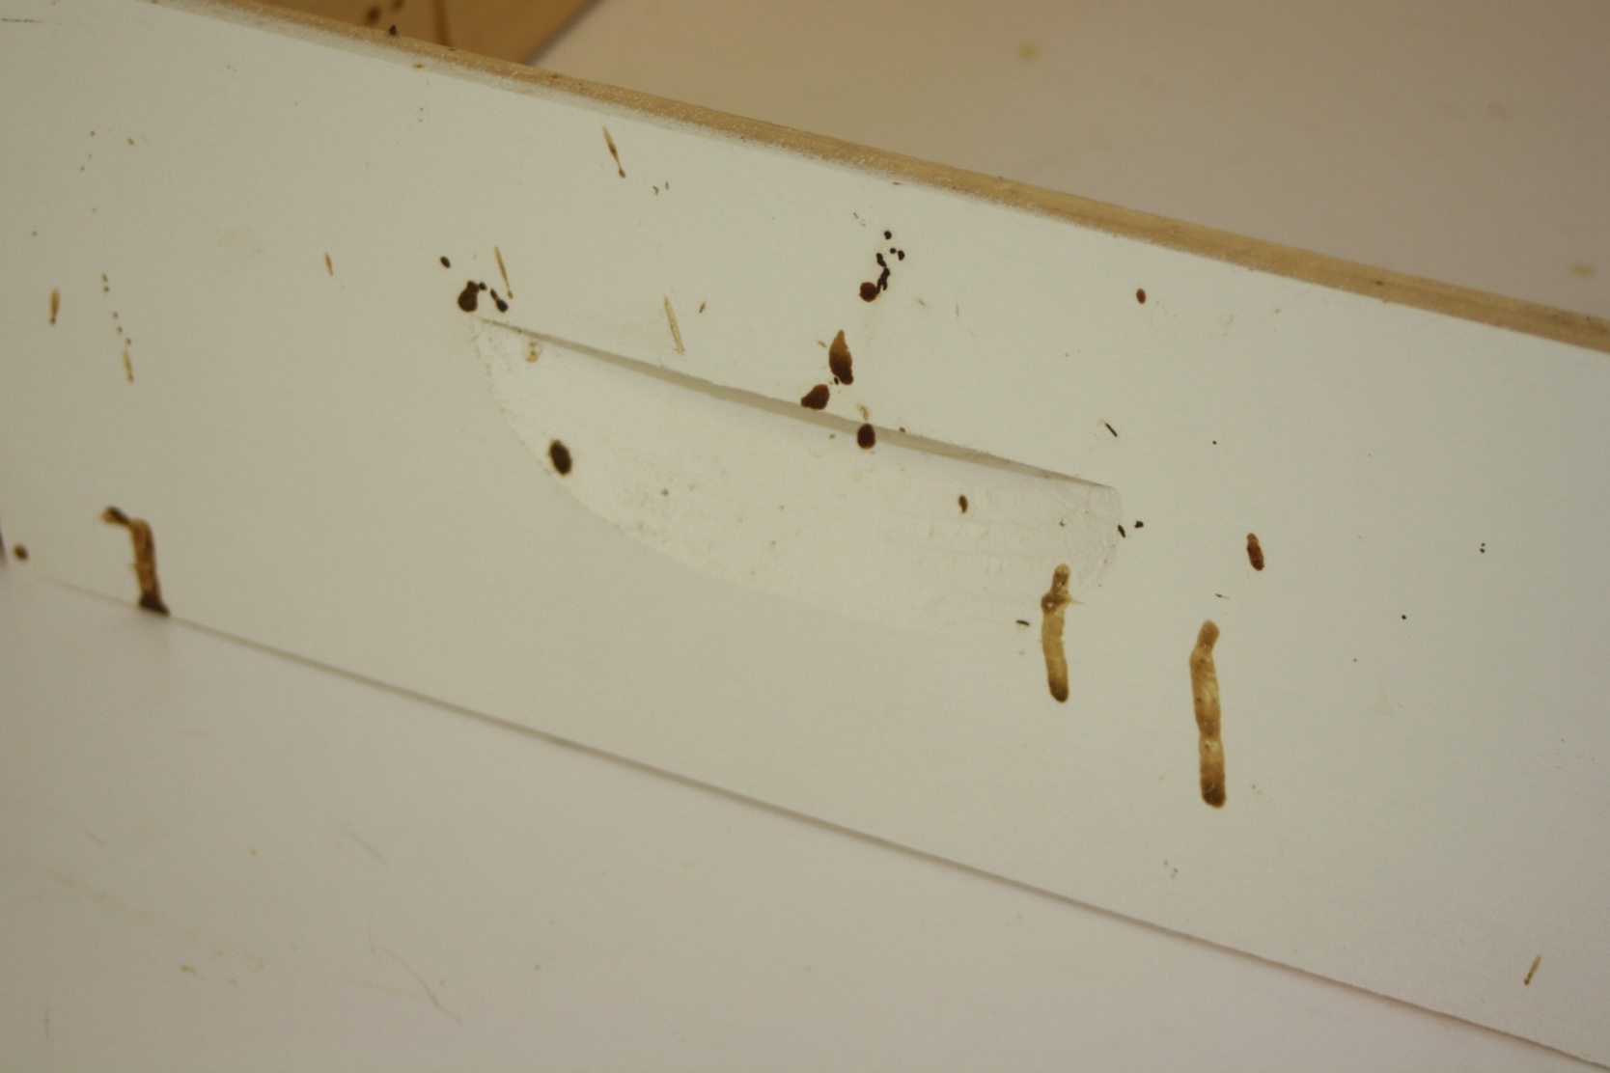
Honey bees too weak to fly relieving themselves on the outside of the hive.

Slide 24
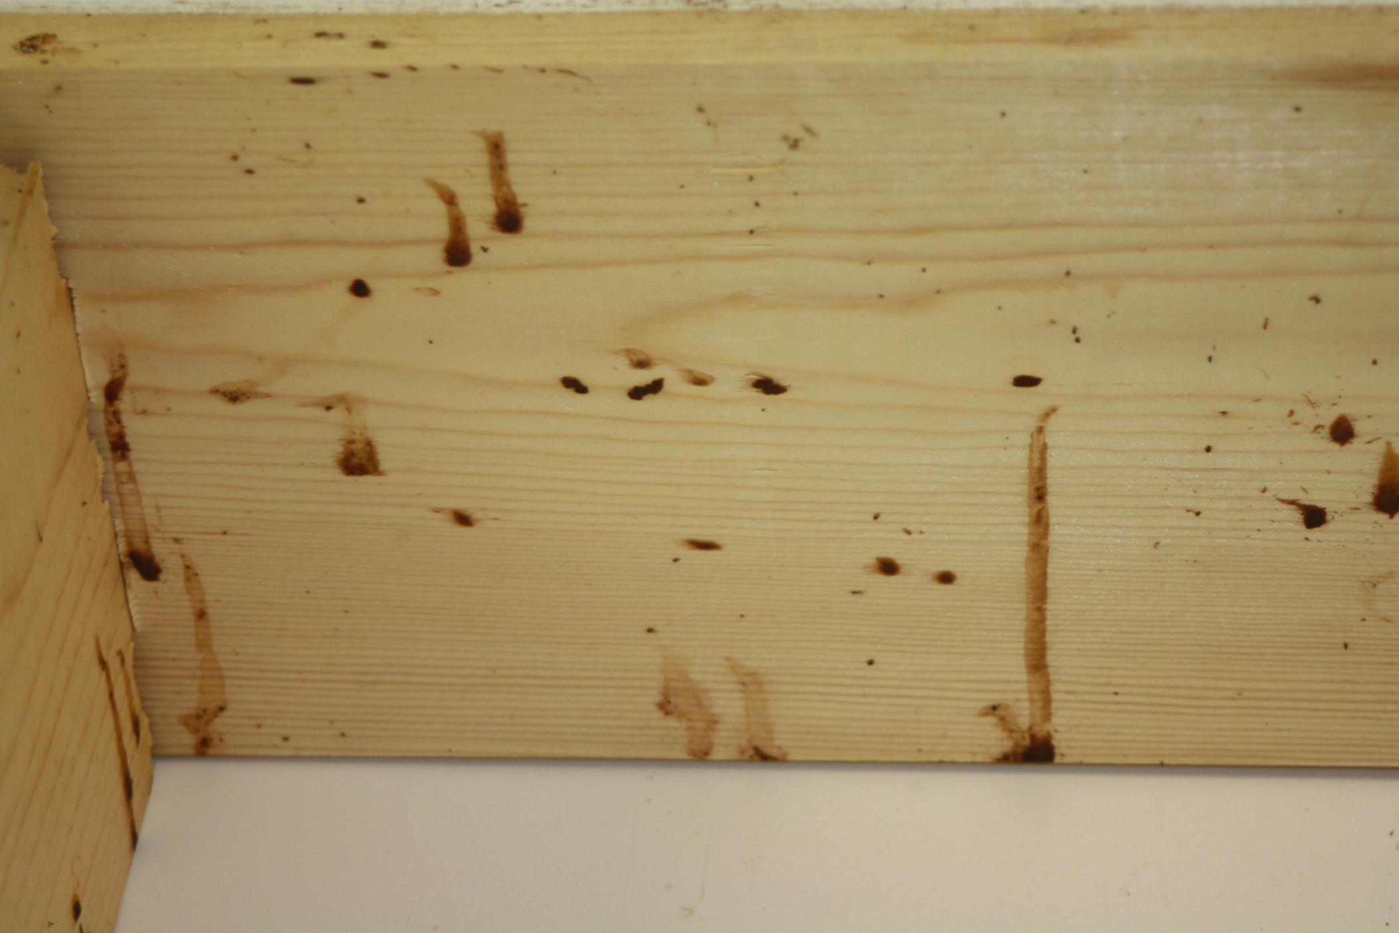
Sick bees relieving themselves inside the hive.

Slide 25
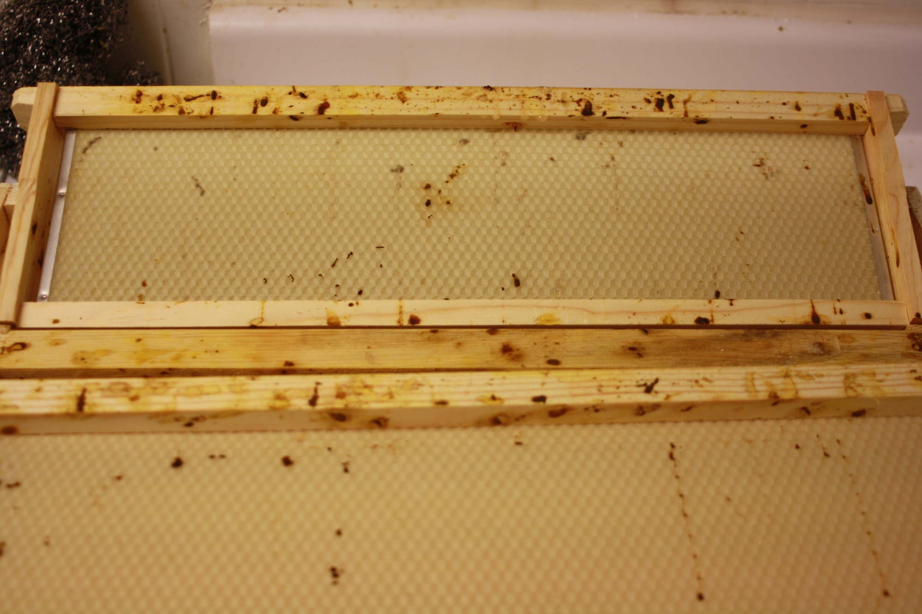
Indication that the hive is sick from Nosema

Slide 26
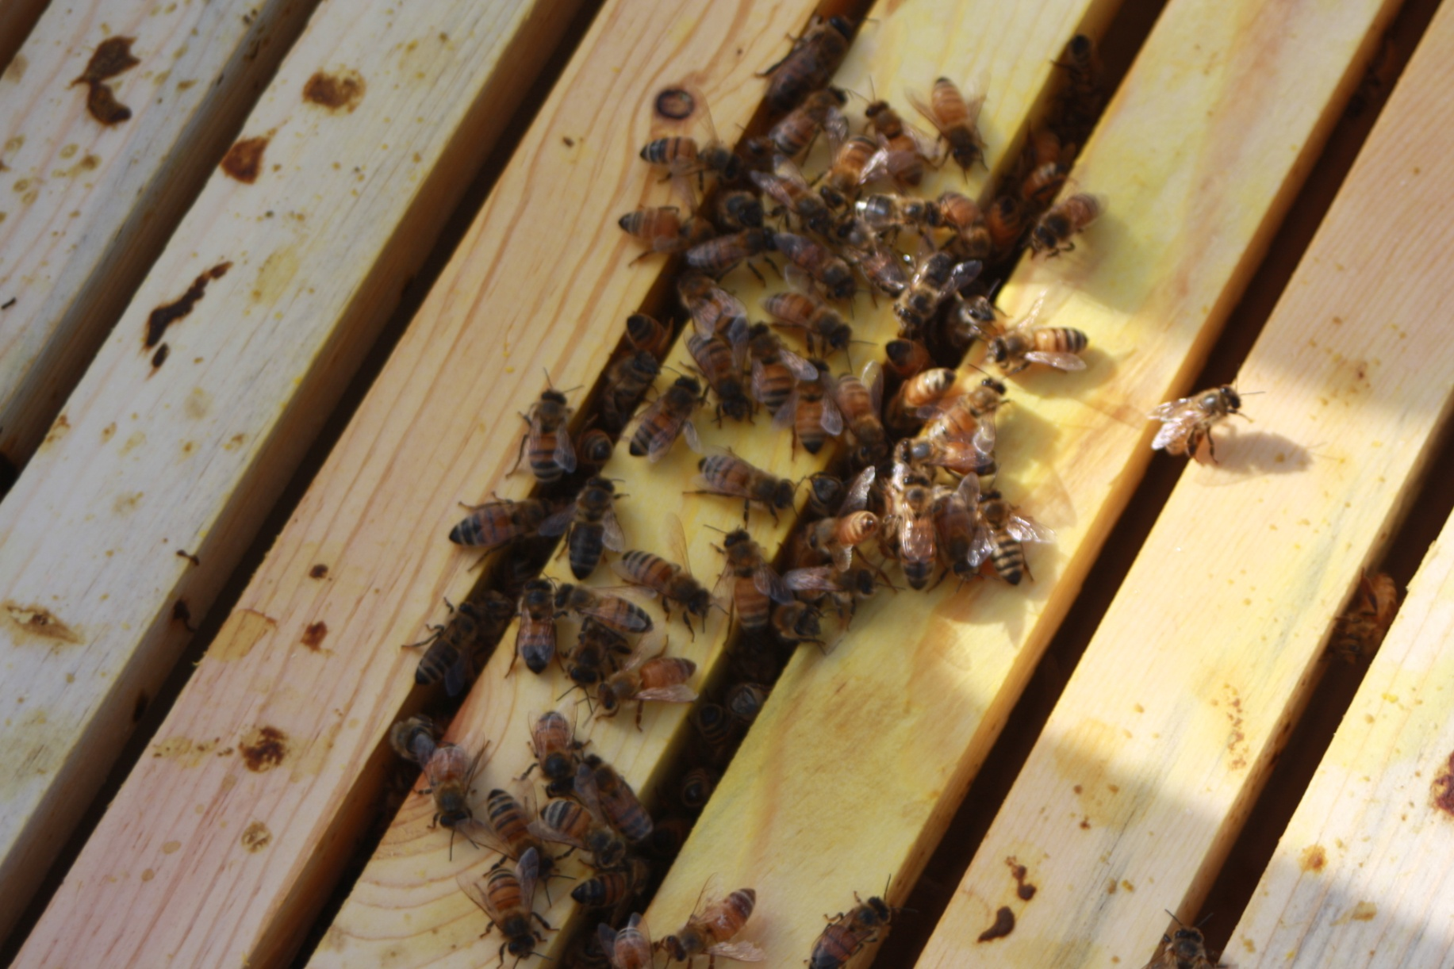
Same hive on the 14th of May, 27 days after installation.

Slide 27
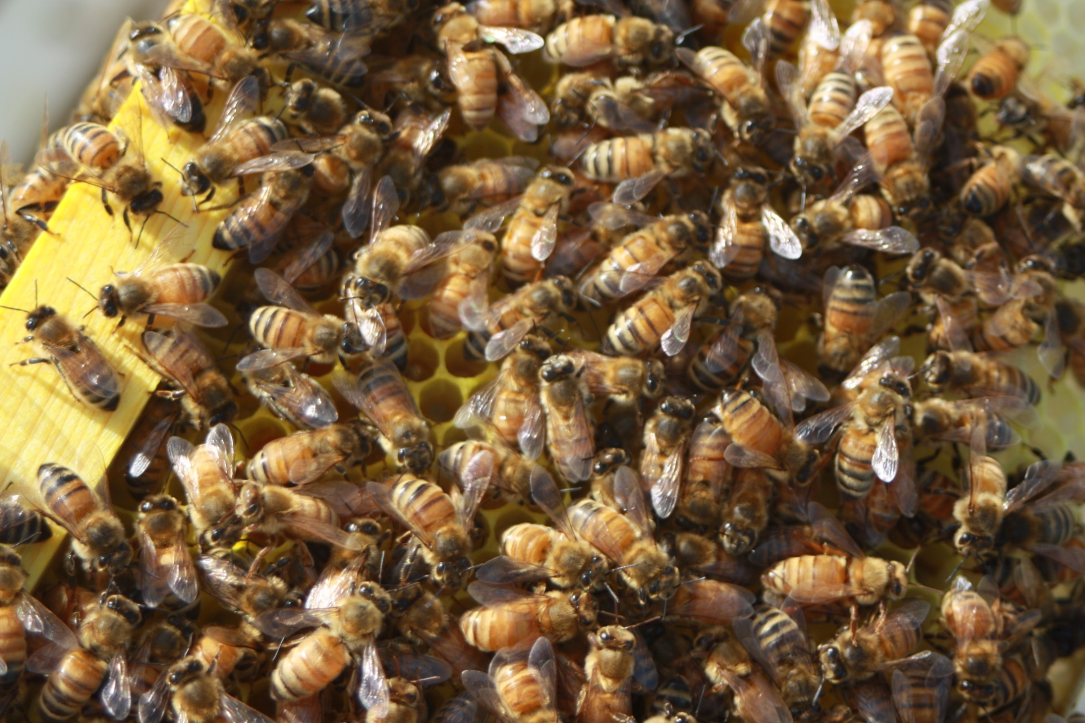
Sick hive that has recovered from Nosema, now building comb, the abdomen do not look bloated.

Slide 28
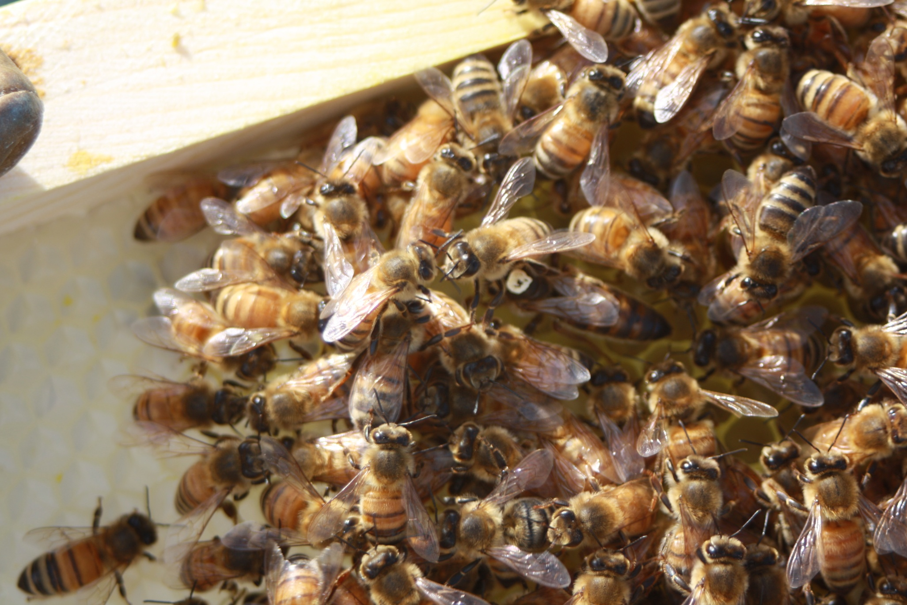
Sick not healthy hive. Same queen and the cluster is making comb and taking care of brood.

Slide 29
Recovered Hive
Sick Hive

Slide 30
Testing of Samples
FIRST TEST ON MAY 3RD
WEIGHT 0.10 GRAMS PER BEE
PH WAS 6.60
NOSEMA SPORES WERE 8,400,000
SECOND TEST ON MAY 18TH
WEIGHT 0.12 GRAMS PER BEE
PH WAS 5.45
NOSEMA SPORES WERE 5,850,00

Slide 31
What helped with the survival of the colony?
The sun
Fresh warm air
Essential oils
  Thymol
  Tea Tree
  Lemon Grass
  Eucalyptus

Slide 32
Varroa mites and essential oils
For the past five years I have tested my hives for mites using the INTEGRATED PEST MANAGEMENT (ipm) method.
  The results have been averaging about one to two mites per hive.
  This past summer I had two hives that averaged about 30 mites per hive.
  I placed a vitamin pill (Jim's mixture of essential oils) in the hives.
    After ten days a second test was conducted.
      one of the hives dropped to about 7 mites.
      The second hive dropped to about 20 mites.

