Slide 1
Bee Diseases
We want healthy bees

Slide 2
Healthy Bees – How do we tell?
Observations
  Look at landing board – do bees look normal?
    In & out activity
    Dead bees on landing board/in front of hive
  Sound
  After lifting inner cover
  Poop on hive? (lots? yellow or brown?)
  Mites?
  Wings?
  How does the brood look?
Bee Temperament

Slide 3
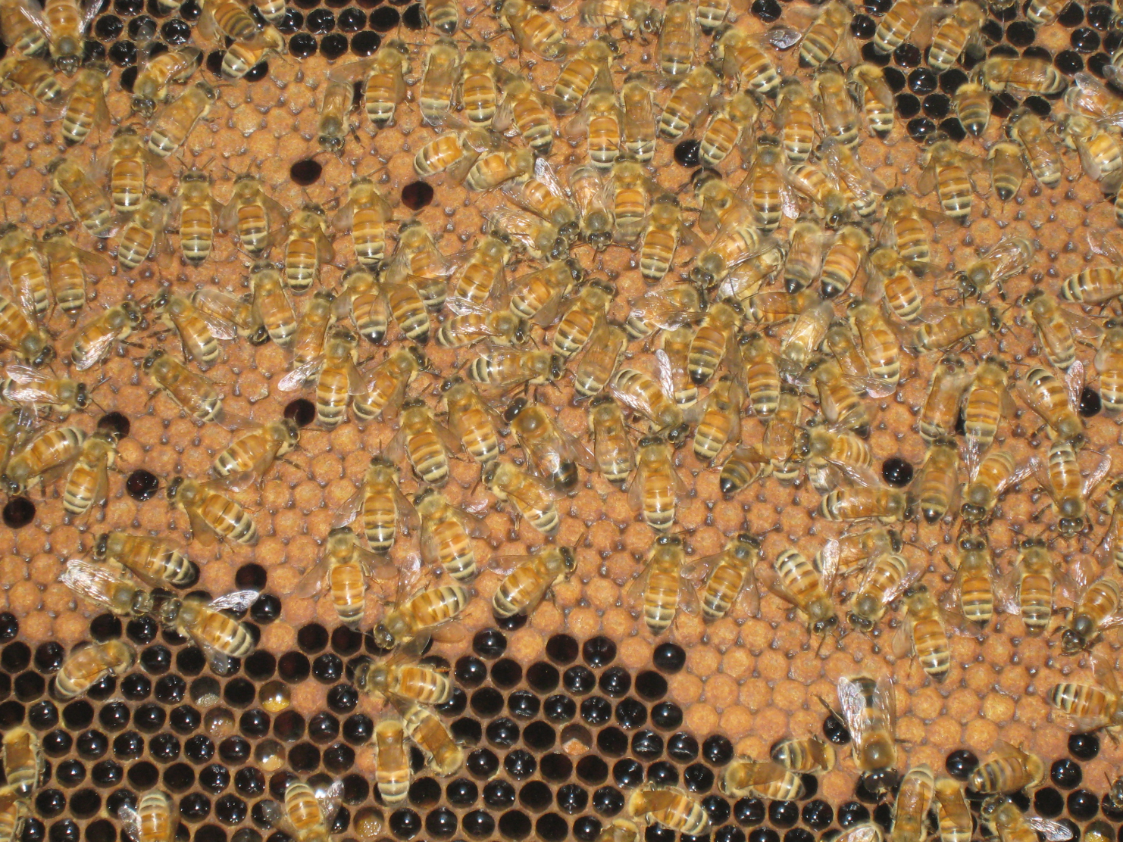
Diseases affecting Brood

Slide 4
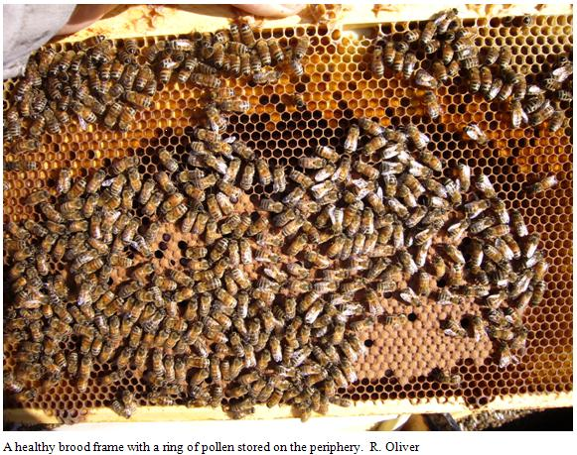
Healthy Bees & Brood

Slide 5
Healthy Brood
Brood grouped together
Uniform color (orangish)
Capped brood is concave (center higher than edges)
Holes – generally centered with smooth edges

Slide 6
American Foulbrood
Cause: Paenibacillus (=Bacillus) larvae, a spore-forming bacterium
Only affects larva, not adult bees
Symptoms: Larva dies & darkens, brood cell cap shrinks into comb, foul smell, dead larva pulls out as dark, thready material

Slide 7
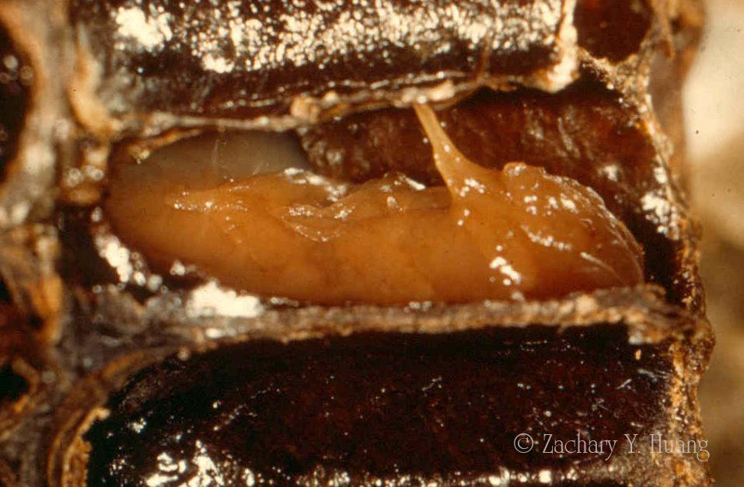
American Foulbrood
Dead larva develops a “false” tongue that points upward.

Slide 8
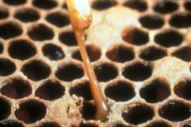
American Foulbrood

Slide 9
American Foulbrood
Transmission:
  Foulbrood goo dries and forms spores
  Spores lodged in honey, dead larvae
  Nurse bees accidentally feed spores to the larvae
  Dried spores can last for 70+ years and are impervious to everything but high heat

Slide 10
American Foulbrood
No Treatment, Only Prevention
If you find it, get rid of diseased combs – burn or put in plastic bags and take to landfill
Do not combine combs from diseased hive with healthy hive
If found, contact state agency that oversees beekeepers
Discard brood comb frames regularly (every 3 years)

Slide 11
American Foulbrood
Prophylactic Issues
WASBA: Treat hives in infected area with Terramycin (antibiotic) in sugar syrup, powdered sugar dust or shortening patty – stop treatment 2 weeks before nectar flow.
Problem: Over 25% of AFB is Terramycin resistant

Slide 12
European Foulbrood
Cause: Melissococcus plutonius, a bacterium
Symptoms: Brown larva (dead) in uncapped cells; sour smell; larva twisted in bottom of cell
Generally, no ropy goo (although atypical EFB has short ropy thread)

Slide 13
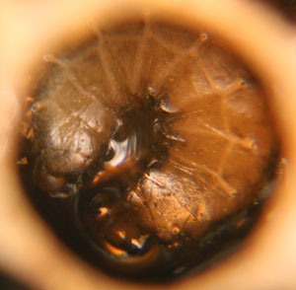
European Foulbrood
Transmission: House bees cleaning out dead larva spread the disease

Slide 14
European Foulbrood
Prevention
  Get Italian bees ☺ (cleanliness)
  Healthy, well fed hives
  Dry, well ventilated hives in sunny site
  Requeen
  Treat hives with Terramycin (like American Foulbrood) in the spring – same issues re: antibiotic overtreatment

Slide 15
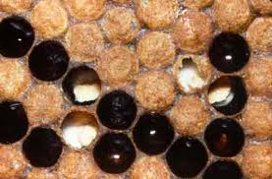
Chalkbrood
Cause: Ascosphaera apis, a fungus
Symptoms: Usually affects brood on edges of comb; larva turns white, then black

Slide 16
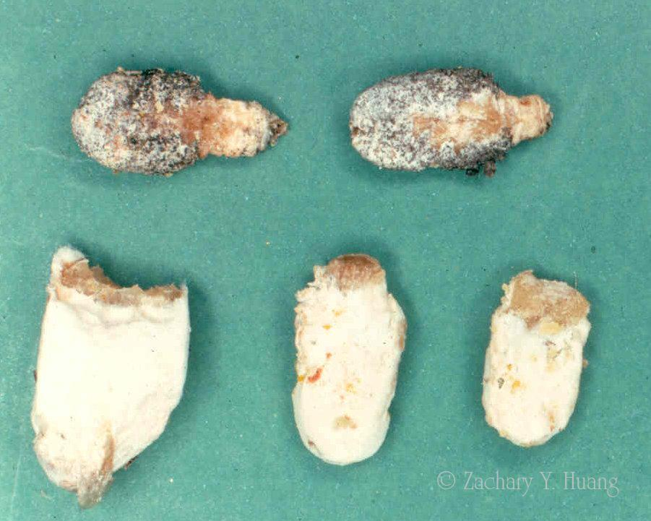
Chalkbrood

Slide 17
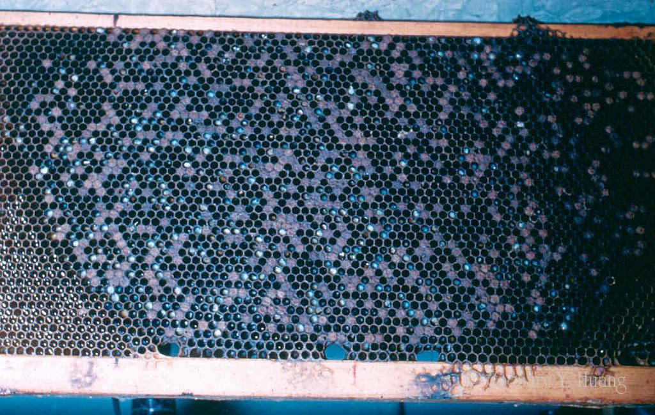
Chalkbrood

Slide 18
Chalkbrood
Prevention – hive cleanliness
  Usual disappears on its own – during summer heat
  Requeen (breeding for cleanliness)
  Replace heavily infected combs
  Clear hive entrance of larval mummies
  Replace brood frames every 3 years

Slide 19
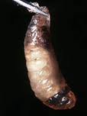
Sacbrood
Cause: Virus morator aetatulas (microscopic)
Symptoms: larva die in the brood cell, often upright, head black, when removed, look like they are in a sack

Slide 20
Sacbrood
Treatment
  Often retreats on its own, no treatment necessary
  Requeen if disease persists
  Bees normally clean diseased area

Slide 21
Chilled brood
Cause: Brood on outside of hive dies due to neglect (comb too cold)
Don’t open the hive when temperature is below 50°F
Treatment: Leave brood in same position in hive, do not move to outside

Slide 22
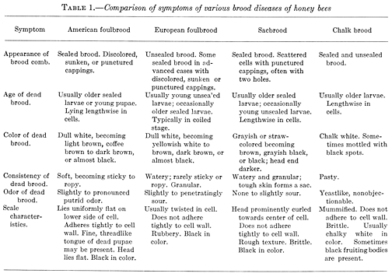
Disease comparison

Slide 23
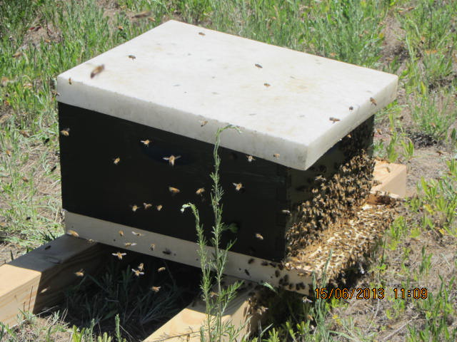
Diseases affecting Adult Bees

Slide 24
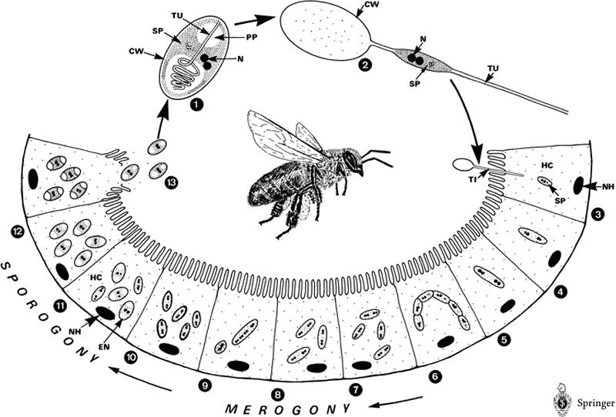
Nosema
2 types - Cause: Fungus– Nosema apis & Nosema ceranae. Attacks the mid-gut area & causing the bees to get sick. Weakens them, weakens the hive.

Slide 25
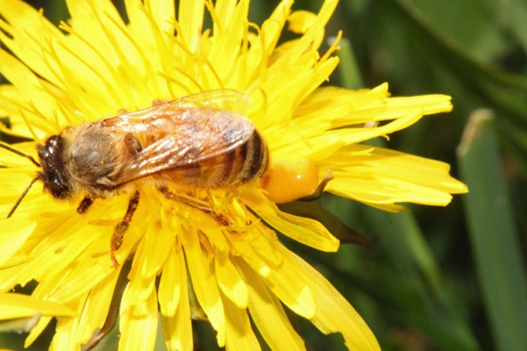
Nosema

Slide 26
Nosema

Slide 27
Nosema
Symptoms: Usually occurs in early spring. Will see lots of fecal material around hive
Can only tell its nosema w/dead bee & microscope – visible spores. See www.scientificbeekeeping.com for method
Bee guts look different – nosema gut swollen & white; healthy gut amber colored

Slide 28
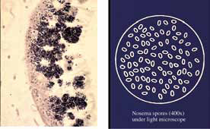
Nosema
(spores under microscope)

Slide 29
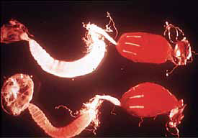
Nosema

Slide 30
Nosema
Treatment:
Non-traditional
Essential oils added to sugar syrup: Feed 1 gallon sugar syrup with the following quantities of essential oils: 1/2 teaspoon of thyme, 1 teaspoon of Lemongrass, 1 teaspoon of Peppermint and 1 teaspoon of Sweet Orange.

Slide 31
Nosema
Treatment:
Traditional
  Feed the infected colonies ~1 gallon sugar syrup containing Fumigil-B in March/April (before nectar flow)
  Fall feeding may reduce Nosema in wintering bees
  Some beekeepers do preventative treatments w/Fumigillan in fall & spring

Slide 32
Paralysis
Cause: Viral – 2 types (Chronic/Acute)
Symptoms: bees tremble & appear to be paralyzed. If picked up by wings & dropped, fall to ground. Bees look old, shiny & greasy
Treatment: Requeen to breed in resistance

Slide 33
Dysentery
Condition/symptom, not a disease – essentially bee diarrhea
Cause – winter food high in solids, causing water in the gut. Bees have to defecate in the hive (which they don’t normally do)
Fecal matter inside the bee > 30-40% of body weight. Bees just can’t hold it.

Slide 34
Poisoning
Bees killed by insecticide sprayed on trees & plants
Can be carried back to the hive and affect other bees & brood
Adults may have enlarged abdomens & show signs of paralysis
Brood may die, remain white but flatten, or become yellowish grey or brown

Slide 35
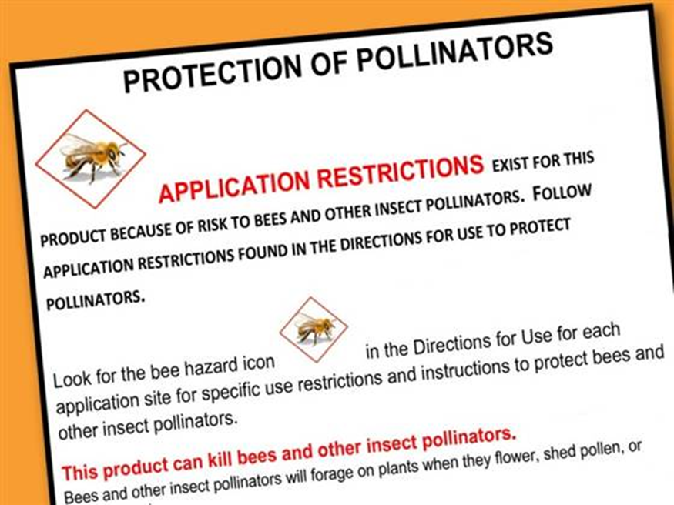
Poisoning
Illegal to use pesticides in a way not prescribed in directions – i.e., when fruit trees in bloom
Ask neighbors not to spray for insects while fruit trees are in bloom
New EPA labeling for neonicotinoids (voluntary)

Slide 36
Colony Collapse Disorder
Bees simply disappear from hive, leaving queen, brood and very few bees
Historically, bee disappearances in 1880s, 1920s, and 1960s
5 million colonies in 1940s to 2.5 million today
Between 2006-2011, CCD caused losses of ~11% of all hive losses

Slide 37
Colony Collapse Disorder
What causes CCD? No one really knows. It could be –
  Cyclical bee die offs
  Pests? Varroa mite contributes? (High levels of varroa mites found in collapsed hives)
  Management issues? Too many bees, too close together? (commercial beekeepers)
  Environmental stressors? Pesticides – Neonicotinoids? Correlation, not causation
  The perfect storm?

Slide 38
Sources
USDA Ag Research Service – www.ars.usda.gov
www.beesource.com
http://wasba.org/
www.cyberbee.net (photos)

Slide 39
Sources
Vivian, John, Keeping Bees
www.scientificbeekeeping.com
Penn state: A field guide to Honey bees and their maladies, http://pubs.cas.psu.edu/FreePubs/PDFs/AGRS116.pdf

Slide 40
http://pubs.cas.psu.edu/FreePubs/PDFs/AGRS116.pdf

